Slide 1
It Makes Sense: Using a Multi-Sensory Approach to Teaching Students with Autism to Love Reading
West Virginia Department of Education Virtual Conference

Slide 2
Objectives
Define Autism Spectrum Disorder (ASD)
Become familiar with current statistics about ASD
Recognize environmental stimuli and sensory processing as it relates to students with autism and mathematics
Learn research based instructional strategies that will offer students with autism better access to the mathematics curriculum
Notes:
jason

Slide 3
What is Autism Spectrum Disorder?
What is your preconceived notion when you hear or see the term autism?
Preconceived feelings?
Notes:
Rainman?, a child rocking in the corner?, based on your previous education and own experience with people

Slide 4
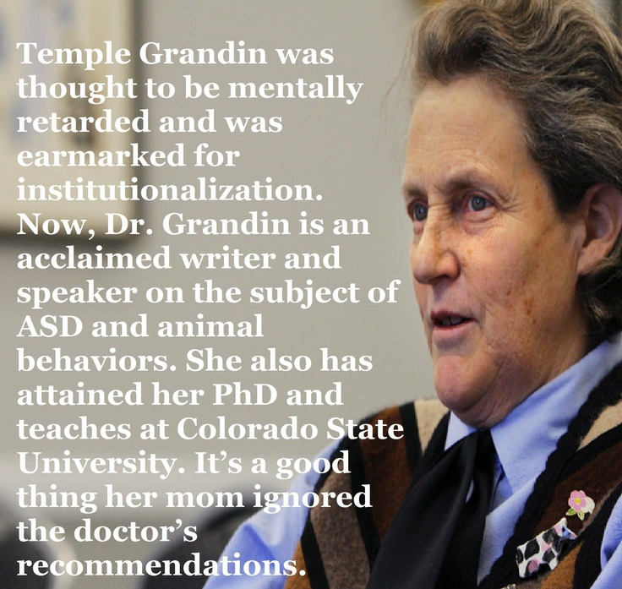
Teach children they can!
Notes:
Dr. Grandin did not talk until she was three and a half years old. She was fortunate to get early speech therapy. Her teachers also taught her how to wait and take turns when playing board games. She was mainstreamed into a normal kindergarten at age five. When she was young, she was considered weird and teased and bullied in high school. The only place she had friends was activities where there was a shared interest such as horses, electronics, or model rockets. Mr. Carlock, her science teacher, was an important mentor who encouraged her interest in science. When she had a new goal of becoming a scientist, she had a reason for studying. Today half the cattle in the United States are handled in facilities she has designed.

Slide 5
Understanding Autism Improves:
Instruction
Management of behavior leading to fewer incidents and behavior referrals
Student achievement
LRE and placement decisions
Performance on standardized tests
Fewer students taking alternate assessments
Graduation rates
Teacher retention

Slide 6
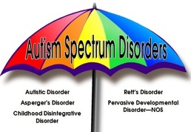
What is Autism Spectrum Disorder?
Autism Spectrum Disorder is a neurodevelopmental disorder characterized by communication challenges, social interaction deficits, and a tendency to engage in repetitive behaviors.
These core areas vary in severity among individuals with autism spectrum disorder.
If you know one person with ASD, you know one person with ASD.
Don’t judge one person with autism by your past experience with another person with autism.

Slide 7
What is the prevalence rate of autism?
Notes:
(book to the closest guess)

Slide 8
Statistics
Estimated prevalence rate of autism is 1 in 54 births in the US (CDC, 2020)
Boys are 4 times as likely to be identified (CDC, 2018)
Treatable, not curable
No known single cause
Early intervention is critical to development
More than 3.5 million Americans live with an autism spectrum disorder. (Buescher et al., 2014)
Prevalence has increased by nearly 10 percent since 2016.

Slide 9
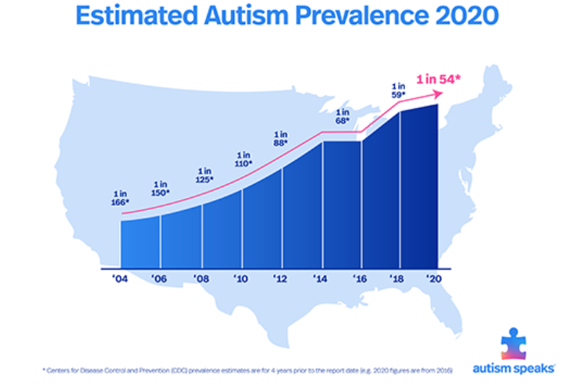
Autism is the fastest-growing developmental disability.
Prevalence of autism in U.S. children increased by 175 percent from 2005 (1 in 166) to 2020 (1 in 54).
Figure 1 Source: Autism Speaks, 2020
Notes:
According to the Centers for Disease Control and Prevention, the most recent data reveals about 1 in 54 children has been identified with autism spectrum disorder (ASD) compared to data just two years ago reporting 1 in 59 children (Figure 1). This recent research supporting a 10% jump in just two years reported that these findings are a conservative estimate even though many states were found to have higher prevalence rates when researchers had full access to the student files containing eligibility records. Although this data was recently released in 2020, the actual collection of data on 8-year olds occurred in 2016.
(CDC, 2014)
These images could go with the above slide

Slide 10
West Virginia Statistics on Autism
There are currently 2,857 students in West Virginia who are being provided services under the eligibility category of autism.
Since 2015 there has been a 54.6% increase of students who are receiving special education service for autism.
There is a great chance that every school will have at least one student with autism in their building either identified or not identified.
Notes:
Have these animate in

Slide 11
WVEIS December 1 Child Count (2019) (federal reporting of youth eligible for IDEA-funded services ages 3-21):

Slide 12
Understanding Autism Improves:
Instruction
Management of behavior leading to fewer incidents and behavior referrals
Student achievement
LRE and placement decisions
Performance on standardized tests
Fewer students taking alternate assessments
Graduation rates
Teacher retention

Slide 13
Be Aware of Environmental and Sensory Stimuli
Hypersensitive
(over-responsive)
Hyposensitive
(under-responsive)
Remove excessive visual stimuli
Be aware of and eliminate small noises
Reduce brightness by using a lamp instead of overhead light
Provide noise-canceling headphones
Avoid using cologne, air fresheners, and scented candles
May prefer not to be touched
Be aware of textures due to tactile defensiveness
May require repeated verbal or partial physical prompting
Schedule and provide sensory input throughout day (deep pressure activities, water play, vibrating pillows, squishy toys, fish aquarium, beanbag breaks, sweet/sour/salty foods, sensory bin)
Provide hands-on learning
Select a window seat on the bus
Notes:
Hyposensitive; lacks appropriate response to stimuli: does not have the typical response to sensory stimuli in the environment; may run into something and get her but not respond appropriately to it. Watch for injuries in these children as they may not let you know they have been hurt. Often, they will seek out strong sensory input such as deep pressure, textures, surfaces which may manifest in biting, hitting, self-injurious behaviors, or mouthing objects or people. Students with autism and sensory issues may be hypersensitive one day and hyposensitive another day.

Slide 14
Sensory Processing for Students with ASD
Common terms associated with ASD: sensory integration, sensory processing, and sensory processing disorder.
The STAR institute estimates that 75% of children with autism have “significant symptoms of sensory processing disorder.”

Slide 15
Sensory Systems
Did you know that there are actually 8 sensory systems in your body, not just 5?
Auditory - sound/hearing
Visual - sight
Olfactory - smell
Gustatory - taste
Tactile - touch
Vestibular - movement
Proprioception - input from muscles and joints
Interoception - internal sensors indicating physiological conditions

Slide 16
Sensory
For people with autism, the sensory processing dysfunction can manifest in many different ways, such as:
language delays or deficits
fine and gross motor delays
strong sensory interests
sensory aversions
an inability to interact with people and objects
an inability to stay within an interaction
repetitive sensory stereotypies (stimming)
and much more

Slide 17
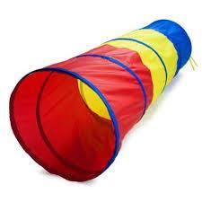
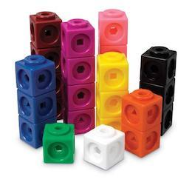
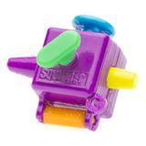
Supporting Students with ASD Sensory Issues and Needs
Some things that you can do to support our student’s sensory needs are:
Designing a “Sensory Diet” that works for you and your child
Assembling a “Sensory Tool Box” of activities and equipment that can be used at
home and on-the-go
Some of the top Sensory Toys, Stim-Toys, and Fidgets to improve self-regulation
Sensory Integration Therapy
Sleep Issues, Autism, and how to support sleep with sensory input like weighted blankets

Slide 18
https://www.youtube.com/watch?v=bB0nB0CyBe4&feature=emb_err_woyt

Slide 19
General Research-Based Strategies
Capitalize on the student’s strengths and specific interests.
Explicitly teach and model social expectations for the student.
Provide a predictable environment and daily schedule for the student.
Design the classroom space in an organized manner so that clutter is kept to a minimum.

Slide 20
Decoding of text
Comprehension of language
Reading to gain meaning
Notes:
A simple formula. When you are presented with a passage of text, how do you get meaning from it? You need to do two things” convert written words into speech, and understand that speech.
Ss with autism may be able to decode text, and will likely continue to read even when the words they are reading make no sense to them.

Slide 21
Text Complexity
Quantitative Measure (Lexile)
Qualitative Features
Qualitative
Features
Reader and Task Considerations
Notes:
Quick refresher of the full complexity of texts and that our students need access to texts that are rich in vocabulary and syntax (high Lexile) as well as texts that are rich in figurative language, nuances of structure, and layers of meaning. We also have to be mindful of student interest and motivation when we select texts and mindful of what we’re going to ask them to do with the text (standards).

Slide 22
Lexile Measure for Texts =
Sentence Length
Word Length
Unknown Words
Notes:
To define the quantitative measure of a text, the number of words in each sentence, the number of syllables in each word, and the number of unknown words in the text are analyzed. Texts with longer sentences, multi-syllabic words, or specialized vocabulary have a higher Lexile measure than texts with simpler sentences, shorter words, or more commonly known words.

Slide 23
Lexile measure of a text does not account for…
Quantitative Measure (Lexile)
Layers of Meaning
Figurative Language
Author’s Purpose
Craft and Structure
Language Conventions
Knowledge Demands
Qualitative Features
Qualitative
Features
Reader and Task Considerations
Notes:
Remember that the Lexile Framework for Reading defines the Quantitative measure of a text. This is only 1/3rd of text complexity. When teachers select texts for instruction, they also need to factor for the qualitative features of the text such as: layers of meaning, figurative language, author’s purpose, craft and structure, language conventions, and knowledge demands. They should also remember that a Lexile match doesn’t mean a student can analyze these elements – that’s what their instruction provides. Lexile does not equal mastery of standards – just comprehension predictions.

Slide 24
Lexile measure of a text does not account for…
Quantitative Measure (Lexile)
A student’s prior knowledge
A student’s interests or motivation to read
A student’s ability to use information gained to perform a task
Qualitative Features
Reader
and Task Considerations
Reader and Task Considerations
Notes:
Remember that the Lexile Framework for Reading defines the Quantitative measure of a text. This is only 1/3rd of text complexity. When teachers select texts for instruction, they also need to factor for reader and task considerations: interest in topic/genre, motivation to read (because it’s a grade isn’t very motivating), what will student be asked to do with the text… Prior knowledge, interest, and motivation have been shown to increase comprehension even when student Lexile is lower because they often know many of the words already if they are interested in topic and they are motivated to push through complex syntax or unknown words. Also remember – Lexile isn’t standards. Just because they have a Lexile match doesn’t mean they can read it and produce a product – instruction in the standards must occur to produce the product if it’s anything other than DOK 1 or 2 comprehension questions (recall and describe t.

Slide 25
Special Considerations in Teaching Reading to Children with Autism
Typically very focused on the explicit and literal meaning of texts
Making inferences beyond what is stated in the text is challenging
Often struggle to make predictions or answer questions about predictions
Identifying emotional states of individuals and characters is very difficult as students with autism have “theory of mind” deficits
Notes:
Theory of mind refers to the notion that many individuals with autism do not understand that other people have their own plans, thoughts, and points of view. Furthermore, it appears that they have difficulty understanding other people's beliefs, attitudes, and emotions.

Slide 26
A systematic, balanced approach
Notes:
A systematic, balanced approach to reading instruction is crucial for students with ASD. Incorporate daily reading , writing, and word work.

Slide 27
Strategies Before, During and After Reading

Slide 28
Before Reading
Priming: Activate/Develop background knowledge
Children with ASD often lack the social background knowledge or have inaccurate background knowledge.
Any necessary background information is directly taught to the student so that he/she will be able to make connections while reading the text.
Should be short and easy to complete
Should provide positive reinforcement for the student
Notes:
Develop background knowledge or activate background knowledge
What do I know about the topic? Make connections to personal life

Slide 29
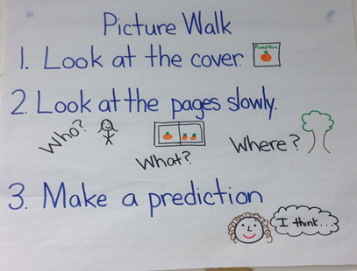
Before Reading
Picture Walks: A shared activity between an adult and child(ren) before reading an unfamiliar story
Only select pictures that will provide an accurate and clear understanding of the events in the story
Immediately correct any misunderstandings for the student so s/he knows exactly what to expect
Notes:
Develop background knowledge or activate background knowledge

Slide 30
Before Reading
Think Aloud: The teacher explicitly models cognitive strategies to help understand a text
Model predicting, questioning, clarifying, and summarizing
Stop at specific places in the story to say what a student might/should be thinking at that point
Colored post-it notes are recommended
Summarize
Predict
Clarify
Question
Notes:
I think this may be before reading
Let’s model this and have teachers keep track of when we use each strategy ?
Ideas for books: where the wild things are, Elephant and Piggy

Slide 31
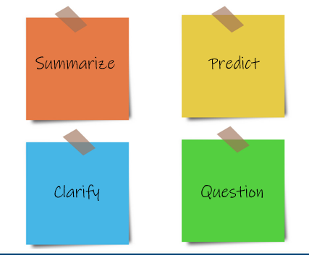
During Reading
Reciprocal Teaching: A scaffolded discussion technique students can use in small groups
Students work together to practice the strategies the teacher modeled in the think aloud
Students can be assigned different roles
Or, they can take turns being the “teacher”

Slide 32
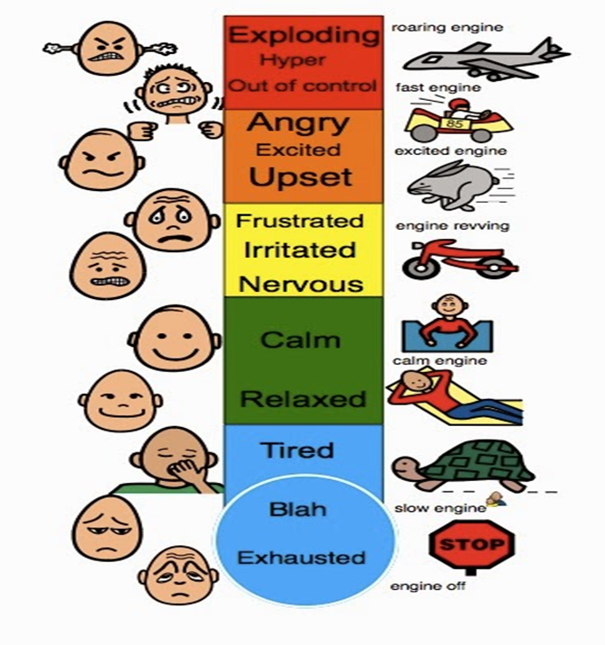
During Reading
Emotional Thermometers: Used to help students understand the emotions of characters
Shades of colors are used in a spectrum to help students understand the different degrees of an emotion someone can feel
One color is used for a single emotion but in different shades
Use Green for positive feelings or ideas
Use Red for negative feelings or ideas
Bonus: the student can be asked to rate his/her own emotions on the thermometer

Slide 33
After Reading
Structure Mapping: Helps children with autism visualize how events in a story are interrelated and dependent on the characters.
In a visual or graphic format, the teacher lists the main characters of the story and creates a simple statement about each one.
Another graphic organizer is used to list the main characters and events in the story
lines, arrows, and shapes are included to clarify interrelations among characters and events.
Stress how characters can influence the actions of each other (standards 1-6)

Slide 34
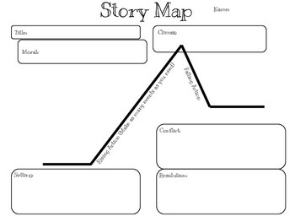
After Reading
Story Mapping: Visual representations of elements that make up a narrative so students focus on the important elements: theme, characters, problems, resolution
Can be as simple as beginning → middle → end

Slide 35
After Reading
Social Story Analogies: Helps students consider the perspective of characters in stories and others in social situations
Teacher develops a simple story based on what students are reading to help explain character’s actions and feelings
Typically told orally and must connect to information the students already understand
Can be used to explain certain language in the text that may be contradictory to the character’s actions
Notes:
Example of irony or sarcasm or something else inferred and come up with a real-life example

Slide 36
Remember
High Expectations
High Support
Notes:
As part of a universal design for learning, offer scaffolding to everyone and let students decide when they’re ready to go it alone. Some students may need some scaffolds and accommodations for the whole year.

Slide 37
Conclusion
The reading strategies designed for children with autism can benefit all students, but the teacher must ensure that ample modeling is provided and that responsibility is gradually released to students.

Slide 38
Conclusion
Need support from both the general and special education teachers in order to become successful learners who are part of the school community.
Visual aids should be utilized consistently as this is the primary modality through which children with ASD are able to learn.
The learning environment should be kept simple with limited amounts of stimuli so that the child’s focus is optimized.
The reading strategies designed for children with autism can benefit all students, but the teacher must ensure that ample modeling is provided and that responsibility is gradually released to students.
Notes:
Jason

Slide 39
Things to Consider When Returning to School
When returning to school, relationships, social/emotional well-being and physical health of our students and staff is our number one priority along with learning.
Communication with students and families will be key in making re-entry successful. Educators should use a variety of communication tools, such as social media, robocalls, personal phone calls, email, online learning management systems, and other means, to keep students and their families informed.
Students will be at different places emotionally and academically. Educators should use available tools, such as observation, formative assessment, interim and diagnostics assessments, and other means, to determine where students are and identify their needs.

Slide 40
Things to Consider When Returning to School
Educators should use personal and professional observations, conversations, informal assessments, formative assessments, interim and diagnostics assessments to determine whether students need one or all the following:
Remediation
Re-teaching
Direct instruction
Differentiated instruction
Enrichment
Social/emotional and health support
Referrals to appropriate staff (for example, counselors, nurses, case managers, speech pathologist, psychologists, etc.)
Other supports and services as necessary
Schools should use vertical teaming with teaching staff to identify gaps in the prerequisite skills needed for students to be successful academically.

Slide 41
Resources
Premium access to Lexile Hub: (https://hub.lexile.com/)
Search texts by interests, grade-level, and readability
Support for WVCCRS documents: https://wvde.us/college-and-career-readiness/educators/.
Notes:
using their K12 email address.

Slide 42
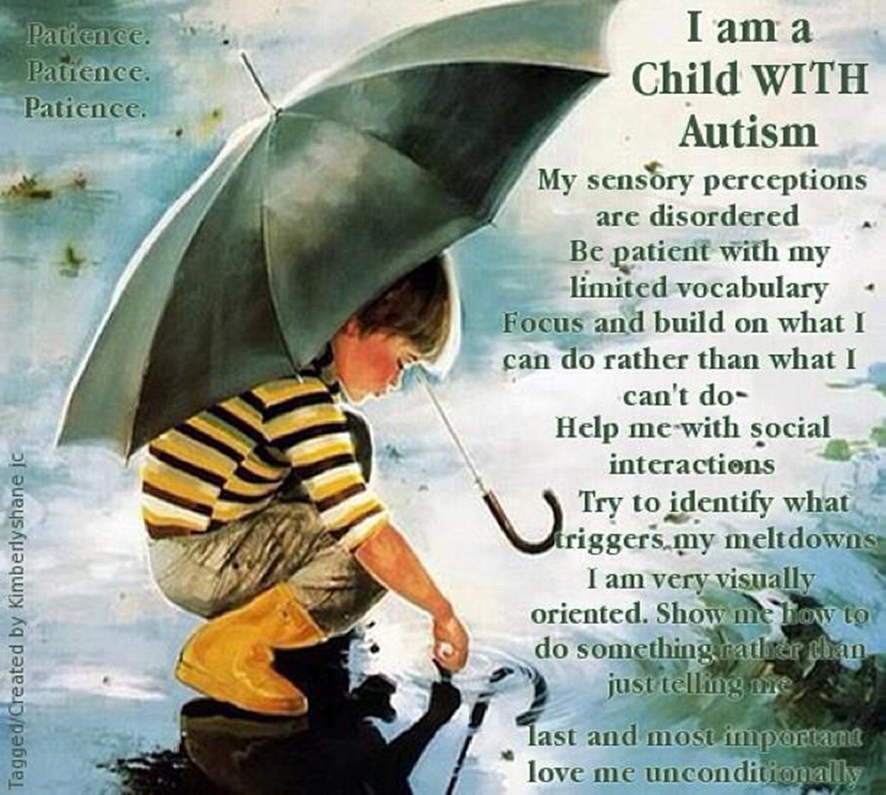

Slide 44
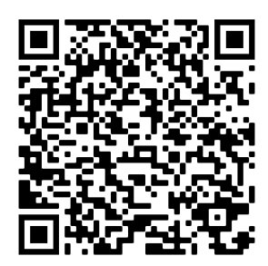
Please Remember to Complete the Evaluation
I will post the evaluation link in the chat.
https://nam01.safelinks.protection.outlook.com/?url=https%3A%2F%2Fforms.office.com%2FPages%2FResponsePage.aspx%3Fid%3DS7AZ4AwzekaLrgn7FzdNapEOszzk9RJgS7C6cljCXdUMVc3VUoyS1cxMDRGWVZRMTMzMkJaTVU5MC4u&data=02%7C01%7Cvrhudy%40k12.wv.us%7C1c81194748b343cedbe108d82814ed22%7Ce019b04b330c467a8bae09fb17374d6a%7C0%7C0%7C637303417651509005&sdata=vNP%2BB71OSG1F4foyYGyz0effDyu%2BtKBfdIlhg4hZFWo%3D&reserved=0

Slide 45
Office of Special Education and Student Support
Jason Conaway, Ed.D., NCSP
Coordinator of Autism Spectrum Disorder
jconaway@k12.wv.us

