Slide 1
Increasing Literacy Gains for a All Students: Text Complexity and Diverse Readers in Grades 6-12
Instructional Support Professional Learning Forum
August 2020

Slide 2
Session Learning Goals
Increase understanding of the three components of text complexity
Identify barriers that each component may present for students
Gain strategies and tools to overcome barriers and leverage each component to increase students’ comprehension, vocabulary, and reading stamina

Slide 3
Session Structure
3 Part Session
Text Complexity: Quantitative Measure
Text Complexity: Qualitative Measure (Break)
Text Complexity: Reader and Task Considerations

Slide 4
Quantitative Measure: What does it mean? How do I use it?
Part 1 of 3: Text Complexity and Diverse Readers in Grades 6-12

Slide 5
Part One Learning Goals
Gain a clearer understanding of what quantitative measures do and do not measure related to texts and to students.
Gain a clearer understanding of how to use the Lexile Framework for Reading as a quantitative measure to support standards-based instruction.

Slide 6
Text Complexity
Quantitative Measure
Qualitative Features
Qualitative
Features
Reader and Task Considerations

Slide 7
Quantitative Measure for Texts =
Sentence Length
Word Length
Unknown Words
Notes:
To define the quantitative measure of a text, the number of words in each sentence, the number of syllables in each word, and the number of unknown words in the text are analyzed. Texts with longer sentences, multi-syllabic words, or specialized vocabulary have a higher Lexile measure than texts with simpler sentences, shorter words, or more commonly known words.

Slide 8
Sample 1:
“I am excessively fond of a cottage; there is always so much comfort, so much elegance about them. And I protest, if I had any money to spare, I should buy a little land and build one myself, within a short distance of London, where I might drive myself down at any time, and collect a few friends about me and be happy. I advise everybody who is going to build, to build a cottage.”
Notes:
For example, Sense and Sensibility by Jane Austen measures at 1180L and has a complex sentence structure with frequent use of archaic or unknown vocabulary. (CLICK) Notice the length of this sentence as well as the placement of commas and use of conditional and prepositional phrases. This sentence can be difficult to follow and is one example of the type of phrasing which makes this text as a whole quantitatively rather complex.

Slide 9
Sample 1:
“I am excessively fond of a cottage; there is always so much comfort, so much elegance about them. And I protest, if I had any money to spare, I should buy a little land and build one myself, within a short distance of London, where I might drive myself down at any time, and collect a few friends about me and be happy. I advise everybody who is going to build, to build a cottage.”
Notes:
For example, Sense and Sensibility by Jane Austen measures at 1180L and has a complex sentence structure with frequent use of archaic or unknown vocabulary. (CLICK) Notice the length of this sentence as well as the placement of commas and use of conditional and prepositional phrases. This sentence can be difficult to follow and is one example of the type of phrasing which makes this text as a whole quantitatively rather complex.

Slide 10
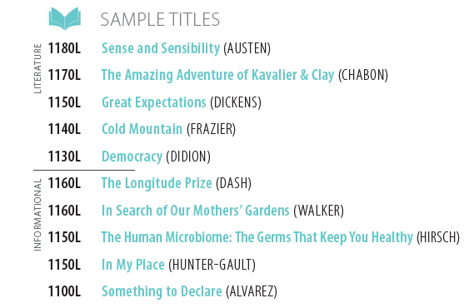
1180L Sense and Sensibility (AUSTEN)
This presentation constitutes the confidential information of MetaMetrics, Inc.
Copyright ©2017. All rights reserved.
Notes:
For example, Sense and Sensibility by Jane Austen measures at 1180L and has a complex sentence structure with frequent use of archaic or unknown vocabulary. (CLICK) Notice the length of this sentence as well as the placement of commas and use of conditional and prepositional phrases. This sentence can be difficult to follow and is one example of the type of phrasing which makes this text as a whole quantitatively rather complex.

Slide 11
Sample 2:
“Perhaps it had something to do with living in a dark cupboard, but Harry had always been small and skinny for his age. He looked even smaller and skinnier than he really was because all he had to wear were old clothes of Dudley's, and Dudley was about four times bigger than he was.”
Notes:
Meanwhile, books in the Harry Potter series measure on average around 940L and have moderately complex sentence structure and more modern vocabulary usage. (CLICK) And so, even though this sentence is fairly long (31 words), (CLICK) the words in the sentence are modern, every day words and the adjectives used to add detail are also very commonly used words and they are repeated within this section of text which keeps the complexity of this text only moderately complex.

Slide 12
Sample 2:
“Perhaps it had something to do with living in a dark cupboard, but Harry had always been small and skinny for his age. He looked even smaller and skinnier than he really was because all he had to wear were old clothes of Dudley's, and Dudley was about four times bigger than he was.”
Notes:
Meanwhile, books in the Harry Potter series measure on average around 940L and have moderately complex sentence structure and more modern vocabulary usage. (CLICK) And so, even though this sentence is fairly long (31 words), (CLICK) the words in the sentence are modern, every day words and the adjectives used to add detail are also very commonly used words and they are repeated within this section of text which keeps the complexity of this text only moderately complex.

Slide 13
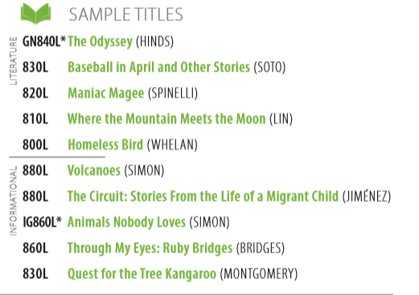
880L Harry Potter and the Sorcerer’s Stone (ROWLING)
This presentation constitutes the confidential information of MetaMetrics, Inc.
Copyright ©2017. All rights reserved.
Notes:
Andrea
Meanwhile, books in the Harry Potter series measure on average around 940L and have moderately complex sentence structure and more modern vocabulary usage. (CLICK) And so, even though this sentence is fairly long (31 words), (CLICK) the words in the sentence are modern, every day words and the adjectives used to add detail are also very commonly used words and they are repeated within this section of text which keeps the complexity of this text only moderately complex.

Slide 14
Quantitative measure of a text does not account for…
Quantitative Measure (Lexile)
Layers of Meaning
Figurative Language
Author’s Purpose
Craft and Structure
Language Conventions
Knowledge Demands
Qualitative Features
Qualitative
Features
Reader and Task Considerations
Notes:
Remember that the Lexile Framework for Reading defines the Quantitative measure of a text. This is only 1/3rd of text complexity. When teachers select texts for instruction, they also need to factor for the qualitative features of the text such as: layers of meaning, figurative language, author’s purpose, craft and structure, language conventions, and knowledge demands.

Slide 15
Quantitative measure of a text does not account for…
Quantitative Measure (Lexile)
A student’s prior knowledge
A student’s interests or motivation to read
A student’s ability to use information gained to perform a task
Qualitative Features
Reader
and Task Considerations
Reader and Task Considerations
Notes:
Remember that the Lexile Framework for Reading defines the Quantitative measure of a text. This is only 1/3rd of text complexity. When teachers select texts for instruction, they also need to factor for the qualitative features of the text such as: layers of meaning, figurative language, author’s purpose, craft and structure, language conventions, and knowledge demands.

Slide 16
How does the Lexile Framework for Reading support instructional decision making?

Slide 17
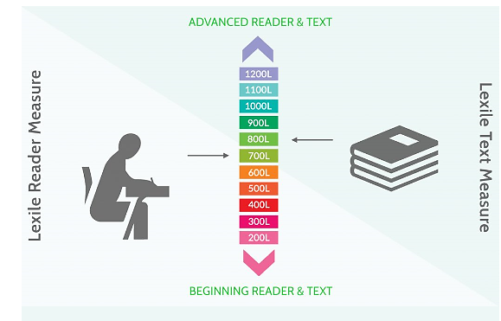
ADVANCED READER & TEXT
Reading Ability
Quantitative Complexity
1200L
1100L
1000L
900L
Lexile Reader Measure
800L
700L
Lexile Text Measure
600L
500L
400L
300L
200L
BEGINNING READER & TEXT
This presentation constitutes the confidential information of MetaMetrics, Inc.
Copyright ©2017. All rights reserved.
Notes:
Lexile defines the (CLICK) quantitative complexity of reading material AND (CLICK) also measures the independent reading ability of individual readers.

Slide 18
ADVANCED READER & TEXT
Reading Ability
1200L
Readability
1100L
1000L
900L
Lexile Reader Measure
800L
700L
Lexile Text Measure
600L
500L
400L
300L
200L
BEGINNING READER & TEXT
This presentation constitutes the confidential information of MetaMetrics, Inc.
Copyright ©2017. All rights reserved.
Notes:
Andrea
Lexile defines the (CLICK) quantitative complexity of reading material AND (CLICK) also measures the independent reading ability of individual readers.

Slide 19
Lexile Scores for Grades 3-8
Always at individual student level, not averaged for groups of students
Lexile scores for individual students are located
Online in Reporting
Printable PDFs of Individual Student Report (ISR)
Assessments that report out Lexile score
WVGSA
Computer Adaptive Comprehensive Interim Assessment (CA-CIA)
Fixed Form Comprehensive Interim Assessment (FF-CIA)

Slide 20
Additional Tools to Determine Student’s Lexile Measure

Slide 21
Where Students’ Reading Skills Should Be to Graduate CCR
LEXILE MEASURE
CCR: 1200L – 1380L
GRADE
This presentation constitutes the confidential information of MetaMetrics, Inc.
Copyright ©2017. All rights reserved.
Notes:
Becoming a college- and career-ready reader doesn’t happen overnight. To develop college- and career-ready reading skills, students need to work with a range of increasingly complex texts over the course of their school years.

Slide 22
WV CCR Standards Text Complexity Expectations
Grade Band* | Lexile Range
K-1 | Not in policy MetaMetrics suggests BR120L to 295L for Grade 1
2-3 | 420L-820L
4-5 | 740L-1010L
6-8 | 925L-1185L
9-10 | 1050L-1335L
11-12 | 1185L-1385L
*English Language Arts Standards 18 and 19 provide more detailed grade-level expectations.
Notes:
To support the need for students to work with increasingly complex texts each school year, the WV College- and Career- Readiness Standards for English Language Arts define the Lexile range goals for each programmatic level in the section titled “Text Complexity Expectations”. Specific grade level expectations are defined in Standards 18 and 19.

Slide 23
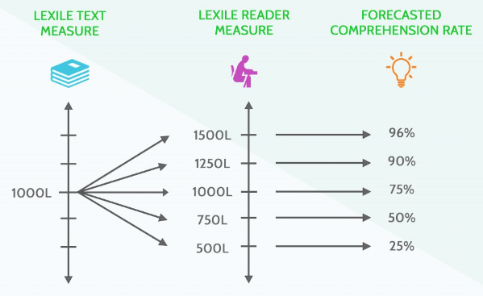
Lexile measures inform instructional planning by:
Forecasting independent reading comprehension rate
Providing data for selecting “just right” texts
Providing data for differentiating instruction with grade-level texts
Notes:
Lexile measures inform instructional planning by:
(CLICK)Forecasting independent reading comprehension rate
(CLICK)Providing data for differentiating texts
(CLICK)Providing data for differentiating instruction

Slide 24
Lexile Measures: Forecast Comprehension
LEXILE TEXT MEASURE
LEXILE READER MEASURE
FORECASTED COMPREHENSION RATE
This presentation constitutes the confidential information of MetaMetrics, Inc.
Copyright ©2017. All rights reserved.
Notes:
Using Lexile measures to discuss both readers and texts allows us to forecast how well a reader will comprehend the text. For example, (CLICK) if we look at the chart on the slide we see that a reader with a Lexile measure of 1000L can be expected to experience at least 75% comprehension on a text that measures 1000L.
However, (CLICK) when a reader with a Lexile measure of 750L is paired with a text that measures at 1000L, then the forecasted comprehension decreases to only 50%.
(CLICK) When a reader with a Lexile measure of 1250L is paired with a text that measures at 1000L, then the forecasted comprehension increases to 90%.

Slide 25
Lexile Measures: Forecast Comprehension
LEXILE TEXT MEASURE
LEXILE READER MEASURE
FORECASTED COMPREHENSION RATE
This presentation constitutes the confidential information of MetaMetrics, Inc.
Copyright ©2017. All rights reserved.
Notes:
Using Lexile measures to discuss both readers and texts allows us to forecast how well a reader will comprehend the text. For example, (CLICK) if we look at the chart on the slide we see that a reader with a Lexile measure of 1000L can be expected to experience at least 75% comprehension on a text that measures 1000L.
However, (CLICK) when a reader with a Lexile measure of 750L is paired with a text that measures at 1000L, then the forecasted comprehension decreases to only 50%.
(CLICK) When a reader with a Lexile measure of 1250L is paired with a text that measures at 1000L, then the forecasted comprehension increases to 90%.

Slide 26
Lexile Measures: Forecast Comprehension
LEXILE TEXT MEASURE
LEXILE READER MEASURE
FORECASTED COMPREHENSION RATE
This presentation constitutes the confidential information of MetaMetrics, Inc.
Copyright ©2017. All rights reserved.
Notes:
Using Lexile measures to discuss both readers and texts allows us to forecast how well a reader will comprehend the text. For example, (CLICK) if we look at the chart on the slide we see that a reader with a Lexile measure of 1000L can be expected to experience at least 75% comprehension on a text that measures 1000L.
However, (CLICK) when a reader with a Lexile measure of 750L is paired with a text that measures at 1000L, then the forecasted comprehension decreases to only 50%.
(CLICK) When a reader with a Lexile measure of 1250L is paired with a text that measures at 1000L, then the forecasted comprehension increases to 90%.

Slide 27
Reader and Text Measures
A reader’s Lexile range spans up to 50L above and 100L below his/her Lexile measure.
Matching a reader’s Lexile measure to a text with the same Lexile measure leads to an expected 75% comprehension rate when reading independently.
This presentation constitutes the confidential information of MetaMetrics, Inc.
Copyright ©2017. All rights reserved.
Notes:
In addition to determining the complexity of a text, Lexile measures can also be used to provide us with information about how well a reader will comprehend a given text.
(CLICK) A reader’s Lexile range spans up to 50L above and 100L below his/her Lexile measure.
(CLICK) Because the text and the reader are measured on the same scale, matching a reader’s Lexile measure to a text with the same Lexile measure leads to an expected 75% comprehension rate when reading independently.
As depicted in the graphic here, a reader with a Lexile measure of 1240L can be expected to have at least a 75% comprehension rate on texts between 1140L and 1290L.

Slide 28
Why 75% Comprehension?
Research suggests that at 75% a reader…
can have a successful reading experience without frustration or boredom.
can achieve “functional comprehension” of the text.
will be sufficiently challenged (by vocabulary and syntax).
75% is the “right amount of challenge”
Challenge Matching
Notes:
This is different from a student’s “independent” level. This is expected rate of comprehension when reading this text independently. Growth mindset – Zone of Proximal Development

Slide 29
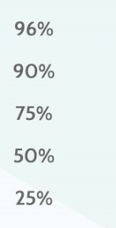
Creating the Right Amount of Challenge
Readability of text paired with reading ability of student forecasts…
Productive Struggle
This presentation constitutes the confidential information of MetaMetrics, Inc.
Copyright ©2017. All rights reserved.

Slide 30
Creating the Right Amount of Challenge
Readability of text paired with reading ability of student forecasts…
Destructive
Struggle
This presentation constitutes the confidential information of MetaMetrics, Inc.
Copyright ©2017. All rights reserved.
Notes:
Growth mindset – Carol Dweck, Angela Duckworth

Slide 31
Creating the Right Amount of Challenge
FORECASTED COMPREHENSION RATE INDICATES…
Readability of text paired with reading ability of student forecasts…
Little or No Struggle
This presentation constitutes the confidential information of MetaMetrics, Inc.
Copyright ©2017. All rights reserved.

Slide 32
Opportunities to Master Grade-Level Standards Through Multiple Text Selection
Instruction Promotes:
Independent reading
Productive struggle with “just right” texts
Small group and whole group discussion of:
key ideas & details
craft & structure
vocabulary & language
Notes:
NOTE: The two uses for Lexile Measure that are being shared are both necessary for students to grow as readers.
Teachers and Parents can also use Lexile measures to help students locate texts that they can read independently and that will keep them moving towards success with more and more complex texts.

Slide 33
When using multiple texts, make certain that all options:
include necessary content specific language.
accurately and completely address the CCR standard(s).
are appropriate for students.
300L
vs
1370L
Notes:
When substituting a text based on Lexile measure, check the text carefully to make sure that it:
includes the content specific language needed to fully understand the content/concept.
(CLICK)accurately and completely addresses the concepts of the learning standard(s) for which it was selected.
(CLICK) is appropriate for the age of your students (text and graphics):
many texts with a low Lexile measure are designed for younger children
some texts are “High Interest-Low Lexile” (HL) and are designed for older audiences.

Slide 34
Remember: Students Need a Steady Diet of Increasingly Complex Texts to Become College- and Career- Ready Readers
This presentation constitutes the confidential information of MetaMetrics, Inc.
Copyright ©2017. All rights reserved.
Notes:
To ensure that (CLICK) all students are progressing toward college and career readiness goals, classroom instruction must also utilize texts that have Lexile measures within the grade-level complexity guidelines.

Slide 35
Differentiated Instruction with Same Text
More Readability Supports:
Read aloud
Shared reading
Comprehension Supports:
Guided reading
Build/access knowledge
Unpack syntax
Address vocabulary
Notes:
NOTE: The two uses for Lexile Measure that are being shared are both necessary for students to grow as readers.
Teachers and parents can also use Lexile measures to better understand what supports are needed in order to personalize instruction for students. For example, students whose Lexile measure is more than 50 points below the measure of a text might benefit from instructional supports like guided reading or scaffolded tasks to increase their comprehension and help them grow as readers.

Slide 36
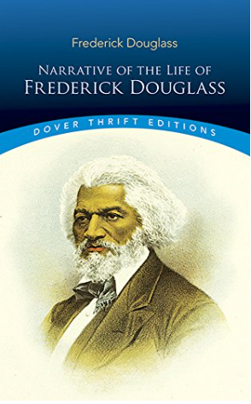
Differentiated Instruction with Same Text
Reader Ability | Text: Narrative of the Life of Frederick Douglass (1845) | Forecasted Comprehension
500L 750L 880L 1000L 1100L 1250L | 1080L 1080L 1080L 1080L 1080L 1080L | 24% 49% 63% 75% 82% 90%
Additional Supports:
Note-taking
Scaffold TDQs
Chunk text
Graphic organizers
Peer mentor
Dictionary/Thesaurus
This presentation constitutes the confidential information of MetaMetrics, Inc.
Copyright ©2017. All rights reserved.
Notes:
DETAILED Other supports might include activities to build or access knowledge, to unpack the syntax of the text, or to provide vocabulary support. (CLICK) Teachers may also support students with strategies for taking notes, scaffolding text dependent questions, or chunking the text into more manageable portions.

Slide 37
Differentiated Instruction with Same Text
Fewer Readability Supports:
Independent reading
Peer partner reading
Comprehension Supports:
Guided reading
Paired texts
Deeper questioning
Research extensions
Notes:
Teachers and parents can also use Lexile measures to better understand what supports are needed in order to personalize instruction for students. For example, students whose Lexile measure is more than 50 points below the measure of a text might benefit from instructional supports like guided reading or scaffolded tasks to increase their comprehension and help them grow as readers.

