Slide 1
Qualitative Complexity: What is it? How can I use it to inform instruction?
Part 2 of 3: Text Complexity and Diverse Readers in Grades 6-12

Slide 2
Part Two Learning Goals
Gain a clearer understanding of qualitative complexity as it relates to texts.
Gain a clearer understanding of how qualitative complexity informs instructional decision-making.

Slide 3
Review:
Text Complexity
Quantitative Measure
Qualitative Features
Qualitative
Features
Reader and Task Considerations
Notes:
Quick refresher of the types of texts our students need to be able to access.

Slide 4
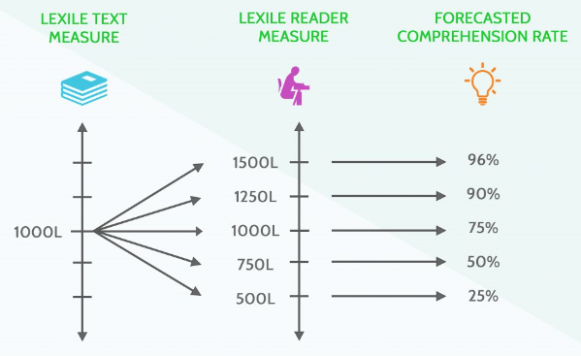
Review: Quantitative Measure (Lexile) =
Sentence Length
Word Length
Unknown Words
Notes:
To define the quantitative measure of a text, the number of words in each sentence, the number of syllables in each word, and the number of unknown words in the text are analyzed. Texts with longer sentences, multi-syllabic words, or specialized vocabulary have a higher Lexile measure than texts with simpler sentences, shorter words, or more commonly known words.

Slide 5
Qualitative Complexity =
Quantitative Measure (Lexile)
Author’s Purpose
Central Idea(s)
Layers of Meaning
Craft and Structure
Figurative Language
Language Conventions
Knowledge Demands
Vocabulary
Concepts
Context/History
Qualitative Features
Qualitative
Features
Reader and Task Considerations
Notes:
Remember that the Lexile Framework for Reading defines the Quantitative measure of a text. This is only 1/3rd of text complexity. When teachers select texts for instruction, they also need to factor for the qualitative features of the text such as: layers of meaning, figurative language, author’s purpose, craft and structure, language conventions, and knowledge demands.

Slide 6
“Now then, Pooh," said Christopher Robin, "where's your boat?" "I ought to say," explained Pooh as they walked down to the shore of the island, "that it isn't just an ordinary sort of boat. Sometimes it's a Boat, and sometimes it's more of an Accident. It all depends." "Depends on what?" "On whether I'm on the top of it or underneath it.”
620L (3rd and ^{4th} grade)
s
Qualitative
Notes:
What’s qualitatively complex about this piece?
The Lexile framework is based on the literal meaning of words. But connotation, which the framework does not address, is what gives text its depth and complexity. Humor, for example, is the most difficult part of language to learn (particularly for non-native speakers) because it relies on developmental, cultural, emotional associations that often contrasts with the literal meaning of the word. Here are two examples.

Slide 7
"Sir Winston, if you were my husband, I would poison your tea.”
"Madame, if you were my wife, I would drink it."
— Conversation between Lady Astor and Sir Winston Churchill
390L (1st and 2nd grade)
s
Qualitative
Notes:
What’s qualitatively complex about this piece?

Slide 8
…When in the Course of human events, it becomes necessary for one people to dissolve the political bands which have connected them with another, and to assume among the powers of the earth, the separate and equal station to which the Laws of Nature and of Nature's God entitle them, a decent respect to the opinions of mankind requires that they should declare the causes which impel them to the separation.
2030L (Graduate School +)
s
Qualitative
Notes:
What’s qualitatively complex about this piece?
Keeping lexiles in mind is particularly important when using primary sources such as our nation’s Founding Documents. The opening paragraph of the Constitution lexiles at 2030. Students going on to college should be able to read independently texts that lexile at about 1300. We shouldn’t expect our students to be interested in or able to read and understand these texts without first providing them with a good deal of support.

Slide 9
Critical Consideration for Instructional Design:
Consideration #1: How do I know if the text I’ve selected is complex?

Slide 10
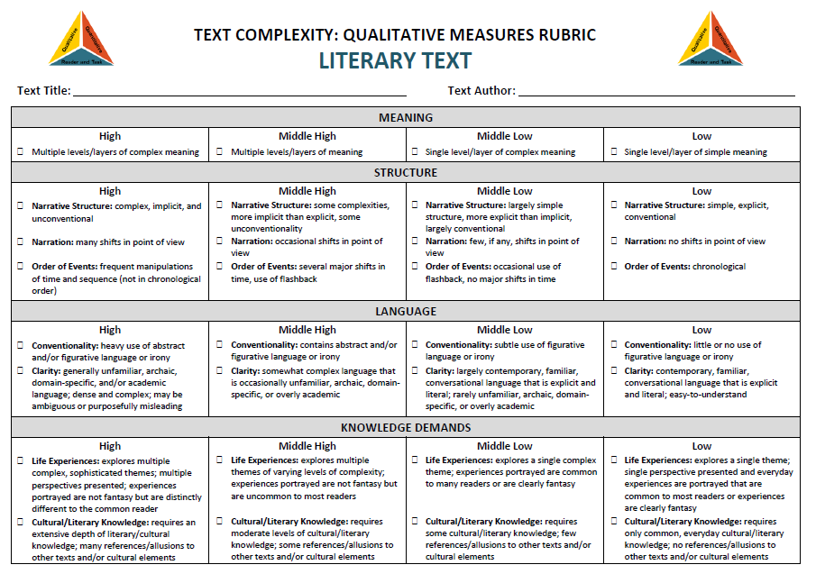

Slide 12
Considering Overall Text Complexity:
The Tell Tale Heart by Edgar Allan Poe
Qualitative Features:
Layers of Meaning
Figurative Language
Author’s Purpose
Craft and Structure
Language Conventions
Knowledge Demands
Reader Considerations:
Prior knowledge
Interests or motivation to read
Age/Maturity
Cultural/Societal
Lexile: 820
Notes:
If using an excerpt of the text to complete a participant task:
Independent - 5 minutes – read closely
Independent - 3 minutes – jot down notes on the rubric (slide 10 or 11 depending on text type)
Table Partner – 5 minutes – discuss, add to notes
Share Out – 3-5 minutes – participants share out

Slide 13
Considering Overall Text Complexity: The Giver by Lois Lowry
Qualitative Features:
Layers of Meaning
Figurative Language
Author’s Purpose
Craft and Structure
Language Conventions
Knowledge Demands
Reader Considerations:
Prior knowledge
Interests or motivation to read
Age/Maturity
Cultural/Societal
Lexile: 760
Notes:
If using an excerpt of the text to complete a participant task:
Independent - 5 minutes – read closely
Independent - 3 minutes – jot down notes on rubric (slide 10 or 11 depending on text type)
Table Partner – 5 minutes – discuss, add to notes
Share Out – 3-5 minutes – participants share out

Slide 14
Task One: Determine the central idea of the passage below and provide a summary distinct from personal opinion.
“The former render possible theoretical cognition according to principles a priori; the latter in respect of this theoretical cognition only supplies in itself a negative principle (that of mere contrast), but on the other hand it furnishes fundamental propositions which extend the sphere of the determination of the will and are therefore called practical.”
Passage taken from pg. 1 of Immanuel Kant’s Critique of Judgment
Notes:
Attempt task as participants – 3-5 minutes

Slide 15
Task Two: Read the following passage, then write a brief argument either defending or countering Fern’s point of view in regard to her father’s approach to raising farm animals.
“Where's Papa going with that ax?" said Fern to her mother as they were setting the table for breakfast.
"Out to the hog house," replied Mrs. Arable. "Some pigs were born last night.“
"I don't see why he needs an ax," continued Fern, who was only eight.
"Well," said her mother, "one of the pigs is a runt. It's very small and weak, and it will never amount to anything. So your father has decided to do away with it.”
"Do away with it?" shrieked Fern. "You mean kill it? Just because it's smaller than the others?"
Notes:
Attempt task as participants 3-5 minutes

Slide 16
Table Discussion
Which task was more challenging?
Why?
Notes:
Discuss the tasks on slides 14 and 15

Slide 17
Table Discussion
Would a lesson on finding main idea or summarizing prepare you to more effectively tackle Task 1?
Why or why not?
Notes:
Discuss the tasks on slides 14 and 15

Slide 18
How does this activity shape our thinking when designing instruction?
Notes:
Discuss the tasks on slides 14 and 15

Slide 19
Key Take-Aways
Quantitative measures and qualitative features both factor into the overall complexity of a text.
Addressing grade-level standards requires the study of texts that are quantitatively and qualitatively complex.
Quantitative measures help us forecast what scaffolds may be necessary to meet our instructional goals with a text.
Qualitative features help us align the study of a text to specific grade-level standards.

Slide 20
Reader and Task Considerations: What are they? How do they round out text complexity?
Part 3 of 3: Text Complexity and Diverse Readers in Grades 6-12

Slide 21
Part Three Learning Goals
Gain a clearer understanding of reader and task considerations and their role in determining text complexity.
Gain a clearer understanding of the relationship between standards-aligned tasks and text complexity.

Slide 22
Review:
Text Complexity
Quantitative Measure
Qualitative Features
Qualitative
Features
Reader and Task Considerations
Notes:
Quick refresher of the types of texts our students need to be able to access.

Slide 23
Review: Quantitative Measure (Lexile) =
Sentence Length
Word Length
Unknown Words
Notes:
To define the quantitative measure of a text, the number of words in each sentence, the number of syllables in each word, and the number of unknown words in the text are analyzed. Texts with longer sentences, multi-syllabic words, or specialized vocabulary have a higher Lexile measure than texts with simpler sentences, shorter words, or more commonly known words.

Slide 24
Qualitative Complexity =
Quantitative Measure (Lexile)
Author’s Purpose
Central Idea(s)
Layers of Meaning
Craft and Structure
Figurative Language
Language Conventions
Knowledge Demands
Vocabulary
Concepts
Context/History
Qualitative Features
Qualitative
Features
Reader and Task Considerations
Notes:
Remember that the Lexile Framework for Reading defines the Quantitative measure of a text. This is only 1/3rd of text complexity. When teachers select texts for instruction, they also need to factor for the qualitative features of the text such as: layers of meaning, figurative language, author’s purpose, craft and structure, language conventions, and knowledge demands.

Slide 25
Reader and Task Considerations=
Qualities the reader brings to the text and to the nature of the task being undertaken
Attention, short term working memory, critical and analytical skills
Reader’s skillfulness w/ inferring, predicting, visualizing, etc…
Engagement, motivation, prior knowledge and experience
Maturity and sensitivity
Expectation of the task (aka standard(s) being addressed
Quantitative Measure (Lexile)
Qualitative Features
Reader
and Task Considerations
Notes:
Remember that the Lexile Framework for Reading defines the Quantitative measure of a text. This is only 1/3rd of text complexity. When teachers select texts for instruction, they also need to factor for the qualitative features of the text such as: layers of meaning, figurative language, author’s purpose, craft and structure, language conventions, and knowledge demands.

Slide 26
Critical Consideration for Instructional Design:
Consideration #2: How will I provide students with on-grade level, standards-aligned learning activities and tasks?

Slide 27
Reader and Task Considerations: Reader’s Lexile Measure Lower than the Text’s
When the reader’s Lexile measure is lower than the measure of the text, the reader will often struggle with the task if left unsupported.
Use the Lexile Framework to help identify additional supports students may need with vocabulary and sentence structure.
Address complex sentence structures and challenging phrases explicitly as part of an overall study of the text’s theme/central idea.
Address discipline specific and other challenging vocabulary explicitly and in context to the text.

Slide 28
Reader and Task Considerations: Comprehension and Retention
Specific learning disabilities as well as social/emotional factors may impede a student’s ability to comprehend or retain what they read complicating their ability to complete on-grade level, standards-aligned tasks.
Work with counselors and special educators to identify student needs
Utilize chunking, note-taking, mnemonics, and other supports
Be mindful of social/emotional factors when selecting texts and topics of study

Slide 29
Considering Overall Text Complexity:
The Tell Tale Heart by Edgar Allan Poe
Lexile
Qualitative Features
820L
Lexile Range:
Grades 3-5
Suggested for:
Grades 6-8
Unreliable narrator
Difficult content like murder and insanity
1843 –archaic language
Unconventional sentence structure and punctuation
Notes:
The Tell-Tale Heart
Narrator calls himself a madman which makes everything he tells the reader questionable
An old man is murdered and his body is hidden under the floor
Additionally, the language reflects that of 1843 when the text was written so many words may be unknown to students today
Furthermore, Edgar Allan Poe used unconventional punctuation which makes many of the sentences either short and absent of complete thought or overly long and rambling with many thoughts jumbled into one sentenceTell-Tale Heart – note that going by Lexile alone, this short story falls into the range for grades 3-5. However, not only would this text be confusing for students due to the language and sentence structure, but the topics of murder and insanity may be frightening for 8 to 10 year olds and so while the Lexile measure is within the 3-5 grade range, the qualitative features and the reader considerations mean that this book is not likely to be an appropriate instructional choice for these students. Instead, the Tell Tale Heart is mostly commonly recommended for use in grades 6-8, but with proper question strategies and instructional techniques it could be used to effectively address ELA standards through grade 12.

Slide 30
Considering Overall Text Complexity: The Giver by Lois Lowry
Lexile
760L
Lexile Range:
Grades 3-5
Suggested for:
Grades 7-9
Qualitative Features
Narrative contains several flashbacks
Difficult content like loss of free will and death of loved ones
Use of euphemism requires inference making
Notes:
The Giver also falls by Lexile into grades 3-5, but once again, the qualitative features in regards to theme and content make it more
suitable for grades 7-8 though with proper planning it could be used to address standards effectively in grades 6-10.
The Giver
Narrative contains flashbacks to multiple points in history
Great deal of euphemism which students must make inferences about
Deals with genetic engineering, loss of free will, and euthanasia
Describes a young man dying on a Civil War battlefield and an elephant being killed by poachers
Before using a text with students, remember:
Analyze qualitative features like theme, content, layers of meaning, language conventions, etc…
Consider your readers and their experiences, knowledge levels, and motivation for reading

Slide 31
Reader and Task Considerations: Reader’s Level of Skillfulness
When readers struggle with comprehension skills like inferencing, predicting, and/or visualizing, explicit support is often needed to support them with on-grade level, standards-aligned tasks.
Analyze a text’s qualitative features to help identify sections where students may struggle: complex ideas, themes, or text organization as well as figurative language and literary techniques.
Design sets of standards-based text-dependent questions to scaffold students from part-to-whole, including “support” TDQs targeting a standard in a lower grade level to give students the step they need to reach the current standard on the “focus” TDQ.

Slide 34
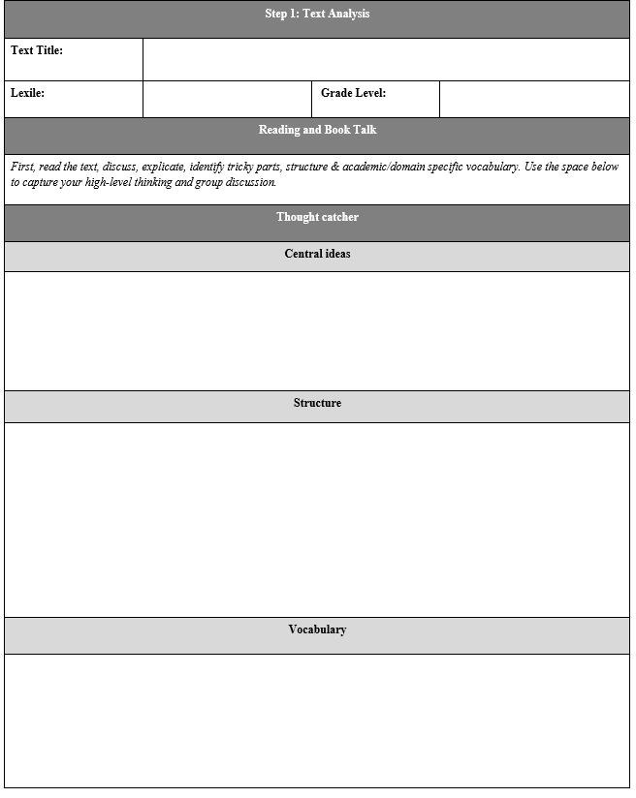
Determining Text Complexity
Analyze a classroom text for three aspects of text complexity:
Central ideas
Structure
Vocabulary

Slide 35
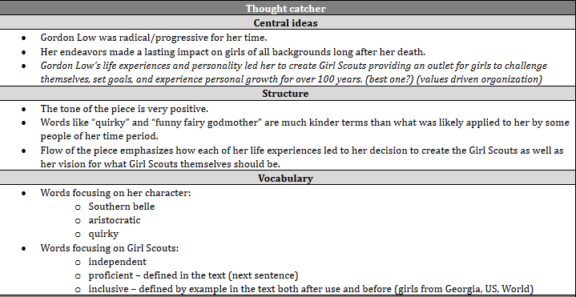
Sample of Completed Text Complexity Analysis

Slide 36
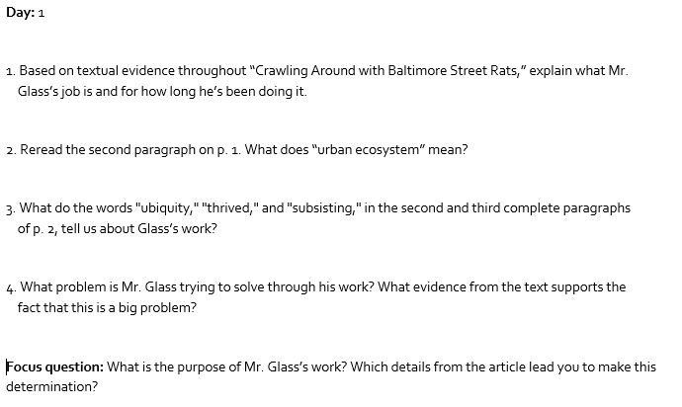
Standards-Aligned Practice: TDQs
ELA.7.4
Start
Small
ELA.7.10
Address Challenging Portions
ELA.7.10
Address Central
Ideas
ELA.7.6
ELA.7.5, ELA.7.6
Analysis
Notes:
Question: How do questions 1-4 provide scaffolding for the Focus Question?

Slide 37
Reader and Task Considerations: Reader’s Prior Knowledge and Experiences
A reader’s prior knowledge of a topic can be a barrier or a blessing.
Determine how much students already know about the topics, vocabulary, and concepts in the text.
Help students with higher levels of knowledge/experience leverage their familiarity to strengthen their comprehension and overcome other areas where they may be weaker.
Help students with lower levels of knowledge/experience close their knowledge or experience gaps by addressing vocabulary and content necessary to understand the text explicitly remembering to always bring the learning back into context with the text.
Notes:
Because so many standards rely on the integrated application of other standards, it can be challenging to drill down to a specific cause

Slide 38
“The Baseball Study” – Recht & Leslie (1988)
Notes:
Ask familiarity – RAISE Hand feature then Predict percentages in comments
After they predict percentages, show them this slide and give them a minute to take it in. They should notice that the low reading ability students with high knowledge outperformed the high reading ability students with low knowledge In addition there is little difference between the two high knowledge groups and the two low knowledge groups.
from pg. 18, table 1, Recht & Leslie 1988. (Qualitative Measure) Note: conversion from raw numbers to percentages achieved by dividing score by achieved by total possible score.
Frequently Asked Questions:
Is this study generalizable? Yes! In fact a European study replicated the finding exactly with students of a totally different background on the topic of soccer. Additional research has shown similar results on a wide variety of other topic and subject areas.
Is the impact here from knowledge or from interest? Knowledge. It’s hard to disentangle these variables, but a separate study using basketball was able to distinguish the two and found that the one that had the major impact was knowledge.
If knowledge is so important does this undermine the value of close reading? No. Close reading teaches students how to gain knowledge from text by attending to it carefully. But, as we will soon discuss, high volume reading of informational text is also necessary to build the base of knowledge and vocabulary necessary to succeed with close reading. This is a BOTH, AND type of question, not an either or.

Slide 39
Ensuring All Students Success with On-Grade Level, Standards-Aligned Learning Activities and Tasks
Do the questions mirror the language and the skills in the standard itself?
Is the focus passage(s) appropriate to answer the focus question?
Do the scaffolding questions help gather the evidence necessary to answer the focus question?
Are there more than 3 or 4 scaffolding questions per focus question?
If there are more than four, the size and scope of the focus TDQ/lesson is likely too big and it needs to be reevaluated.

Slide 40
Key Take-Aways
Quantitative Measures, Qualitative Features, and Reader and Task Considerations all factor into the overall complexity of a text for students.
Quantitative measures help us forecast what scaffolds may be necessary to meet our instructional goals with a text.

Slide 41
Key Take-Aways
Qualitative features help us align the study of a text to specific grade-level standards.
Intentionally sequenced learning activities and tasks support student mastery of standards and student perseverance with complex texts.

Slide 42
Dr. Andrea N. Lemon
Lead Coordinator
Office of Middle/Secondary Learning
alemon@k12.wv.us
304-558-5325

