Slide 1
Overview and Potential Uses

Slide 2
WELCOME!
Please mute your microphone and turn off your camera
Close captioning is available via the toolbar
Ask questions by using the chat box or your microphone
Register to receive non-degree graduate credit for certificate renewal at https://wveis.k12.wv.us/registration/

Slide 3
GOALS
Participants will be able to:
Consider using the STEPS program during COVID-19
Describe the rationale for the STEPS Program
Identify how the STEPS program can enhance service delivery
List the basic requirements of the STEPS program
Identify potential candidates for the STEPS program

Slide 4
INTERACTION
Ask questions in the chat box
Participate in the surveys

Slide 5
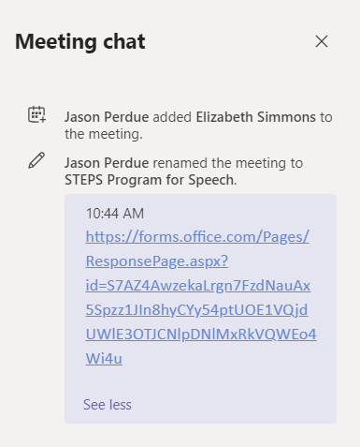
ACCESS TO CHAT BOX AND SURVEYS
Highlight code in text box
Copy
Paste in your browser
Type your question here and then hit return

Slide 6
BACK TO TEAMS

Slide 7
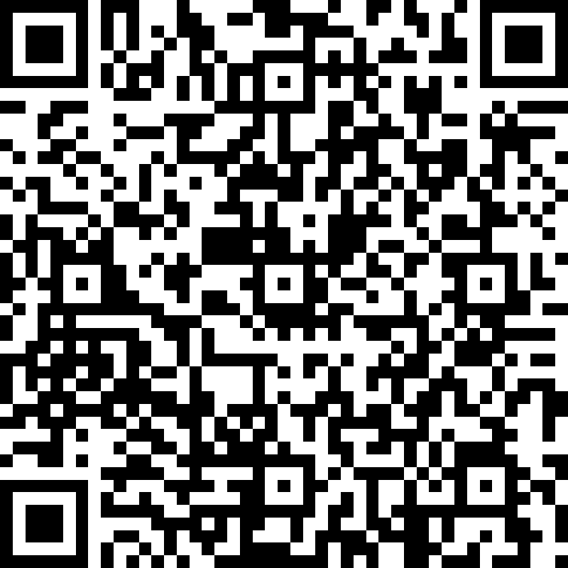
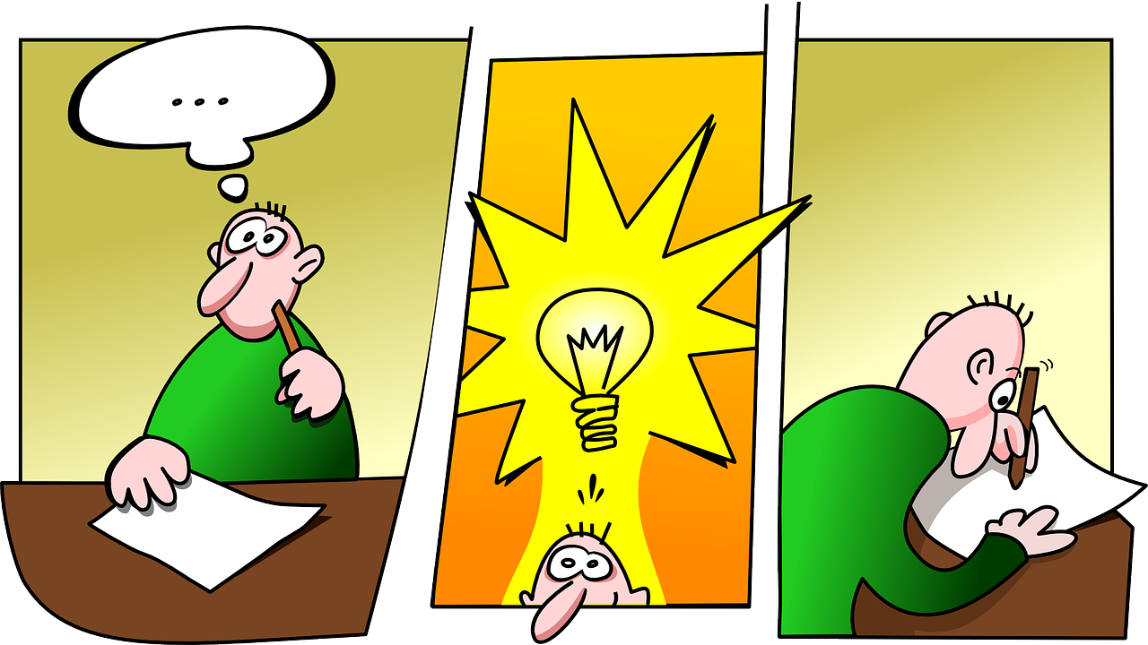
RETURN TO SCHOOL
https://forms.office.com/Pages/ResponsePage.aspx?id=S7AZ4AwzekaLrgn7FzdNauAx5Spzz1JIn8hyCYy54ptUOE1VQjdUWlE3OTJCNlpDNlMxRkVQWEo4Wi4u

Slide 8
COVID-19 UNKNOWNS
HYBRID?
INCLASS?
VIRTUAL?

Slide 9
DREAM

Slide 10
REALITY (FOR NOW)
Students needing services now (have IEPs)
Student who were in the referral process
Students who may be identified in Child Find
Students you are following through rechecks

Slide 11
SERVICES
You may be able to pull the students out of the classroom
You may be allowed in the classroom
You may be providing virtual services
You WILL be working on a tighter schedule, especially if students have less time in school

Slide 12
TOGETHER WE CAN DO THIS!

Slide 13
TIME TO THINK "OUTSIDE THE BOX"

Slide 14
DO NOT’S AND DO’S
NO
Evaluation
Cannot use STEPS in lieu of making a referral
Intervention
Cannot use STEPS in place of services on an IEP
YES
Evaluation
Can use data from STEPS as part of the assessment process
Intervention
Can provide STEPS while student is going through the referral process

Slide 15
MULTI-TIERED SYSTEM OF SUPPORTS (MTSS)
One method that can be used with all students to:
Provide early intervention and prevention
Improve learner outcomes
Data-driven system
Evidence-based practices
Notes:
Students in the general education setting can be assisted through MTSS or multi-tiered system of supports. The goal of MTSS is academic achievement for all students through early intervention and prevention. The school-wide MTSS is data driven and utilizes evidence-based practices.

Slide 16
MULTI-TIERED SYSTEM OF SUPPORTS
WVMTSS
Special Education
EL
Title I
RTI
STEPS
PBIS
Notes:
Multi-tiered System of Supports (MTSS) is an umbrella for all supports provided to students, including special education, Title 1, RTI and even the STEPS Program. MTSS is a school-wide system of supports which looks at how to adapt the curriculum and supports so all students can learn to the best of their ability. As we take up our role as educational speech-language pathologists, we will become an integral part of MTSS. Our role will be more than special education.

Slide 17
WVMTSS AND THE STEPS PROGRAM
WVMTSS
MTSS encompasses the STEPS Program
MTSS and the STEPS Program focus on early intervention and prevention
MTSS and the STEPS Program do not wait for the student to "fail" before intervening
Addresses academic, social, emotional, behavioral development of children
STEPS
Program
Overall sustainable school Improvement
Greater collaboration between general education and special education
Notes:
Remember that MTSS encompasses the STEPS Program. What you do with the students who have communication disorders can positively impact academic, social, emotional, and behavioral development. MTSS and the STEPS Program focus on early intervention and prevention.
Addressing language issues will improve overall school performance. However, we do not wait until the child fails before we get involved.
Making these changes requires greater collaboration.

Slide 18
THE STEPS PROGRAM AND SPECIAL EDUCATION
Policy 2419 paperwork requirements apply to special education, not the STEPS Program
Written parent permission is required for participation in special education and should be obtained for the STEPS Program
WVMTSS
SPECIAL EDUCATION
STEPS
Program
Notes:
The STEPS Program and special education are under the umbrella of MTSS.
However, special education paperwork regulations, do not apply. No IEPs. No Eligibility requirement for the STEPS Program. No make-up therapy. Only written parent permission and documentation. It should be noted, however, that children fall under the same protections of Policy 2419 as do students who are "suspected" of possibly having a disability and are being referred to the SAT. Should a student be referred for special education, STEPS Program documentation is very useful in assessment and writing goals.

Slide 19
THE STEPS PROGRAM
Based on the MTSS Model, the STEPS Program can be used with:
Students who would benefit from early intervention/prevention strategies prior to being identified under speech-language impaired (SLI) eligibility criteria
Students whose speech or language impairments do not adversely impact educational performance
Notes:
Based on the MTSS Model, the STEPS Program can be used with students who would benefit from early intervention/prevention strategies prior to being identified for service under the Speech-Language Impaired eligibility criteria. Based on the professional judgement of the speech-language pathologist, students can also receive support through the STEPS Program who have speech or language impairments that do not adversely impact educational performance.

Slide 20
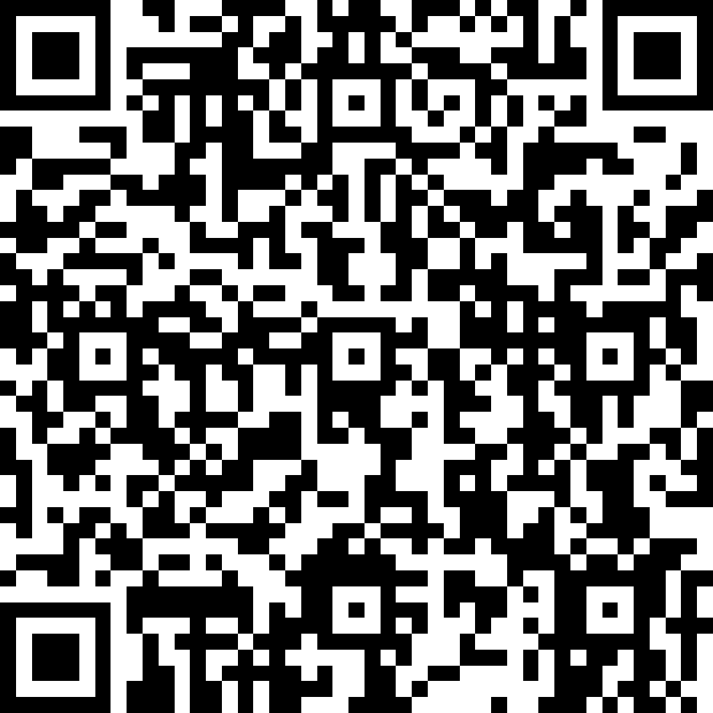
USING STEPS
https://forms.office.com/Pages/ResponsePage.aspx?id=S7AZ4AwzekaLrgn7FzdNauAx5Spzz1JIn8hyCYy54ptUNlFOSEdEWFJHMlZJNFJIRTdRM09SNkg5OC4u

Slide 21
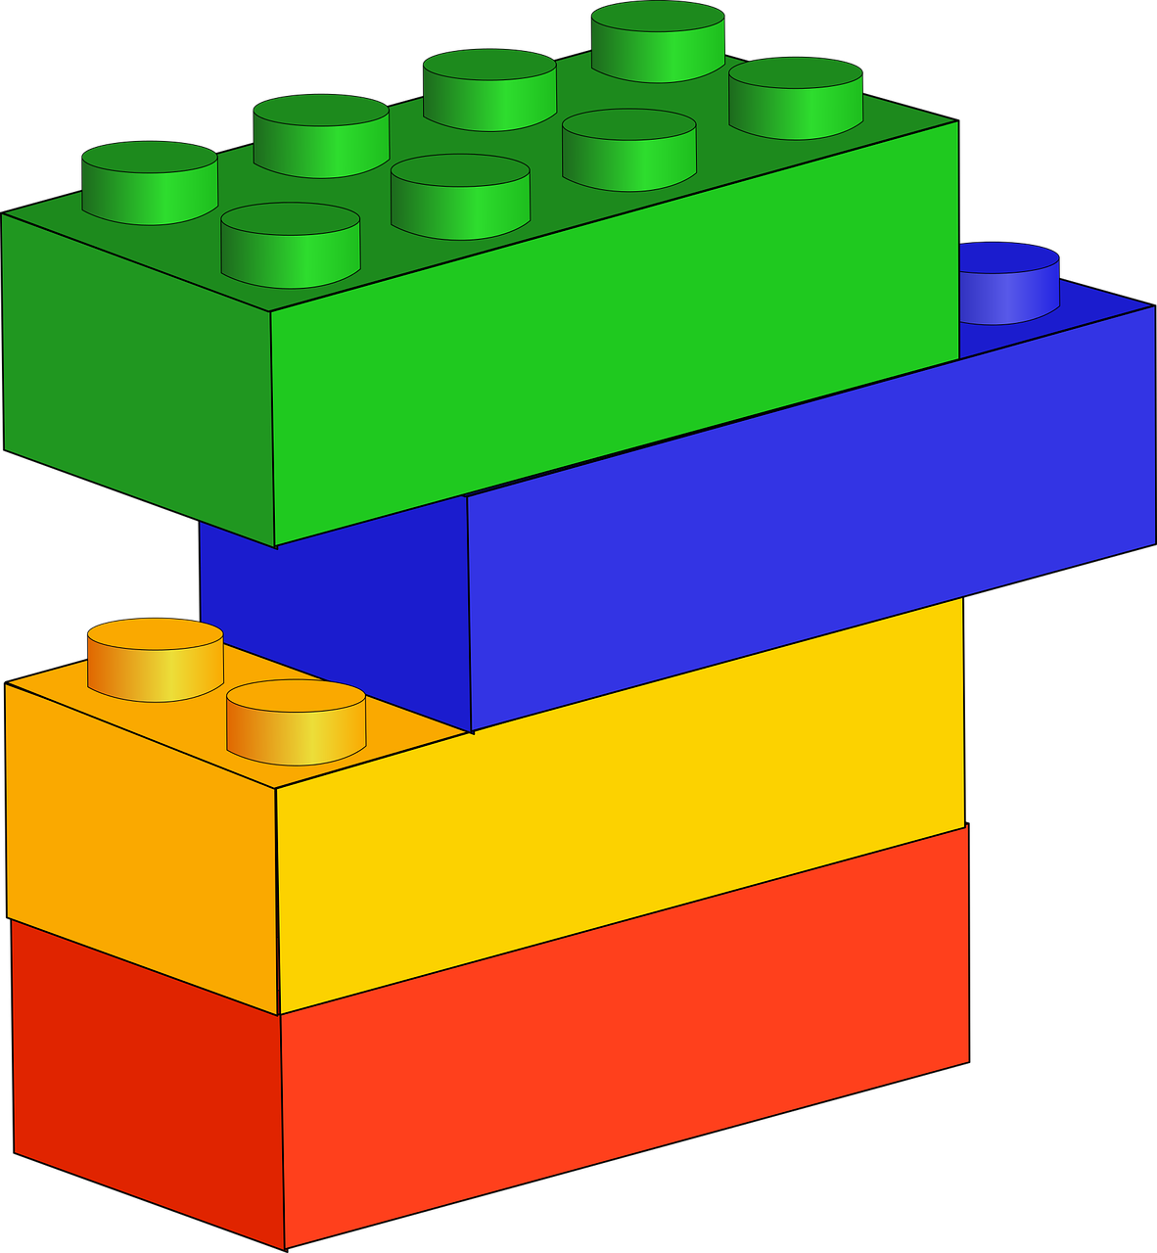
BUILDING BLOCKS OF THE STEPS PROGRAM
Parents become partners in providing intervention
SLP’s professional judgement determines enrollment and continuation in the STEPS Program
Data drives the STEPS Program decision-making process
Notes:
Parents play a critical role in all tiers of this model. In the initial stages when students are identified, SLPs consult with parents regarding their child’s delayed speech or language issues and provide appropriate materials and strategies for home intervention. Parents become partners in providing intervention as well as teachers.
The SLP's professional judgement will determine which students are good candidates for the STEPS Program and how best to meet their needs. Professional judgement is data-driven.

Slide 22
SERVING STUDENTS WITH COMMUNICATION DISORDERS
Special Education
IF the student’s communication disorder adversely impacts their educational performance – academic, social, and
vocational
Multi-step, pre-referral, early intervention program
General education initiative
Students who are “at risk”
Students whose communication disorder does not impact their educational performance
Notes:
Right now we are serving students with IEPs and our plates are full. As we move toward educational relevance, we are required to examine the Three-Prong Test of Eligibility. Some of the students on our caseload will no longer qualify for special education services because their communication disorder does not adversely impact their educational performance.
What about those students? We see the impairment but it is not educationally relevant. That’s where a multi-tiered, pre-referral, early intervention program can be helpful.

Slide 23
CHANGING THE WAY WE DO THINGS
“Traditional approaches to speech therapy often result in students being enrolled in programs for long periods of time without making significant progress. SLPs must dedicate significant time and maintain burdensome paperwork to navigate the special education process. A multi-leveled model allows SLPs to provide speech-language intervention within the general education environment with the educator, parent and the student prior to referral for special education."
(Speech-Language Pathology: Services in WV Schools – Guidance for West Virginia Schools and Districts, 2015)
Notes:
In 2015 the Speech-Language Pathology Services in West Virginia Schools Guidance document added “STEP Up to Speech” as an option for service delivery. Read slide. Please note that this has been in the guidance document since at least 2015.

Slide 24
DEFINING EARLY INTERVENTION SERVICES?
It’s more than a speech club but it’s not special education
No IEP
Counties and schools differ
SLPs differ in how they do their job…what works for one does not for another SLP
Notes:
How do you see school-based early intervention services? Do you see it as a Speech Club? Do you want it to be more defined? How prescriptive do you think it should be? We have provided training in several counties and we find that the counties and schools differ in how they see it working. And we have discovered that SLPs have different approaches to organization and scheduling. It is hard to find a system that works for everyone.

Slide 25
THE ETHICS OF PROVIDING SERVICES
Principals of Ethics I
Individuals shall honor their responsibility to hold paramount the welfare of persons they serve professionally…
H. Individuals shall obtain informed consent from the persons they serve …
Q. Individuals shall maintain timely records and accurately record and bill for services provided …
(ASHA Code of Ethics)
Notes:
According to the ASHA Code of Ethics, we must obtain informed consent and we must maintain timely records for any service provided. Our STEPS Program should have an ethical foundation.

Slide 26
PARENT PERMISSION
Even though this is a general education initiative, parents must be notified of recommended services and written permission MUST be obtained.
Notes:
Parent notification and written permission makes ethical sense and it protects you.

Slide 27
DOCUMENTATION
Strong documentation is critical for making sound decisions for
students.
As the saying goes, "If you didn't document it, you didn't do it.“
(Documentation in the Schools)
Notes:
We know the importance of documentation. We use it to determine how best to help our students. How you document your services is a matter of personal preference. However, it must include date, length of service and what was done. Some people tally their results every session. Others estimate progress and assess periodically. Because this is a general education initiative, we are not tied to Medicaid billing requirements or IEP constraints. However, we are ethically bound to document our services.

Slide 28
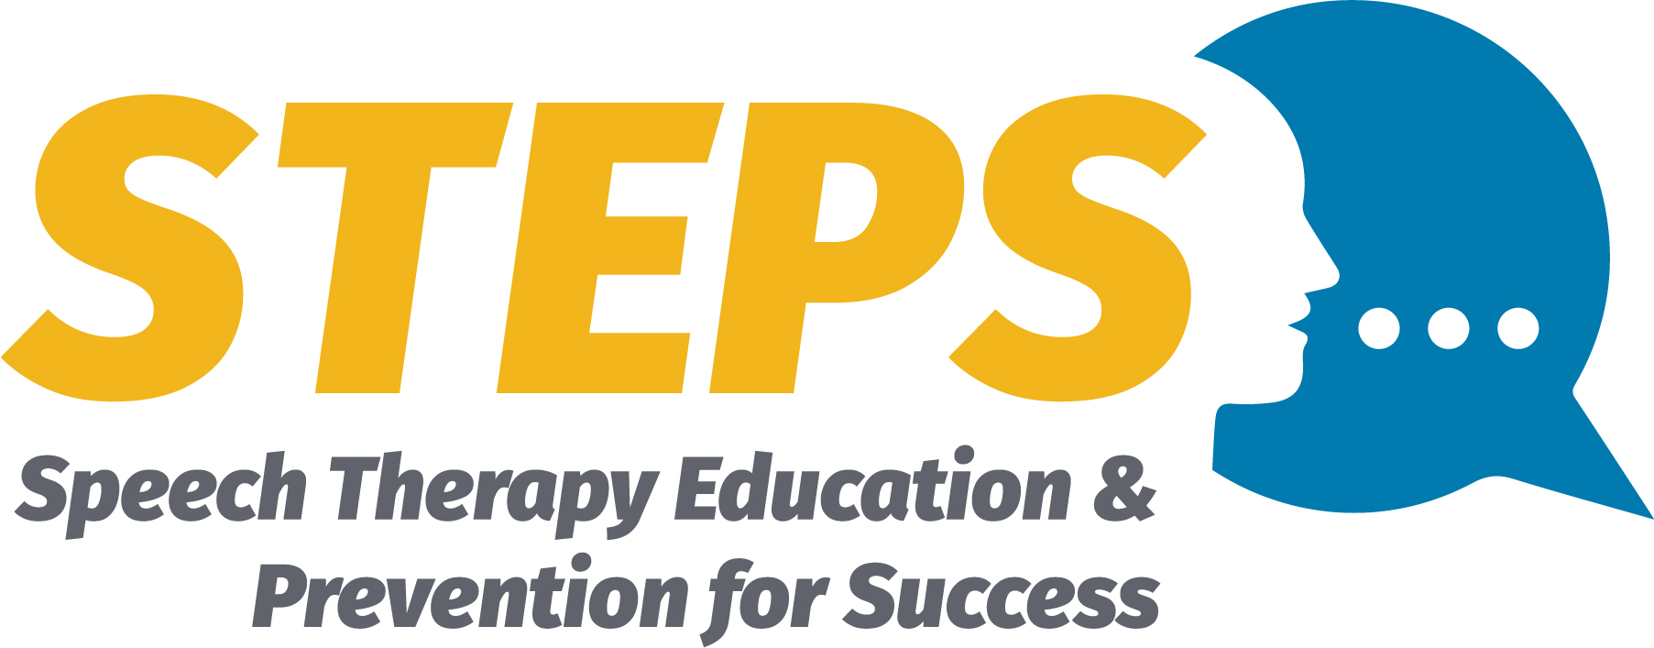
THE STEPS PROGRAM
Notes:
In this module I will provide an overview of the STEPS Program.

Slide 29
Speech
Therapy
Education – Presentations, SATs, Grade-Level Meetings, Information
Prevention – Consultation, Observation, Intervention, Monitoring
Success – Generalization to all settings

Slide 30
EDUCATION ACTIVITIES
Parent-Teacher Conferences
SAT Meetings
Participation in grade-level meetings
Handouts
Demonstrations in classrooms
Information on websites and apps
Presentations to families and staff
Consultations
Notes:
Education is an important part of the STEPS program. Education can be very broad, addressing common needs or it can be very specific to the student. I am sure many of you already do some of the activities…STEPS provides an opportunity to document them.

Slide 31
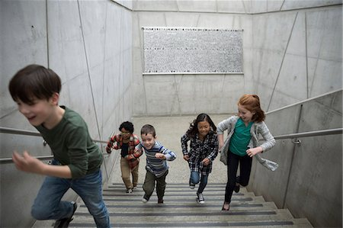
PREVENTION
A multi-step, pre-referral, early intervention program which provides speech and language assistance to students who are "at risk" but have not been identified or suspected as having a communication disability that impacts educational performance.
Notes:
STEPS is a useful tool for prevention .. is defined as (read slide)

Slide 32
PREVENTION ACTIVITIES
Observations of student
Consultations with parents and teachers regarding the targeted student
Sending home practice packets
Monitoring progress
Working directly with the student (Intervention)
Notes:
Prevention Activities can range from observations of the student and consultations with the parents and teacher (indirect activities) to direct intervention with the student. The beauty of the STEPS program is its flexibility allowing the Speech Language pathologist the opportunity to change the activities as needed based on data and professional judgement.

Slide 33
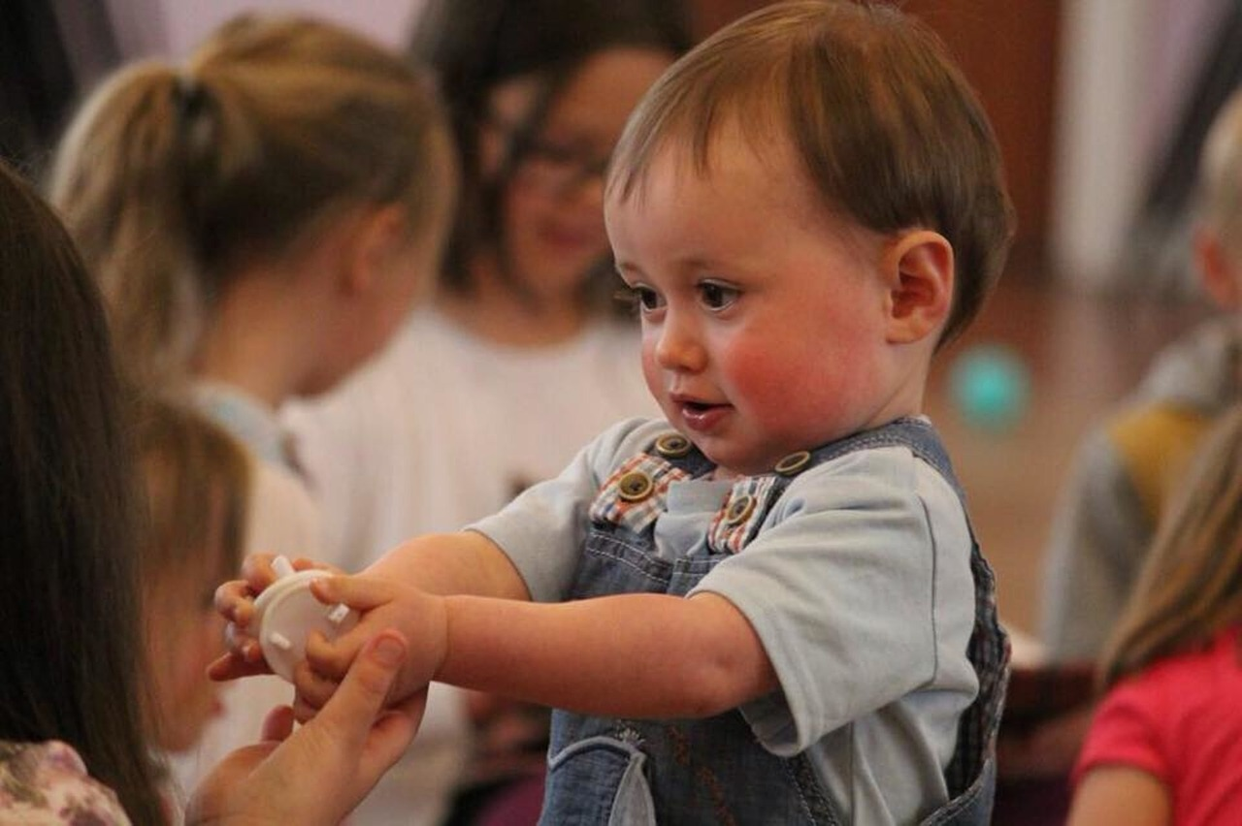
INTERVENTION
Can be one-on-one or small group (No students with IEP)
Can be in classroom or in therapy room
Can vary in length, intensity and location
Make-up sessions are not required
Decisions are based on professional judgement
Notes:
The STEPS Program students can be seen one-on-one or in a small group. However, they cannot be grouped with students who have an IEP. You can see them in the classroom or in your therapy room. Sessions can vary in length, frequency and location without having to schedule a meeting each time there are changes. Make up sessions are not required. As always, decisions are based on professional judgement.

Slide 34
SUCCESS!
Student has acquired the targeted speech/language skills in the therapy setting—STEPS Program or Speech Therapy (with IEP)
True success occurs when the student generalizes the acquired speech/language skills into the classroom and home settings.
Specialized instruction is not needed for generalization.
Notes:
Success is more than achieving 90% accuracy in the therapy setting. Our ultimate goal is generalization and carryover into all settings…true success.
While the speech-language pathologist should monitor and encourage the production of the targeted skills in all environments, their specialized knowledge and skills are no longer needed. It is up to the student, the family and the educational staff.

Slide 35
SUCCESS ACTIVITIES
Monitoring the student
Checking on generalization with parent(s) and teacher(s)
Working with the student, as needed, as a reminder of the targeted skill
Notes:
Once the SLP has provided instruction and the student has learned the targeted skill, the STEPS program will consist or monitoring the student, checking in with parents and teachers to see how generalization is going and working with the student, as needed, to provide a “tune up” or the targeted skill.

Slide 36
POSSIBLE CANDIDATES FOR STEPS PROGRAM
Students identified as “at risk” during speech and language screening but not being impacted academically
Students who are stimulable for age appropriate sound or language skill
Students with one or two developmental sound errors (mild articulation disorder)
Notes:
Feedback over the years from therapists utilizing the STEPS Program has resulted in a list of possible candidates. Your county may decide to include all of these options or start small with just a few candidate options.
The best use of the STEPS Program is for students who have a noticeable speech disorder but who will not be eligible for speech therapy because their academics are not impacted. They do fine in school but they still have a speech disorder that is noticeable to you especially.
A student who is stimulable for an age appropriate sound or language skill may just need a little assistance and they will get it. So time spent working with the student, as opposed to the time spent going through the Eligibility and IEP process may be time well spent. Have you ever referred a student for a developmental sound and by the time you get them in therapy they have corrected the sound?
The STEPS Program is for mild speech sound disorders…one or two errors. By no means should you wait to refer students who have phonological disorders or multiple sound errors. They will be eligible and should be referred immediately.

Slide 37
POSSIBLE CANDIDATES FOR STEPS PROGRAM
English Learners (EL)
Students who have not been exposed to language rich or structured environments and who would benefit from exposure to preschool activities
Students with mild, inconsistent dysfluencies
Students with mild, developmentally inappropriate social skills
Notes:
English learners can be eligible for services, IF they have a speech and/or language disorder in BOTH languages. Determining this will take some time. Observations and dynamic assessments reveal how easily the student learns a new skill, compared to other EL peers.
Some students will score poorly on standardized tests for preschool. However, exposure to preschool with its language rich opportunities and structure may be all they need. The SLP may choose to target these students in the STEPS Program and provide assistance within the routines of the preschool classroom, where skills are best observed and consistent repetitions can occur.
Some students have mild and/or inconsistent dysfluencies. They would not qualify for special education services but still consultations with parents and monitoring.
Some students have mild socially inappropriate behaviors but they do not have a pragmatic language disorder (as determined by eligibility guidelines) They just may need instruction on how to act in certain social or academic situations.

Slide 38
ADDITIONAL CANDIDATES FOR STEPS PROGRAM
Students who participated in specialized instruction, speech therapy with an IEP, acquired the targeted skills in the therapy setting, and are working on generalization of the skill into other settings.
Notes:
A valuable aspect of the STEPS program is its use with students who are dismissed from speech therapy (with an IEP). After the student has acquired the targeted skills in the therapy program, generalization into all settings becomes the goal. The specialized skills of the SLP are no longer needed. The STEPS program can be useful in monitoring carryover and providing “tune ups” as needed.

Slide 39
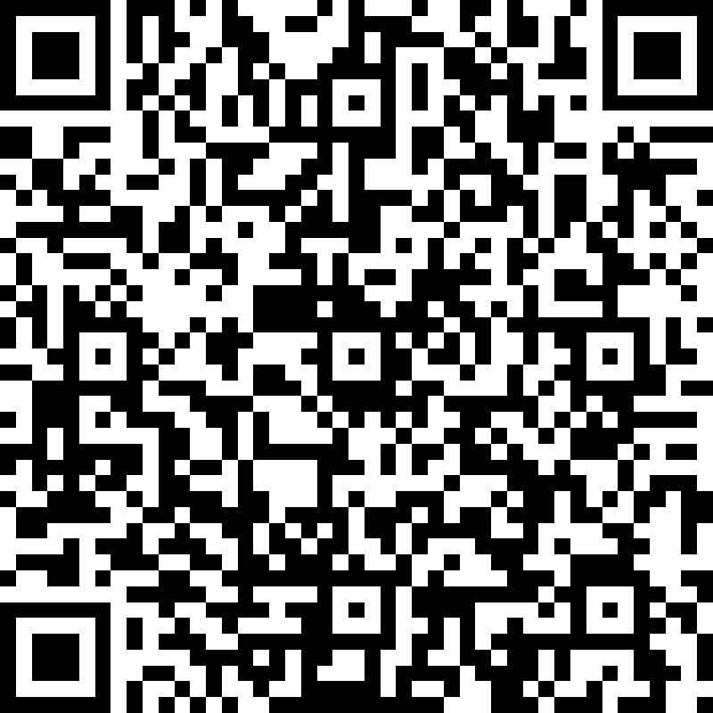
CANDIDATES FOR STEPS
https://forms.office.com/Pages/ResponsePage.aspx?id=S7AZ4AwzekaLrgn7FzdNauAx5Spzz1JIn8hyCYy54ptUMkdOU0xSR1lWQ1VFSTRURlRLUFdETUZHVy4u

Slide 40
PROFESSIONAL JUDGEMENT
Education
Review
Prevention
Success!
Notes:
Decisions about next steps is based on professional judgement which is based on data. The importance of a periodic assessments and review can not be overemphasized. And of course parent and teacher input is in valuable.

Slide 41
NEXT STEPS AFTER REVIEW
Progressing
Continue in STEPS
Mastery
Discontinue STEPS
Not Progressing
Look at therapy
Refer or Other Options
Notes:
Upon assessment the speech-language pathologist makes a decision about next steps. The options are progressing, mastery and not progressing.

Slide 42
DOCUMENTATION FOR STEPS
STEPS Brochure
Screening Log
Parent Information and Permission
Students Enrolled in STEPS Program
Activities Form
Dismissal Letter
Notes:
Documentation is crucial for the success of the STEPS program. We have developed forms which you may find useful. Feel free to adapt the wording to better meet your specific needs and the requirements of your County. The important thins is that there is consistency with you county on documentation. We will review …

Slide 43
DOCUMENTATION
https://wvde.us/special-education/resources-sp-page/speech-language-impairment/
WVDE Teaching and Learning Special Education
Exceptionalities Speech-Language Impaired
Documents

Slide 44
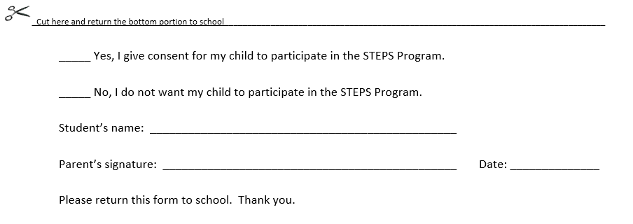
PARENT PERMISSION SECTION
Notes:
There is a place for written permission from the parent. You will notice that the permission is for all the steps activities. In this way you can move back and forth, based on what the student needs.

Slide 45
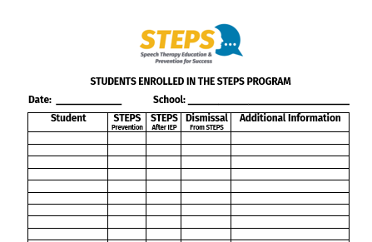
DOCUMENTATION OF STUDENTS
Notes:
Documentation of the students you serve through STEPS is crucial. This is a summary of the students you serve who are not on your caseload. This information supports your possible reduction in caseload and/or justifies your workload. Some lead therapists or administrators request copies of this documentation.

Slide 46
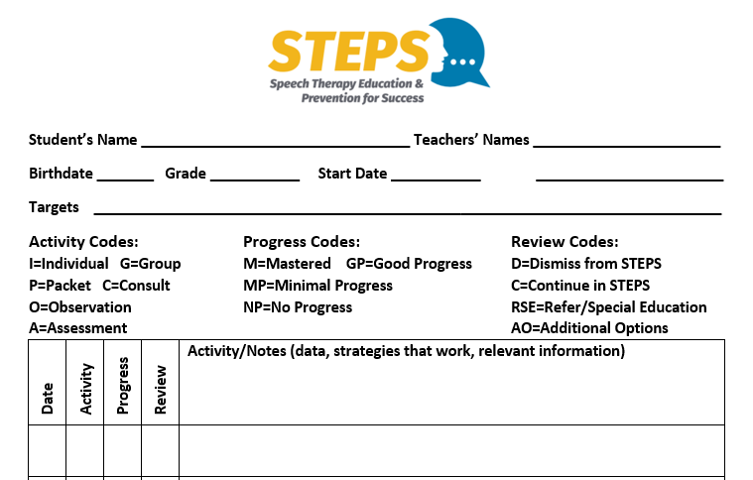
STEPS ACTIVITIES FORM
Notes:
We have attempted to make this form as functional and all inclusive as possible.

Slide 47
CODES
Notes:
The Activity Codes that could be used are ……. And they go in this column.

Slide 48
SUMMARY
Notes:
At the bottom of the page is a place for summarizing information about the student’s participation in the STEPS program. This would be useful when the student’s participation in the STEPS program changes. For example, he moves to a different county or school. Or the STEPS program is discontinued because the students has mastered the targeted skills. In other words, it is an explanation of the discontinuation of STEPS by the present therapist, and summarizes the student’s progress.

Slide 49
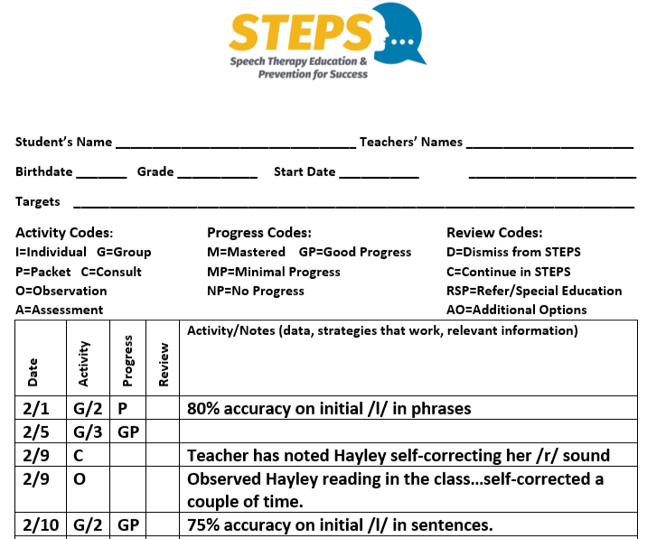
EXAMPLE
Notes:
This is an example of a completed form. At a glance you can see when the student participated in a activity, the type of activity and the student’s progress. You can easily see when the student was assessed and when a review of the STEPS program took place. You can see all of this without having to look in the notes to find the relevant details
The form is a Word Document so it can be adapted to meet your needs. You may not want to include the codes but rather have more room for notes. But in the notes make sure you indicate the type of activity, documentation of progress, assessment results and that there is a clear way to indicate periodic reviews.

Slide 50
STEPS ACTIVITIES FORM
Notes:
The form is a Word Document so it can be adapted to meet your needs. You may not want to include the codes but rather have more room for notes. But in the notes make sure you indicate the type of activity, documentation of progress, assessment results and that there is a clear way to indicate periodic reviews. Each county should be consistent in the documentation they keep.

Slide 51
SURVEY
Must be completed within 10 minutes of this session.
Remember this is how your attendance is documented.
https://forms.office.com/Pages/ResponsePage.aspx?id=S7AZ4AwzekaLrgn7FzdNapE-Oszzk9RJgS7C6cljCXdUMVc3VUoyS1cxMDRGWVZRMTMzMkJaTVU5MC4u

Slide 52
COMPLETE THIS FOR EACH SESSION YOU ATTEND

Slide 53
CONTACT INFORMATION
Notes:
For more information contact Lee Ann Brammer, Coordinator, Speech-Language Impaired

Slide 54
REFERENCES
ASHA - Roles and Responsibilities of Speech Pathologists in Schools, (2010). https://www.asha.org/policy/PI2010-00317
DuFour, R., DuFour, R., Eaker, R., & Karhanek, G. (2004). Whatever it Takes: How Professional Learning Communities Respond When Kids Don’t Learn. Bloomington, IN: Solution Tree.
Ehren, B. J., Montgomery, J., Rudebusch, J., & Whitmire, K. (2006). Responsiveness to Intervention: New Roles for Speech-Language Pathologists. American Speech-Language-Hearing Association. Retrieved from www.asha.org/members/slp/schools/proconsult/NewRolesSLP

Slide 55
REFERENCES
Ehren, B. & Staskowski, M. (2011). Speech-Language Pathologists and RTI. RTI Action Network Talk transcript. http://www.rtinetwork.org/professional/rti-talks/transcript/talk/31
Hurst, S. (2006). What is the Difference between RTI and MTSS? Reading Horizons Blog. https://www.readinghorizons.com/blog/what-is-the-difference-between-rti-and-mtss.
Mills, W.D. (2005). Response to Intervention and instructional consultation teams: The SLP’s Role (Slide no. 48, 98-102). Seminar presented at the ASHA Annual Convention, San Diego, CA.

Slide 56
REFERENCES
Montgomery, J., & Moore, B. (2017). Making a Difference for American's Children: Speech-Language Pathologists in Public Schools (2nd ed.). Greenville, SC: Super Duper Publications.
Speech-Language Pathology: Services in WV Schools – Guidance for West Virginia Schools and Districts (2015).
Kanawha County Schools Pilot STEPS Program (2012-2013).

