Slide 1

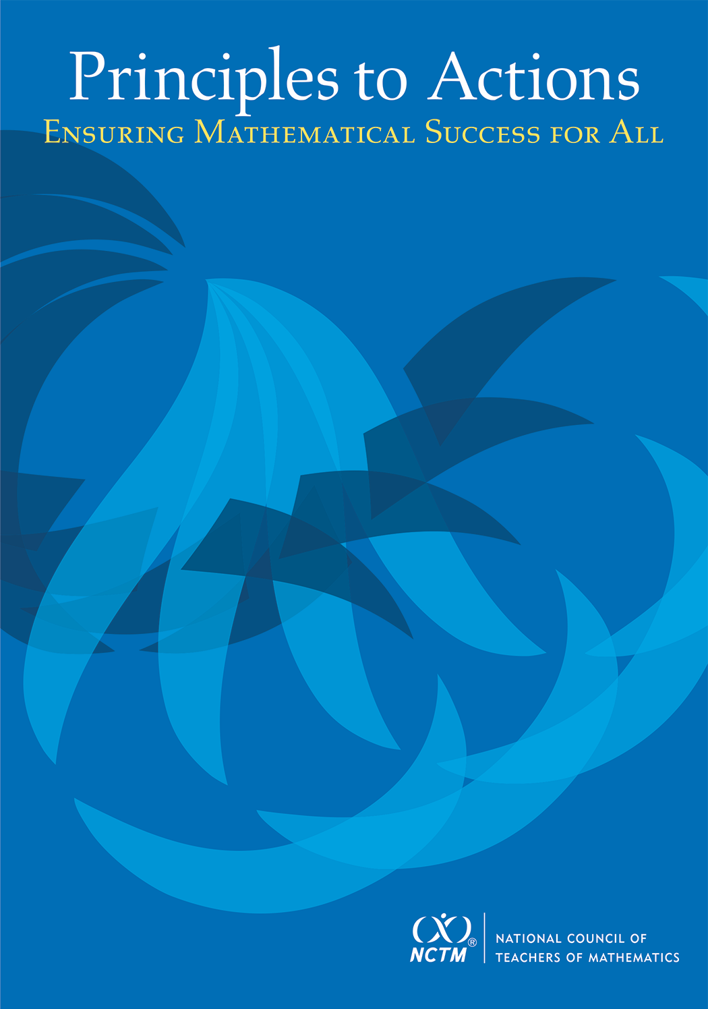
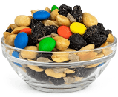
Principles to Actions:
Effective Mathematical
Teaching Practices
  Create Your Own Trail Mix:
  A WV Classroom
  Video Experience
  Grade 9
Notes:
Facilitator should welcome participants and introduce him/herself to the audience.

Slide 2

PLEASE STAND UP IF:
Notes:
https://www.freeimages.com/search/that-me/3
Warm-up Activity:
Ask participants to stand if:
If you love (summer, winter, spring, fall - select current season)
If you love mathematics
If you love teaching students
If you are standing – this workshop if for YOU!
Share with participants that this session will provide valuable insights for all – regardless of assigned grade level assignment!

Slide 3
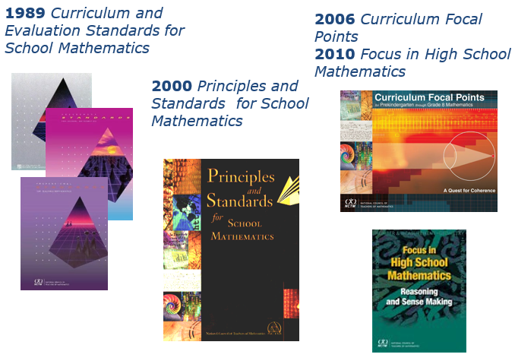
A 25-year History of Standards-Based Mathematics Education Reform
Notes:
Source: NCTM www.nctm.org
Review what has happened in the reform of mathematics education in the US:
1989: Curriculum and Evaluation Standards for School Mathematics
In 1989, the National Council of Teachers of Mathematics (NCTM) released a document of major importance for improving the quality of mathematics education in grades K-12. This document, "Curriculum and Evaluation Standards for
School Mathematics," contains a set of standards for judging mathematics curricula and for evaluating the quality of the curriculum and student achievement. It represents the consensus of NCTM's members about the fundamental
content that should be included in the school mathematics curriculum, establishing a framework to guide reform in school mathematics. Inherent in the STANDARDS is the belief that all students need to learn more, and often different,
mathematics
2000 Principles and Standards for School
A comprehensive and coherent set of mathematics standards for each and every student from prekindergarten through grade 12, Principles and Standards is the first set of rigorous, college and career readiness standards for the 21st
century. Principles and Standards for School Mathematics outlines the essential components of a high-quality school mathematics program. It emphasizes the need for well-prepared and well-supported teachers and administrators, and it
acknowledges the importance of a carefully organized system for assessing students’ learning and a program’s effectiveness. Principles and Standards calls for all partners—students, teachers, administrators, community leaders, and
parents—to contribute to building a high-quality mathematics program for each and every student.
2006 Curriculum Focal Points
Curriculum Focal Points are the most important mathematical topics for each grade level. They comprise related ideas, concepts, skills, and procedures that form the foundation for understanding and using mathematics and lasting
learning. Curriculum Focal Points have been integral in the revision of many state math standards for Pre-K through grade 8.
2010 Focus in High School Mathematics
Focus in High School Mathematics: Reasoning and Sense Making is a conceptual framework to guide the development of future publications and tools related to grades 9–12 mathematics curriculum and instruction. It suggests practical
changes to the high school mathematics curriculum to refocus learning on reasoning and sense making. This shift constitutes a substantial rethinking of the high school math curriculum, advocating for more and better mathematics.

Slide 4
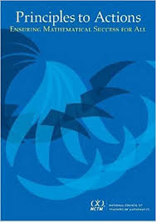
A 25-year History of Standards-Based Mathematics Education Reform
2014 Principles to Actions: Ensuring
Mathematical Success for All
The overarching message of
Principles to Actions is that
effective teaching is the non-
negotiable core necessary to
ensure that all students learn
mathematics.
Notes:
Source: NCTM (www.nctm.org/principlestoactions)
Continuing its tradition of mathematics education leadership, NCTM has defined and described the principles and actions, including specific teaching practices, that are essential for a high-quality mathematics education for all students.

Slide 5
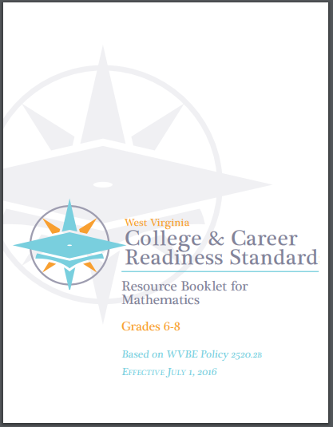
WV College- and Career-Readiness Standards for Mathematics (2016)
The West Virginia College- and Career-Readiness Standards for Mathematics define what students should understand and be able to do in their study of mathematics. However, the Standards do not describe or prescribe the essential conditions required to make sure mathematics works for all students.
Notes:
The development of the standards began with research-based learning progressions detailing what is known today about how students’ mathematical knowledge, skill, and understanding develop over time. The knowledge and skills students need to be prepared for mathematics in college, career, and life are woven throughout the mathematics standards. However, the Standards do not describe or prescribe the teacher practices or actions that will ensure all students will be successful and mathematically literate.

Slide 6
Although We Have Made Progress, Challenges Remain
The average mathematics NAEP score for eighth grade students has been essentially flat since 2009.
Among 79 countries participating in the 2018 Programme for International Student Assessment (PISA) of 15-year-olds, the U.S. ranked 37th in mathematics.
Significant learning differentials remain.
Notes:
Standards have contributed to higher achievement but challenges remain.
In 2019, the National Assessment of Educational Progress (NAEP) mathematics assessment was administered to representative samples of fourth- and eighth-grade students in the nation, states, the District of Columbia, Department of Defense schools, and 27 participating large urban districts. The assessment was delivered on digital devices and assessed students' knowledge and skills in mathematics and their ability to solve problems in mathematical and real-world contexts. Students also answered survey questions asking about their opportunities to learn about and engage in mathematics inside and outside of school.
Mathematical performance, for PISA, measures the mathematical literacy of a 15 year-old student to formulate, employ and interpret mathematics in a variety of contexts to describe, predict and explain phenomena, recognizing the role that mathematics plays in the world. The mean score is the measure. A mathematically literate student recognizes the role that mathematics plays in the world in order to make well-founded judgments and decisions needed by constructive, engaged and reflective citizens.
2019 NAEP: Lower-, middle-, and higher-performing students at grades 4 and 8 made gains compared to the early 1990s and 2000; no significant progress was made at both grades for lower-performing students compared to a decade ago.

Slide 7
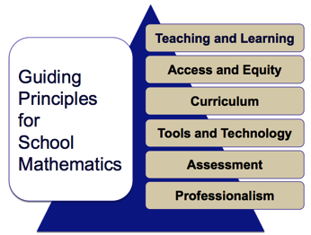
Teaching and Learning Principle
Principles to Actions (NCTM, 2014, p.7)
“An excellent mathematics program requires effective teaching that engages students in meaningful learning through individual and collaborative experiences that promote their ability to make sense of mathematical ideas and reason mathematically.”
Notes:
Source: NCTM Principles to Actions (www.nctm.org/principlestoactions)
Summarize the Teaching and Learning Principle, noting the strong emphasis on promoting students’ ability to make sense of mathematical ideas and to reason mathematically. Ask the participants to keep this Principle in mind throughout the session and in particular as they watch the WV Classroom Video.

Slide 8
Beliefs About Teaching and Learning Mathematics - Activity
DIRECTIONS
In a group or with a partner:
Open the packet and remove the cards.
Find the header cards: Productive and Unproductive. Place these cards on the table.
Each of the remaining cards identifies a belief about teaching and learning. Read each of the belief cards.
Identify which belief cards are Productive and which belief cards are Unproductive.
Place each belief card under the header card to which it was matched.
Be prepared to defend your decisions.
Notes:
Prior to the workshop and based on the expected number of participants, prepare packets of the Beliefs About Teaching and Learning Mathematics cards. Cut the cards apart, shuffle the cards and place them in an envelope. Each pair or group of participants will need one packet of cards. Also, prepare a packet of cards for you to use during the discussion of the activity.
During the activity, circulate among the pairs or groups of participants as they work to sort the belief cards.
After all pairs or groups have completed the sorting task, ask the participants if there were any belief cards they found difficult to classify as either Productive or Unproductive. Ask why they found it difficult to assign the belief card to a category.
Select a belief card from your packet and read the card to the participants. Ask the participants how they classified the belief and why. Repeat selecting cards and engaging the participants until 3 to 5 cards have been discussed. Be sure to select both Productive and Unproductive beliefs.
At the end of the discussion, move to the next slide so that participants may see the correct sorting.
Source: Principles to Actions, Ensuring Mathematical Success for All, (NCTM, 2014) pg. 11.

Slide 9
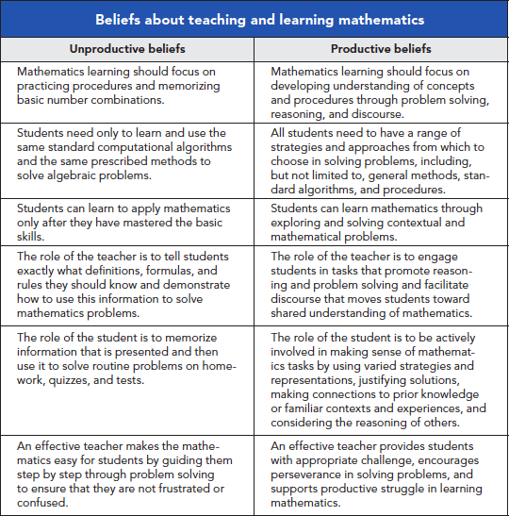
Notes:
Source: Principles to Actions, Ensuring Mathematical Success for All, (NCTM, 2014) pg. 11.

Slide 10
We Must Focus on Instruction
Student learning of mathematics “depends fundamentally on what happens inside the classroom as teachers and learners interact over the curriculum.”
(Ball & Forzani, 2011)
Teaching has 6 to 10 times as much impact on achievement as all other factors combined…Just three years of effective teaching accounts on average for an improvement of 35 to 50 percentile points.”
(Schmoker , 2005)
Notes:
Source: NCTM Principles to Action (www.nctm.org/principlestoactions)

Slide 11
Effective Mathematics Teaching
Practices
Establish mathematics goals to focus learning.
Implement tasks that promote reasoning and problem solving.
3. Use and connect mathematical representations.
Facilitate meaningful mathematical discourse.
Pose purposeful questions.
Build procedural fluency from conceptual understanding.
Support productive struggle in learning mathematics.
Elicit and use evidence of student thinking.
Notes:
Source: NCTM Principles to Actions (www.nctm.org/principlestoactions)
These are the practices at the heart of the work of teaching. According to the research of D. Ball and F.M. Forzani they are the practices that are most likely to affect student learning. Give participants a few minutes to review the list of the eight, research-based, Mathematics Teaching Practices identified by NCTM as highly effective for student learning of mathematics.
Ask the participants to identify the most significant noun within each of the eight practices.
1. Establish mathematics goals to focus learning.
2. Implement tasks that promote reasoning and problem solving.
3. Use and connect mathematical representations
4. Facilitate meaningful mathematical discourse.
5. Pose purposeful questions.
6. Build procedural fluency from conceptual understanding.
7. Support productive struggle in learning mathematics.
8. Elicit and use evidence of student thinking.

Slide 12
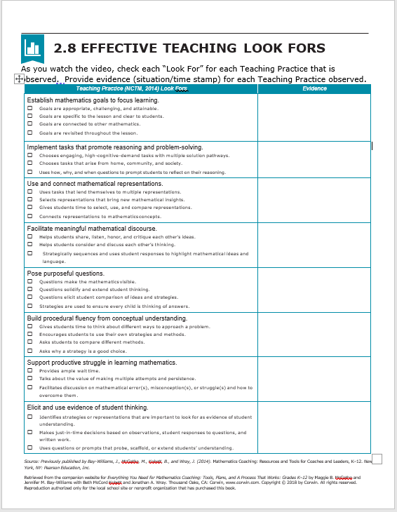
Effective Mathematics Teaching
Practices Look Fors
Notes:
Source: Creating a Road Map, Corwin Publishing https://us.corwin.com/sites/default/files/upm-binaries/92312_Chapter_2__Implementing_Effective_Teaching.pdf
Give each participant the handout, Effective Teaching Look Fors.
Discuss the “Look Fors” for each Teaching Practice. Make sure all participants have the same understanding of what each “Look For.”

Slide 13
WV Classroom Video – Create Your Own Trail Mix Overview
Students generate a mathematical model of a system of inequalities in two variables with a familiar product – trail mix.
Upon successful task completion, students will:
  Interpret inequalities and graphs
  Choose variables, specify constraints, and write inequalities to create a mathematical model of a situation – creating their own trail mix
Notes:
Explain to the participants that they are about to view video clips featuring a WV teacher and her students.
Describe the Create Your Own Trail Mix math activity

Slide 14

A Closer Look
Effective Mathematics
Teaching Practice:
Establish Mathematics Goals
to Focus Learning

Slide 15
Establish Mathematics Goals to Focus Learning
Learning Goals should:
Clearly state what it is students are to learn and understand about mathematics as the result of instruction.
Be situated within learning progressions.
Frame the decisions that teachers make during a lesson.
Notes:
Source: Principles to Action: Ensuring Mathematical Success for All, NCTM , 2014, p. 12.
One of the research-based, teaching practices identified by NCTM is the importance of establishing clear mathematics goals to focus student learning and to guide teacher decisions. The mathematical purpose of a lesson should not be a mystery to students. Classrooms in which students understand the learning expectations for their work perform at higher levels than classrooms where the expectations are unclear (Haystead and Marzano 2009; Hattie 2009). Although daily goals need not be posted, it is important that students understand the mathematical purpose of a lesson and how the activities contribute to and support their mathematics learning. Goals or essential questions motivate learning when students perceive the goals as challenging but attainable (Marzano 2003; McTighe and Wiggins 2013). Teachers can discuss student-friendly versions of the mathematics goals as appropriate during the lesson so that students see value in and understand the purpose of their work (Black and Wiliam 1998a; Marzano 2009). When teachers refer to the goals during instruction, students become more focused and better able to perform self-assessment and monitor their own learning (Clarke, Timperley, and Hattie 2004; Zimmerman 2001).

Slide 16
Establish Mathematics Goals to Focus Learning
Formulating clear, explicit learning goals sets the stage for everything else.
(Hiebert, Morris, Berk & Janssen, 2007)
Notes:
Source: Principles to Action: Ensuring Mathematical Success for All, NCTM , 2014, p. 12.

Slide 17
WATCH VIDEO
NCTM Principles to Action:
Establish Mathematics Goals
to Focus Learning
Video
Notes:
Source: YouTube
https://www.youtube.com/watch?v=EcZBUFqFLxc

Slide 18


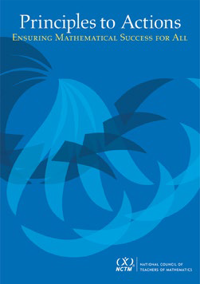
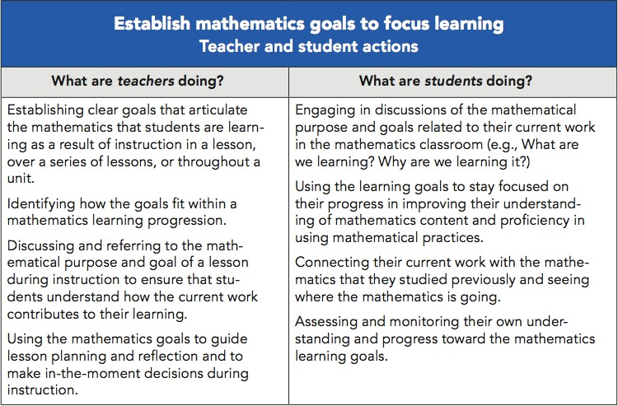
Establish Mathematics Goals to Focus Learning
Notes:
Source: Principles to Action: Ensuring Mathematical Success for All, NCTM , 2014, p. 16.
Compare the actions of teachers versus the actions of students when establishing mathematics goals to focus learning.
Ask the participants if they believe the teacher actions above are routine in their schools. If yes, ask how they know. If no, ask what is needed for the teacher actions above to become routine in their school.

Slide 19
Create Your Own Trail Mix Lesson Alignment to the West Virginia College- and Career-Readiness (WVCCR) Standards
M.1HS.7 / M.A1HS.7
Represent constraints by equations or inequalities, and by systems of equations and/or inequalities, and interpret solutions as viable or non-viable options in a modeling context. (e.g., Represent inequalities describing nutritional and cost constraints on combinations of different foods.) Instructional Note: Limit to linear equations and inequalities.
M.1HS.11 / M.A1HS.17
Graph the solutions to a linear inequality in two variables as a half-plane (excluding the boundary in the case of a strict inequality) and graph the solution set to a system of linear inequalities in two variables as the intersection of the corresponding half-planes.
M.1HS.2 / M.A1HS.2
Define appropriate quantities for the purpose of descriptive modeling. Instructional Note: Working with quantities and the relationships between them provides grounding for work with expressions, equations and functions.

Slide 20
WV Classroom Video – Create Your Own Trail Mix
Goals to focus learning should be written in student-friendly language
Upon successful completion, students will be able to:
Define the constraints in a situation
Create a mathematical model, presented in inequalities and graphs, that represents a situation
Notes:
Goals for the Illustrative Mathematics Create Your Own Trail Mix lesson. Please refer to the Create Your Own Trail Mix Task Guide for additional information.

Slide 21
Establish Mathematics Goals to Focus Learning
Why is it important to establish math expectations for student learning?
In what ways will the math goals focus the teacher’s interactions with students throughout the lesson?
Notes:
THINK, PAIR AND SHARE
Ask participants to respond to the questions on the PowerPoint slide
These will be general responses based on the participants’ experiences and pedagogical knowledge.

Slide 22
A Closer Look
Effective Mathematics
Teaching Practice:
Implement Tasks That Promote Reasoning and Problem Solving

Slide 23
Implement Tasks That Promote Reasoning and Problem Solving
Mathematical tasks should:
Provide opportunities for students to engage in exploration or encourage students to use procedures in ways that are connected to understanding concepts
Build on students’ current understanding and experiences
Have multiple entry points
Allow for varied solution strategies
Notes:
Source: Principles to Action: Ensuring Mathematical Success for All, NCTM , 2014, p. 17.
There is no decision that teachers make that has a greater impact on students’ opportunities to learn and on their perceptions about what mathematics is than the selection or creation of the tasks with which the teacher engages students in studying mathematics.
Tasks should provide opportunities for students to think and make sense of mathematics.
Having multiple entry points is very important because of the impact on equity. If students can make a table, create a drawing, or use manipulatives, the math becomes more accessible to students who might not immediately know how to solve the problem.

Slide 24
Why Are Tasks So Important?
Mathematical tasks :
Represent the meat of instruction
Are how we engage students and support the development of mathematical understanding
Connect learning goals to the actual classroom opportunity to learn
Use procedures to get answers to simple problems BUT are opportunities to develop deeper and broader understanding and application of mathematics
Notes:
Source: Principles to Action: Ensuring Mathematical Success for All, NCTM , 2014, p. 17.
Tasks should provide opportunities for students to make sense of mathematics. Rich mathematical tasks engage students in sense-making through deeper learning that require high levels of thinking, reasoning, and problem solving.
.

Slide 25
What Makes a GOOD Task?
GOOD Mathematical Tasks Are:
Accessible – Have clear directions and multiple entry points
Fair – All students can complete the task
Reasonable – Not too complex and have familiar context
Aligned – Matches standards and current learning goals
Comprehensive – Integrate key understandings and big enough bang for the time commitment
Engaging – Use graphics and have an intriguing or familiar context
Divergent – Have multiple pathways to solve
Notes:
Source: Principles to Action: Ensuring Mathematical Success for All, NCTM , 2014, p. 18.
THINK,PAIR AND SHARE:
Ask participants if the math tasks provided in students’ texts have all the characteristics of a GOOD math task.
If NO, discuss what traits are usually missing in textbook provided math tasks.
Ask participants to share how they find GOOD math tasks (outside of the adopted textbook) for their students.

Slide 26
Implement Tasks That Promote Reasoning and Problem Solving
In what ways can the implementation of a task allow for multiple entry points and engage students in reasoning and problem solving?
Notes:
Mathematical tasks are central to the learning of mathematics. For example, they can “provide the stimulus for students to think about particular concepts and procedures, their connections with other mathematical ideas, and their applications to real-world contexts” (National Council of Teachers of Mathematics (NCTM), 1991).
However, mathematical tasks have no life of their own as a tool for learning. It is the teacher and students who give them life based on how they are interpreted and enacted in the classroom.
THINK, PAIR AND SHARE
Ask participants to respond to the question.
These will be general responses based on the participants’ experiences and pedagogical knowledge.

Slide 27
A Closer Look
Effective Mathematics
Teaching Practice:
Use and Connect
Mathematical Representations
Notes:
In mathematics education, a representation is a way of encoding an idea or a relationship, and can be both internal (e.g., mental construct) and external (e.g., graph). Thus multiple representations are ways to symbolize, to describe and to refer to the same mathematical entity. The use of multiple representations supports and requires tasks that involve decision-making and other problem-solving skills The choice of which representation to use, the task of making representations given other representations, and the understanding of how changes in one representation affect others are examples of such mathematically sophisticated activities.
Source: https://en.wikipedia.org/wiki/Multiple_representations_(mathematics_education)

Slide 28
Use and Connect Mathematical Representations
Because of the abstract nature of mathematics, people have access to mathematical ideas only through the representations of those ideas.
(National Research Council, 2001, p.94)
Notes:
Source: Principles to Action: Ensuring Mathematical Success for All, NCTM, 2014, p. 24
Ask participants what is meant by representations of mathematical ideas.

Slide 29
Use and Connect Mathematical Representations
Representations embody critical features of mathematical constructs and actions, such as drawing pictures, creating tables, or using manipulatives to show and explain mathematical understanding. When students learn to represent, discuss, and make connections among mathematical ideas in multiple forms, they demonstrate enhanced problem-solving ability.
Notes:
Source: Principles to Action: Ensuring Mathematical Success for All, NCTM, 2014, p. 24

Slide 30
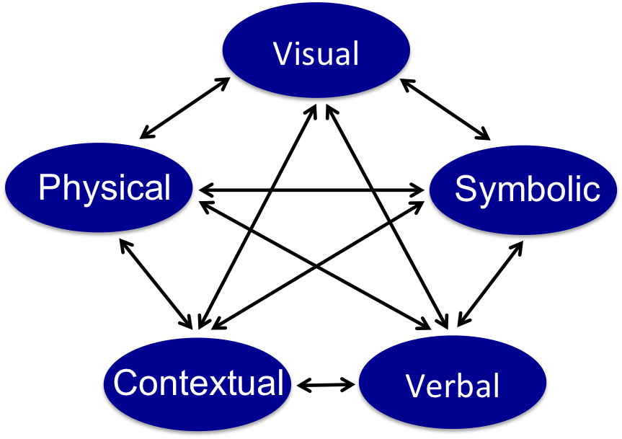
Different Types of Mathematical Representations
Notes:
Source: Principles to Action: Ensuring Mathematical Success for All, NCTM, 2014, p. 25
Engage participants in a discussion of the graphic. Some probing questions you might ask include:
What is the distinction between physical and visual representations?
Describe some physical representations that might support students’ thinking.
Describe some visual representations you would expect students to produce.
In the diagram, why do the arrows go both ways?
The point is not for students to use different representations just for the sake of it. What’s crucial is that students are using/connecting representations as TOOLS to solve problems and to build understanding of concepts. The depth of understanding is related to the strength of connections among mathematical representations that students have internalized (Pape and Tchoshanov 2001; Webb, Boswinkel, and Dekker 2008). For example, students develop understanding of the meaning of the fraction 7/4 (symbolic form) when they can see it as the quantity formed by “7 parts of size one-fourth” with a tape diagram or on a number line (visual form), or measure a string that has a length of 7-fourths yards (physical form).

Slide 31
Use and Connect Mathematical Representations
Teachers should:
Allocate instructional time for students to use, discuss, and make connections among representations
Encourage students to explain, elaborate or clarify their thinking
Ask students to use pictures to explain and justify their reasoning
Notes:
Source: Principles to Action: Ensuring Mathematical Success for All, NCTM, 2014, p. 25

Slide 32
Rich Mathematical Task Rubric – Representations and Connections
TASK LEVEL | DESCRIPTION OF USE AND CONNECTION OF REPRESENTTIONS
ADVANCED | Uses representations to analyze relationships and extend thinking Uses mathematical connections to extend the solution to other mathematics or to deepen understanding
PROFICIENT | Uses a representation or multiple representations to explore and model the problem Makes a mathematical connection that is relevant to the context of the problem
DEVELOPING | Uses an incomplete or limited representation to model the problem Makes a partial mathematical connection or the connection is not relevant to the context of the problem
EMERGING | Uses no representation or uses a representation that does not model the problem Makes no mathematical connections
Notes:
Source: Virginia Department of Education Mathematics Institutes 2019 Professional Development Resources
http://www.doe.virginia.gov/instruction/mathematics/professional_development/institutes/2019/index.shtml
Provide participants with a copy of the Rich Mathematical Task Rubric. Allow time for participants to read the rubric.
Discuss the Task Levels and the Descriptions for Representations and Connections.

Slide 33
Use and Connect Mathematical Representations
How can teachers support students in making connections between and within different types of representations?
Notes:
In mathematics education, a representation is a way of encoding an idea or a relationship, and can be both internal (e.g., mental construct) and external (e.g., graph). Thus multiple representations are ways to symbolize, to describe and to refer to the same mathematical entity. The use of multiple representations supports and requires tasks that involve decision-making and other problem-solving skills The choice of which representation to use, the task of making representations given other representations, and the understanding of how changes in one representation affect others are examples of such mathematically sophisticated activities. Source: https://en.wikipedia.org/wiki/Multiple_representations_(mathematics_education)
THINK, PAIR AND SHARE
In pairs, ask participants to respond to the questions.
These will be general responses based on the participants’ experiences and pedagogical knowledge.

Slide 34
A Closer Look
Effective Mathematics
Teaching Practice:
Facilitate Meaningful
Mathematical Discourse

Slide 35
Facilitate Meaningful Mathematical Discourse
Mathematical discourse should:
Build on and honor students’ thinking;
Provide students with the opportunity to share ideas, clarify understandings, and develop convincing arguments; and
Advance the math learning of the whole class.
Mathematical discourse includes the purposeful exchange of ideas through classroom discussion, as well as through other forms of verbal, visual and written communication. The discourse in the mathematics classroom gives students opportunities to share ideas, clarify understandings, construct convincing arguments, develop language for expressing mathematical ideas, and learn to see things from other perspectives.
Notes:
Source: Principles to Action: Ensuring Mathematical Success for All, NCTM, 2014, p. 29
Ask participants what are their concerns about facilitating meaningful mathematical discourse.

Slide 36
Facilitate Meaningful Mathematical Discourse
Set up classroom norms so that everyone knows their role in the classroom.
The teacher's role includes orchestrating discourse by:
Posing questions to challenge student thinking;
Listening carefully and monitoring understanding; and
Encouraging each student to participate - even if it means asking, "Who can repeat what Andrew said?" or "Who can explain in another way what Bailey did?"
The student's role includes:
Listening and responding to the teacher and one another;
Using a variety of tools to reason, make connections, solve problems; and
Communicating, and make convincing arguments of particular representations, procedures, and solutions.
Notes:
Source: Asking Questions and Promoting Discourse, NCTM
https://www.nctm.org/Conferences-and-Professional-Development/Tips-for-Teachers/Asking-Questions-and-Promoting-Discourse/
Mathematical discourse is a powerful sense-making tool, but it doesn’t just happen. Students must develop both the inclination and habit of attending to each other’s mathematical ideas, and they must have the time and space to make sense of, critique, and develop the ideas. Teacher talk moves are crucial supports for developing students’ capacity to engage in productive mathematical discussions (Kazemi and Hintz, 2014; Chapin, O’Connor, and Anderson, 2009).

Slide 37
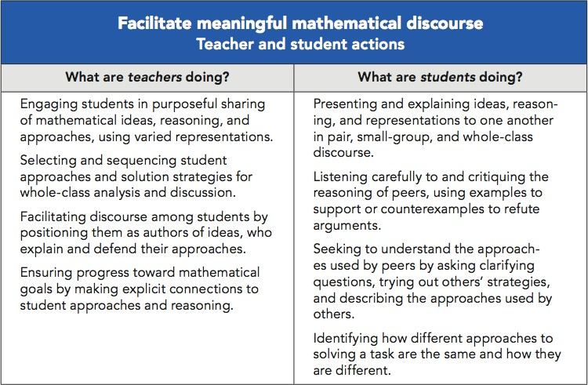
Facilitate Meaningful Mathematical Discourse
Notes:
Source: Principles to Action: Ensuring Mathematical Success for All, NCTM , 2014, p.35.
Ask participants about student interest in engaging in mathematical discourse. Why do some students try to avoid participating in mathematical discourse?
How can the teacher help students to become more active participants in mathematical discourse?

Slide 38
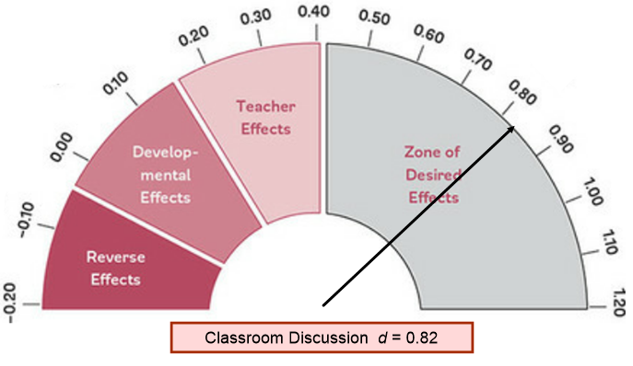
Impact of Meaningful Mathematical Discourse
Notes:
Source: Virginia Department of Education Mathematics Institutes 2019 Professional Development Resources
Grades 6-8 Institute PowerPoint
http://www.doe.virginia.gov/instruction/mathematics/professional_development/institutes/2019/index.shtml
The chart is from the work of Dr. John Hattie. He analyzed the impact of student, teacher, home, curriculum and community actions on student learning. Based on data, each action scored an Effect Rate for the ability to affect student achievement. The values range from a negative .20 to a positive 1.20. The higher the score, the greater the positive impact of the action on student achievement.
Classroom discussion has an effect size of 0.82, which is more than twice what we need to know that a specific strategy will make a difference in learning. Classroom discussion is defined as “a method of teaching that involves the entire class in a discussion.”
Classroom discussion is a critical area with a huge effect size. Classroom discussions provide the opportunity for students to communicate with one another for a variety of functions including to activate prior knowledge, to explore new topics, to learn from others, and to demonstrate their learning. This is an engagement strategy which provides all students the chance to participate, especially when structured in a way that extends beyond a teacher-student question and answer sequence.
Consider what visiblelearning.org asserts regarding what the most effective classroom discussions should include:
creating a series of questions for the students to think about
allocating enough time in the lesson for an elaborate discussion
making sure that students can freely express their opinion without being laughed at or ridiculed

Slide 39
Facilitate Meaningful Mathematical Discourse
What teacher actions support meaningful mathematical discourse?
To what extent does mathematical discourse facilitate student explanations or clarify their thinking?
Notes:
Mathematical discourse encourages students to reveal their understanding of math concepts as they engage in mathematical reasoning and debate. Through rich mathematical conversations with teachers and peers, students become fully involved in questioning, conjecturing, defining, and explaining. Source: (https://www.renaissance.com/edwords/mathematical-discourse/).
THINK, PAIR AND SHARE
In pairs, ask participants to respond to the questions.
These will be general responses based on the participants’ experiences and pedagogical knowledge.

Slide 40
A Closer Look
Effective Mathematics
Teaching Practice:
Pose Purposeful Questions
Notes:
In effective teaching, teachers use a variety of question types to assess and gather evidence of student thinking, including questions that gather information, probe understanding, make the mathematics visible, and justify their reasoning.

Slide 41
Pose Purposeful Questions
Effective teaching of mathematics uses purposeful questions to assess and advance student reasoning and sense making about important mathematical ideas and relationships.
Notes:
Ask participants how posing purposeful questions can be used to inform instruction and assess student understanding?
Ask participants how posing purposeful questions can promote equitable learning opportunities for all students?
Identify, in advance, the big ideas that your lesson examines and the mathematical outcomes that students should achieve. Take time to brainstorm the multiple approaches that could be taken to work through similar problems and the misconceptions that students might have. Make sure that you prepare questions that address these multiple approaches and misconceptions, prompting a discussion about when particular approaches are better than others and how to explain why each misconception is faulty. Close each lesson with a summarizing question that reiterates the big ideas.

Slide 42
Pose Purposeful Questions
Effective Questions should:
Reveal students’ current understandings
Encourage students to explain, elaborate or clarify their thinking
Make the mathematics more visible and accessible for students
Teachers’ questions are crucial in helping students make connections and learn important mathematics concepts. Teachers need to know how students typically think about particular concepts, how to determine what a particular student or group of students thinks about those ideas, and how to help students deepen their understanding.
Notes:
Source: Principles to Action: Ensuring Mathematical Success for All, NCTM, 2014
Effective mathematics teaching relies on questions that encourage students to explain and reflect on their thinking as an essential component of meaningful mathematical discourse. Purposeful questions allow teachers to discern what students know and adapt lessons to meet varied levels of understanding, help students make important mathematical connections, and support students in posing their own questions. However, merely asking questions is not enough to ensure that students make sense of mathematics and advance their reasoning.

Slide 43
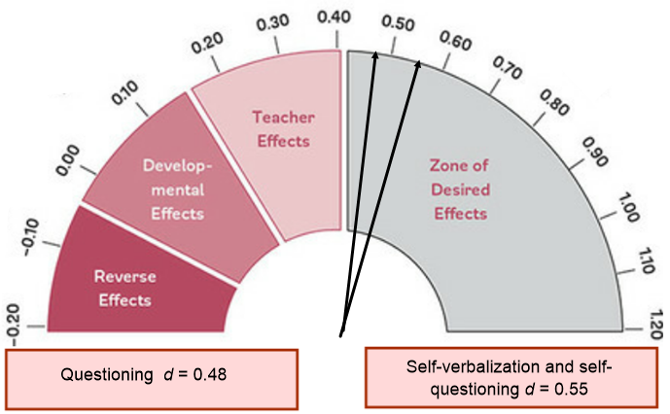
Pose Purposeful Questions
Notes:
Source: Virginia Department of Education Mathematics Institutes 2019 Professional Development Resources
Grades 6-8 Institute PowerPoint
http://www.doe.virginia.gov/instruction/mathematics/professional_development/institutes/2019/index.shtml
The chart is from the work of Dr. John Hattie. He analyzed the impact of student, teacher, home, curriculum and community actions on student learning. Based on data, each action scored an Effect Rate for the ability to affect student achievement. The values range from a negative .20 to a positive 1.20. The higher the score, the greater the positive impact of the action on student achievement.
Ask participants why Self-verbalization and Self-questioning have a greater impact on student achievement.
So much of classroom time is spent with teachers questioning the students. Cotton (1989), for example, reviewed the evidence and found questioning was the second most dominant teaching method (after teacher talk), with teachers spending between 35–50 percent of teaching time posing questioning (e.g., Long & Sato, 1983; van Lier, 1998)— that is about 100 questions per hour (Mohr, 1998)—and the responses from the teacher to the students’ answers to these questions was some form of judgment or correction, primarily reinforcing in nature, affirming, restating, and consolidating student responses. Brualdi (1998) claimed that teachers asked 300 to 400 questions per day, and the majority of these were low-level cognitive questions—60 percent recall facts and 20 percent are procedural in nature (Wilen, 1991) These are not open, inquiry questions, as students understand that the teacher already knows the answer (they are “display” questions; 82 percent are of this nature: Cotton, 1989). The reason for so much questioning relates to the conceptions of teaching and learning held by many teachers—that is, their role is to impart knowledge and information about a subject, and student learning is the acquisition of this information through processes of repetition, memorization, and recall: hence the need for much questioning to check that they have recalled this information. The overall effects of questioning vary, and the major moderator is the type of question asked—surface questions can enhance surface knowing and higher-order questions can enhance deeper understanding.

Slide 44
Five Types of Questions
Question Type | Purpose
Gathering Information | Ask students to recall facts, definitions, or procedures.
Probing thinking | Ask students to explain, elaborate, or clarify their thinking, including articulating the steps in solution methods or completion of a task.
Making the mathematics visible | Ask students to discuss mathematical structures and make connections among mathematical ideas and relationships.
Encouraging reflection and justification | Reveal deeper insight into student reasoning and actions, including asking students to argue for the validity of their work.
Engaging with the reasoning of others | Help students to develop an understanding of each other’s solution paths and thinking, and lead to the co-construction of mathematical ideas.
Notes:
Adapted from Smith, M. S., et al. (2017). Taking Action: Implementing Effective Mathematics Teaching Practices,, National Council of Teachers of Mathematics, p.102
Researchers have created a variety of frameworks to categorize the types of questions that teachers ask (e.g., Boaler and Brodie 2004; Chapin and O’Connor 2007). Though the categories differ across frameworks, commonalities exist among the types of questions. For example, the frameworks generally include questions that ask students to recall information, as well as questions that ask students to explain their reasoning. The chart above displays a set of question types that synthesizes key aspects of these frameworks that are particularly important for mathematics teaching. Although the question types differ with respect to the level of thinking required in a response, all the question types are necessary in the interactions among teachers and students. For example, questions that gather information are needed to establish what students know, while questions that encourage reflection and justification are essential to reveal student reasoning.

Slide 45
Pose Purposeful Questions
What purposes should questions serve?
How can all students’ ideas and questions be heard, valued and pursued?
Notes:
THINK, PAIR AND SHARE
With participants grouped in pairs, ask participants to respond to the questions.
These will be general responses based on the participants’ experiences and pedagogical knowledge.

Slide 46
A Closer Look
Effective Mathematics
Teaching Practice:
Build Procedural
Fluency from
Conceptual Understanding

Slide 47
Build Procedural Fluency from Conceptual Understanding
Effective teaching of mathematics builds fluency with procedures on a foundation of conceptual understanding so that students, over time, become skillful in using procedures flexibly as they solve contextual and mathematical problems.
A rush to fluency undermines students’
confidence and interest in mathematics and is considered a cause of mathematics anxiety.
(Ashcraft 2002; Ramirez Gunderson, Levine, & Beilock, 2013)
Notes:
Source: Principles to Action: Ensuring Mathematical Success for All, NCTM, 2014
Ask participants to share their thoughts on the importance of fluency with procedures to student success in mathematics.
Discuss with the participants the significance of the quote: A rush to fluency undermines students’ confidence and interest in mathematics and is considered a cause of mathematics anxiety.

Slide 48
Build Procedural Fluency from Conceptual Understanding
Procedural Fluency should:
Build on a foundation of conceptual understanding
Over time (months, years), result in known facts and generalized methods for solving problems
Enable students to flexibly choose among methods to solve contextual and mathematical problems.
Notes:
Source: Principles to Action: Ensuring Mathematical Success for All, NCTM, 2014
Paraphrase the bullets on the slide.
Fluency is not intended as the main or sole target of instruction. Problem Solving and Reasoning that are the focus of the second teaching practice need to co-exit with procedural fluency. This occurs when students first have opportunities to develop conceptual understanding.
Computational fluency is strongly related to number sense and involves so much more than the conventional view of it encompasses. Developing students’ computational fluency extends far beyond having students memorize facts or a series of steps unconnected to understanding (Baroody 2006; Griffin 2005)
Early work with reasoning strategies is related to algebraic reasoning. As students learn how quantities can be taken apart and put back together in different ways (i.e., decomposition and composition of numbers), they establish a basis for understanding properties of the operations. Students need this early foundation for meaningful learning of more formal algebraic concepts and procedures throughout elementary school and into middle and high school.

Slide 49
Build Procedural Fluency from Conceptual Understanding
To use mathematics effectively, students must be able to do much more than carry out mathematical procedures. They must know which procedure is appropriate and most productive in a given situation, what a procedure accomplishes, and what kind of results to expect.
Mechanical execution of procedures without understanding their mathematical basis often leads to bizarre results.
Notes:
Source: Principles to Action: Ensuring Mathematical Success for All, NCTM, 2014, p. 42.
Discuss why is it important to build procedures from conceptual understanding.
Ask participants: What kind of ‘bizarre results’ could happen if students are taught mechanical execution of procedures without understanding the mathematical basis?
Fluency is not a simple idea. Being fluent means that students are able to choose flexibly among methods and strategies to solve contextual and mathematical problems, they understand and are able to explain their approaches, and they are able to produce accurate answers efficiently. Fluency builds from initial exploration and discussion of number concepts to using informal reasoning strategies based on meanings and properties of the operations to the eventual use of general methods as tools in solving problems. This sequence is beneficial whether students are building toward fluency with single- and multi-digit computation with whole numbers or fluency with, for example, fraction operations, proportional relationships, measurement formulas, or algebraic procedures.

Slide 50
Build Procedural Fluency from Conceptual Understanding
What are teachers doing? | What are students doing?
Providing students with opportunities to use their own reasoning strategies and methods for solving problems. Asking students to discuss and explain why the procedures that they are using work to solve particular problems. Connecting student-generated strategies and methods to more efficient procedures as appropriate. Using visual models to support students’ understanding of general methods. Providing students with opportunities for distributed practice of procedures. | Making sure that they understand and can explain the mathematical basis for the procedures that they are using. Demonstrating flexible use of strategies and methods while reflecting on which procedures seem to work best for specific types of problems. Determining whether specific approaches generalize to a broad class of problems. Striving to use procedures appropriately and efficiently.
Notes:
Source: Principles to Action: Ensuring Mathematical Success for All, NCTM, 2014, p. 47
Ask participants:
What visual models have they used to build procedural fluency?
Is it important for students to be able to explain why the procedures they used worked? Why?

Slide 51
Build Procedural Fluency from Conceptual Understanding
What procedural fluency skills are essential to completing a task?
What teacher actions do teachers use for building procedural fluency from conceptual understanding?
Notes:
THINK, PAIR AND SHARE
With participants grouped in pairs, ask participants to respond to the questions.
These will be general responses based on the participants’ experiences and pedagogical knowledge.

Slide 52
A Closer Look
Effective Mathematics
Teaching Practice:
Support Productive Struggle
in Learning Mathematics
Notes:
Effective teaching of mathematics provides students both support and opportunities to engage in productive struggle with the content. When students engage in productive struggle, they delve more deeply into understanding relationships among mathematical ideas instead of simply seeking correct solutions. (National Council of Teachers of Mathematics [NCTM], 2014).

Slide 53
Support Productive Struggle in Learning Mathematics
Productive Struggle should:
Be considered essential to learning mathematics with understanding;
Develop students’ capacity to persevere in the face of challenge; and
Help students realize that they are capable of doing well in mathematics with effort.
By struggling with important mathematics we mean the opposite of simply being presented information to be memorized or being asked only to practice what has been demonstrated.
Hiebert & Grouws, 2007, pp. 387-388
Notes:
Source: Principles to Action: Ensuring Mathematical Success for All, NCTM, 2014
Discuss with the participants the importance for students to be able to figure things out for themselves.
It is through this process of figuring things on their own that they will develop authority and ownership of their own learning.

Slide 54
Support Productive Struggle in Learning Mathematics
Productive Struggle entails:
Students individually and collectively grappling with mathematical ideas and relationships
Teachers and students understanding that frustration may occur, but perseverance is important
Communicating about thinking to make it possible for students to help one another make progress on the task
Notes:
Source: Principles to Action: Ensuring Mathematical Success for All, NCTM, 2014, p.48.
In comparisons of mathematics teaching in the United States and in high-achieving countries, U.S. mathematics instruction has been characterized as rarely asking students to think and reason with or about mathematical ideas (Banilower et al. 2006; Hiebert and Stigler 2004). Teachers sometimes perceive student frustration or lack of immediate success as indicators that they have somehow failed their students. As a result, they jump in to “rescue” students by breaking down the task and guiding students step by step through the difficulties. Although well intentioned, such “rescuing” undermines the efforts of students, lowers the cognitive demand of the task, and deprives students of opportunities to engage fully in making sense of the mathematics.

Slide 55
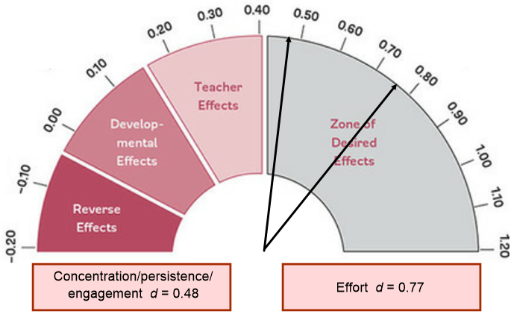
Support Productive Struggle in Learning Mathematics
Notes:
Source: Virginia Department of Education Mathematics Institutes 2019 Professional Development Resources
Grades 6-8 Institute PowerPoint
http://www.doe.virginia.gov/instruction/mathematics/professional_development/institutes/2019/index.shtml
The chart is from the work of Dr. John Hattie. He analyzed the impact of student, teacher, home, curriculum and community actions on student learning. Based on data, each action scored an Effect Rate for the ability to affect student achievement. The values range from a negative .20 to a positive 1.20. The higher the score, the greater the positive impact of the action on student achievement.
There is a high relationship between engagement and degree of concentration on tasks. One way of enhancing concentration is to mentally visualize the processes and strategies involved in a task. Students who mentally visualized various motor tasks were more effective compared to those that did not (d = 0.48).
Teachers greatly influence how students perceive and approach struggle in the mathematics classroom. Even young students can learn to value struggle as an expected and natural part of learning, as demonstrated by the class motto of one first-grade math class: “If you are not struggling, you are not learning” (Carter 2008, p. 136). Teachers must accept that struggle is important to students’ learning of mathematics, convey this message to students, and provide time for them to try to work through their uncertainties. Unfortunately, this may not be enough, since some students will still simply shut down in the face of frustration, proclaim “I don’t know,” and give up. Dweck (2006) has shown that students with a fixed mindset— that is, those who believe that intelligence (especially math ability) is an innate trait—are more likely to give up when they encounter difficulties because they believe that learning mathematics should come naturally. By contrast, students with a growth mindset—that is, those who believe that intelligence can be developed through effort—are likely to persevere through a struggle because they see challenging work as an opportunity to learn and grow.

Slide 56
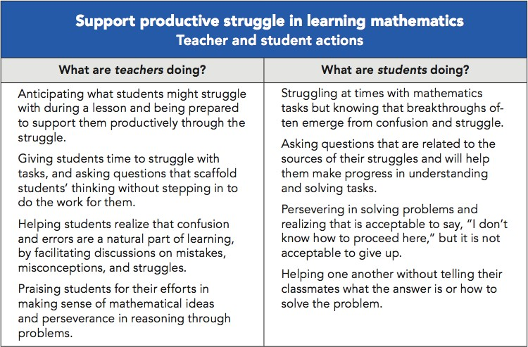
Support Productive Struggle in Learning Mathematics
Notes:
Source: Principles to Action: Ensuring Mathematical Success for All, NCTM, 2014, p.52.
Use the chart to engage participants in a discussion of how they support students to persevere in problem solving.

Slide 57
Support Productive Struggle in Learning Mathematics
How can teachers support productive struggle among students – individually and collectively?
Notes:
THINK, PAIR AND SHARE
With participants grouped in pairs, ask participants to respond to the question.
These will be general responses based on the participants’ experiences and pedagogical knowledge.

Slide 58
A Closer Look
Effective Mathematics
Teaching Practice:
Elicit and Use Evidence of
Student Thinking

Slide 59
Elicit and Use Evidence of Student Thinking
Effective teaching of mathematics uses evidence of student thinking to assess progress toward mathematical understanding and to adjust instruction continually in ways that support and extend learning.
Notes:
Source: Principles to Action: Ensuring Mathematical Success for All, NCTM, 2014, p. 53
Ask participants: What can serve as evidence of student thinking when assessing progress toward understanding?
How should the evidence affect what a teacher does instructionally for students?

Slide 60
Elicit and Use Evidence of Student Thinking
Evidence should:
Provide a window into students’ thinking
Help the teacher determine the extent to which students are reaching the math learning goals
Be used to make instructional decisions during the lesson and to prepare for subsequent lessons
Formative assessment is an essentially interactive process, in which the teacher can find out whether what has been taught has been learned, and if not, to do something about it. Day-to-day formative assessment is one of the most powerful ways of improving learning in the mathematics classroom.
Notes:
Source: Principles to Action: Ensuring Mathematical Success for All, NCTM, 2014, p. 53
Ask participants: What is formative assessment?
Is it possible to do formative assessment everyday?
If so, how?

Slide 61
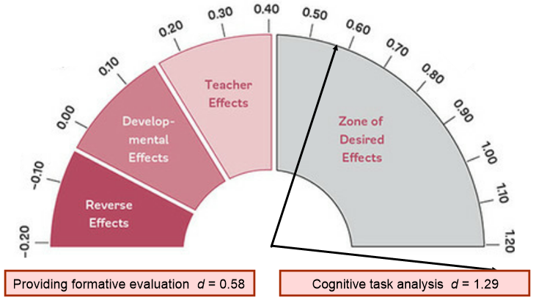
Elicit and Use Evidence of Student Thinking
Notes:
Source: Virginia Department of Education Mathematics Institutes 2019 Professional Development Resources
Grades 6-8 Institute PowerPoint
http://www.doe.virginia.gov/instruction/mathematics/professional_development/institutes/2019/index.shtml
The chart is from the work of Dr. John Hattie. He analyzed the impact of student, teacher, home, curriculum and community actions on student learning. Based on data, each action scored an Effect Rate for the ability to affect student achievement. The values range from a negative .20 to a positive 1.20. The higher the score, the greater the positive impact of the action on student achievement.
Cognitive task analysis was among the highest scoring actions to affect student achievement.
Ask participants to give an example of what a cognitive task might look like in the classroom and why it is so effective.

Slide 62
Elicit and Use Evidence of Student Thinking
Identify specific places during a lesson in which a teacher could elicit evidence of student learning.
Discuss how a teacher might use that evidence to adjust instruction to support and extend student learning.
Notes:
THINK, PAIR AND SHARE
With participants grouped in pairs, ask participants to respond to the questions.
These will be general responses based on the participants’ experiences and pedagogical knowledge.

Slide 63
Going Forward
As you reflect on the Effective Mathematics Teaching Practices, identify 1-2 Practices that will strengthen your own instruction.
Working with a partner, develop a list of actions to begin the next steps of your journey toward ensuring mathematical success for all your students.
Notes:
THINK, PAIR AND SHARE – CLOSURE ACTIVITY
With participants grouped in pairs, ask participants to reflect on what they have learned about the eight Effective Mathematics Teaching Practices.
Ask each participant to select 1-2 Practices to study and to implement with students
In pairs, develop a list of actions they will need to take in the pursuit of mathematical success for all their students.

Slide 64
Create Your Own Trail Mix:
A WV Classroom Video Experience
School: _______ High School
_______, West Virginia
Teacher: _______
Class: Grade 9
Curriculum: Illustrative Mathematics
Size: ___ students

