Slide 1
Comic Strip Lesson
Arts/AV Cluster

Slide 2
Comic Strip Learning Objectives
Design Principles
Character Creation
Sketching
Storytelling
Drawing
Colors

Slide 3
Week at a Glance
Day 1: How do Colors Affect our Audience’s Emotion?
Day 2: How do I Read Comics?
Day 3: Comic Book Exploration
Days 4 & 5: Writing a Comic Storyline
Days 6 – 8: Creating the Comic
Days 9 & 10: Presenting Your Comic

Slide 4
Important Vocabulary
Comic Book
Comic Strip
Cartoon
Speech Bubble
Thought Bubble
Artist
Story
Edit

Slide 5
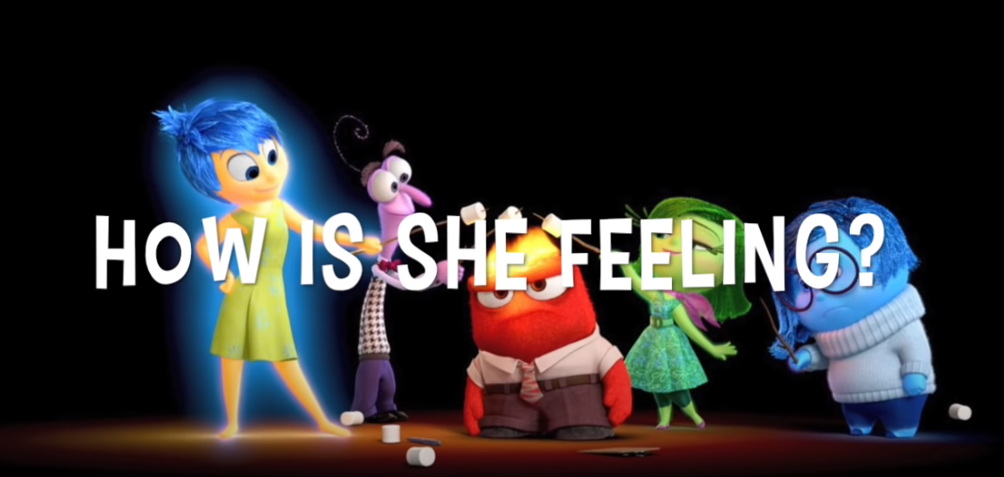
How do Colors affect our Audience’s Emotions?
Notes:
To get started and engage your students start by showing the vide Inside Out: Guessing the Feelings. This video will help your students get introduced to the idea that feelings and colors are associated.
Give students some time to search for their favorite character, movie, or brand. Have then look at the colors and consider what emotions are being communicated to the audience.
Use these videos to help students understand the concepts.

Slide 6
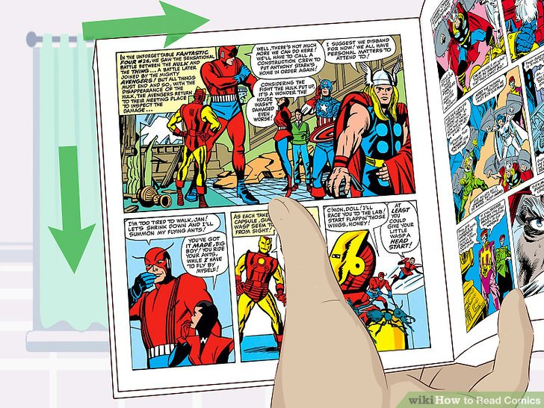
How do I Read Comics?
Notes:
Explain to students how comic books and comic strips work.
Explain how it is read: boxes left to right in rows, the difference between speech, thought and exclamation bubbles. (Examples are on this slide)
Explain how each of the “bubbles” helps the audience understand what is happening in the story.

Slide 7
Comic Book Exploration
Take time to look at and read Comics
Find more online
Notes:
For this activity you will be introducing the students to Comic Books and Comic Strips. Find some comic books, or comic strips from newspapers, or print them from online sources. An online sources is clickable on the slide you can print these ahead of time or navigate through them as a class.
You can distribute the comics to students in pairs, or leave them on a table and allow the students to pick and choose what they want to see or read.
The goal of this activity should be relaxed and unstructured to allow students to enjoy looking at the pictures and the words.

Slide 8
Storyline
STORY
Title: The Perfume Monster
A scientist is experimenting with a new perfume formula, when an assistant bumps into the table and breaks all the beakers of solution.
Kaboom a green hazy smoke cloud began to form.
A security guard for the lab runs in and asks what happened.
Something is coming out of the cloud of smoke; it’s saying something that is hard to understand.
The scientist and the security guard think it is a Green Monster coming after them.
They run towards the door screaming.
Taking one look back they realize it is just the assistant covered in a gooey mushy liquid that made him look like a Green Monster.
What is going on in this lab? … What is in that could of smoke !?!
Oh no what have I done?
KABOOM
Notes:
You can use one of the Comic Strip resources from the previous day to have a class discussion to get the students thinking about ideas for a story. Discuss the StoryBoard Plan on this slide – feel free to change the story for your class.
When building the story keep to the main parts of the story and remember you will need as much verbal communication as possible to help the audience understand what is happening in the comic.
It is important to stress that the students will have to come up with their own original story.
This is the Production part of the Comic.
In this part of the lesson is open-ended. You can choose to put students into groups or allow them to work individually. Each group has to make a story, edit it, show it to you. Provide your students with the Storyline Template Worksheet and have them start creating their story.
Once you approve their story students are ready to start working on the next part of this activity the Comic Strip.

Slide 9
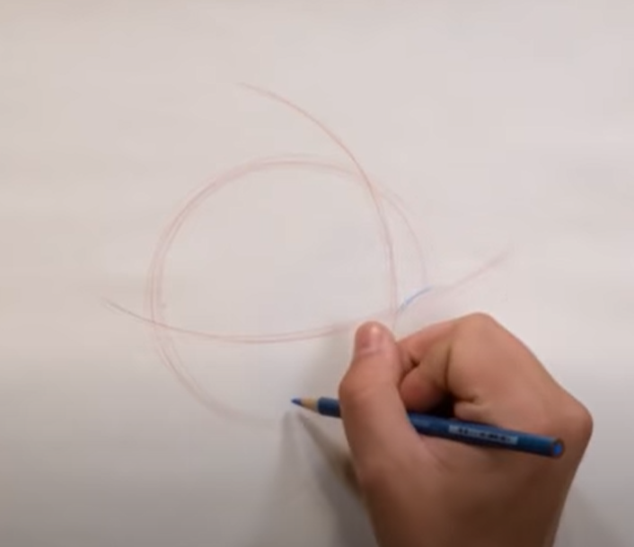
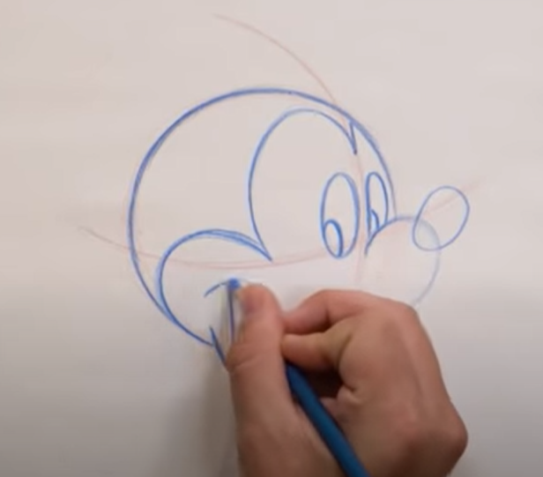
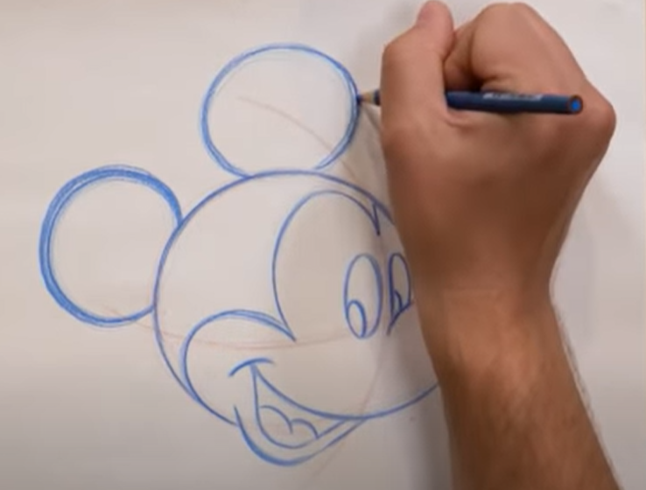
Creating your Character
Disney Parks – How to Draw YouTube Videos
Notes:
In this activity, your students will learn how to draw their characters.
Use this video series to help your students draw a Character. Choose a “How-To Draw for a character that is best for you and your students, paying close attention to the length of the video. As you and your students are watching this, you should draw this on the board with the students. If you feel comfortable skip the video and do instruction with your students on the board without the video.

Slide 10
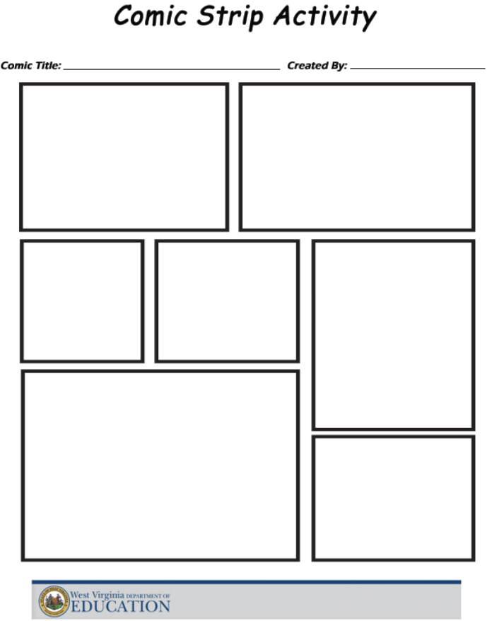
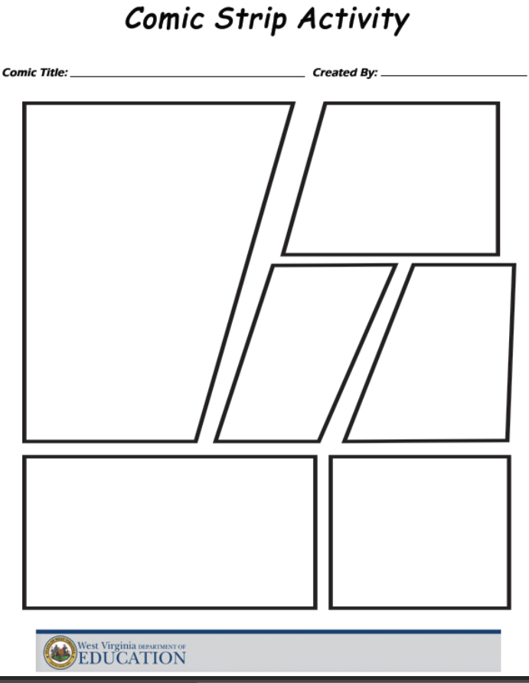
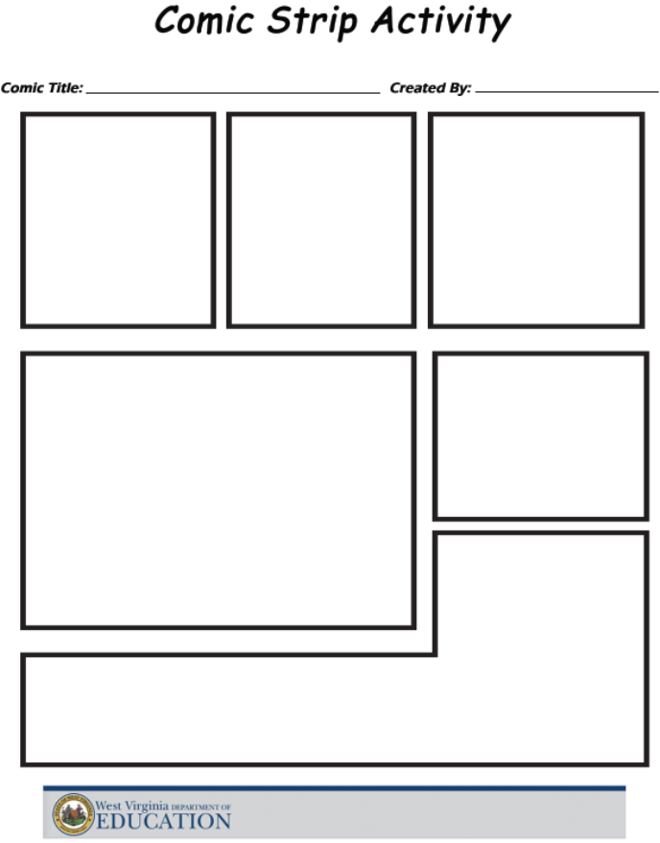
Creating the Comic Strip
Notes:
You can choose to use the provided templates provided to the students as a worksheet allow them to draw their comics on notecards or small sheets of paper and glue onto a poster board.
Give students times to work on their comics and leave a couple days in your time frame for the students/groups to share out their creations.

