Slide 1
New-River Greenbrier Valley
Bridge Design

Slide 2
New-River Greenbrier Valley
Visit the New River Gorge Bridge. One of the world’s longest single-span arches.
https://wvtourism.com/places-to-go/parks-public-lands/national-parks/new-river-gorge-national-park-and-preserve/
Notes:
Option 1: Conduct the Bridge Design Challenge Activity
Option 2: WV Bridge Design Contest https://wvbridgedesignandbuildcontest.com

Slide 3
WV Adventures
STEM

Slide 4
Vocabulary
Engineering Notebook

Slide 5
Essential Questions
Why do Engineers use an Engineering Notebook?

Slide 6
Inspire
“We shape our buildings; thereafter they shape us.”
Winston Churchill

Slide 7
Design Process and the Engineering Notebook
Use the engineering design process
Document the steps in your engineering notebook

Slide 8
Design Process Documentation
This will be quick
Focus on the process
Refer to the Activity Sheet as you Go

Slide 9
Engineering Notebook: Title
Title
Should be Short
As more pages are needed you will use this same title when working on this project
Page Number

Slide 10
Engineering Notebook: Define the Problem
Defining the Problem
Should Only Take About 1 Minute
Simple Problem Statement: No Details

Slide 11
Engineering Notebook: Constraints
Constraints (1 minutes)
Constrains should be listed with values and units
2 linking Cubes (3/4 in)
11x 8.5 inch Paper

Slide 12
Engineering Notebook
Prior Solution Attempts (2 minutes)
Research any past designs
Document 3 sources (could be websites)
In future more time could be given but today 2 minutes

Slide 13
Engineering Notebook:
Brainstorm (2 Minutes)
Generate and communicate as many concepts as possible
Take the full 2 minutes but make sure you have atleast 3 sketches

Slide 14
Engineering Notebook
Develop A Solution (2 Minutes)
This could mean Building
This could me annotating a sketch

Slide 15
Engineering Notebook
Construct and Test Prototype (10 Minutes)
This is the time when you act
Take your developed solution and move it into prototype phase
Test

Slide 16
Engineering Notebook
Evaluate a Solution (1 Minute)
What went right
What can you improve on

Slide 17
Engineering Notebook
Present Solution
Tend to keep this to an Elevator Pitch (2-3 minutes)

Slide 18
Complete Remaining Steps
Document remaining steps

Slide 19
What is design
Design is turning a concept into a product that can be produced.
Design is a process that you follow to solve problems.
Notes:
Think of design as anything that has been produced through a mindful human effort. Take the time to talk about the fact that it isn’t just TV’s and Videogames that have been designed but it is the tables that they sit at and the chairs they are on. The bookbags that they carry and the pencils that they are writing with.

Slide 20
Statics, does it matter?

Slide 21
Statics, does it matter?
Or
is a C good enough?

Slide 22
At work one day you are sitting at your desk and the boss comes in and says:
“You know the TV tower you designed? The site called said they have a small problem. Could you to go down there and see what the problem is.”
When you arrive you see…….

Slide 23
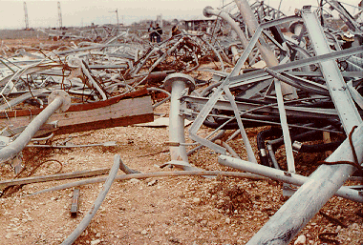

Slide 24
I knew I shouldn’t have slept in Exploration Class!

Slide 25
3 persons died in this accident. It was caused by an incorrect calculation of a simple Statics problem!

Slide 26
At work one day you are sitting at your desk and the boss comes in and says:
“You know the electrical transmission towers you designed? The northeast US has lost power and they think there might be something wrong with your towers. Could you go down there and see what the problem is.”
When you arrive you see…….

Slide 27
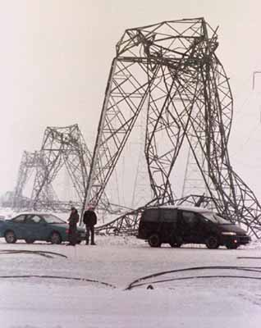

Slide 28
Oh, here is that missing
negative sign!

Slide 37
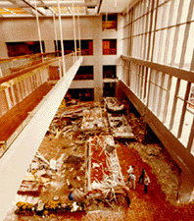

Slide 38
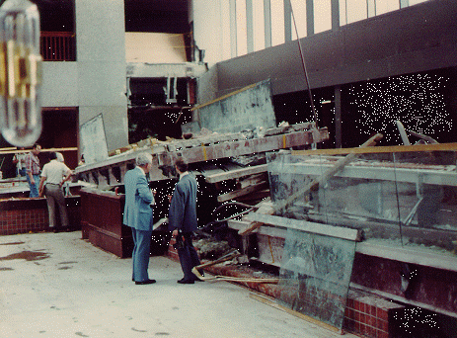

Slide 39
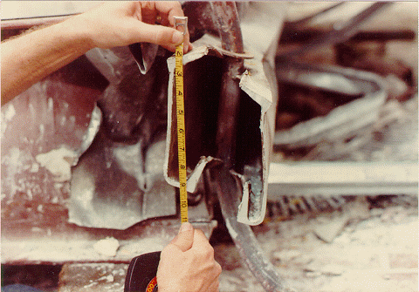

Slide 40
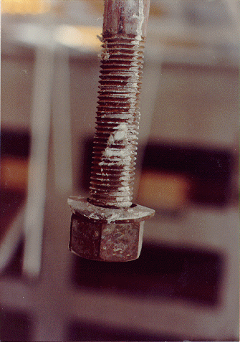

Slide 41
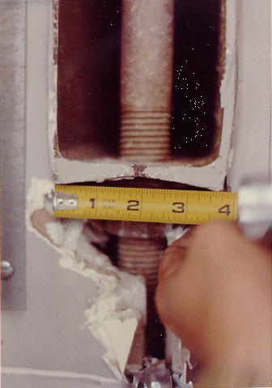

Slide 42
As Designed

Slide 43
As Designed
As Built

Slide 44
As Designed
As Built
What is the load here?

Slide 49
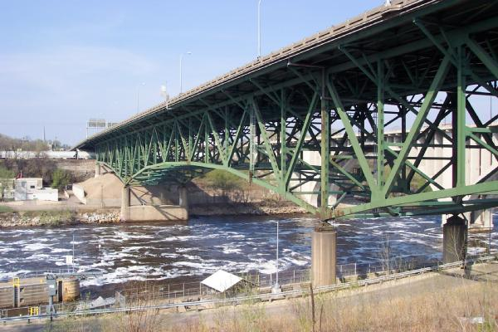
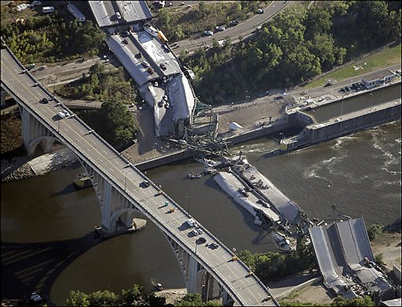
Minneapolis bridge collapse

Slide 50
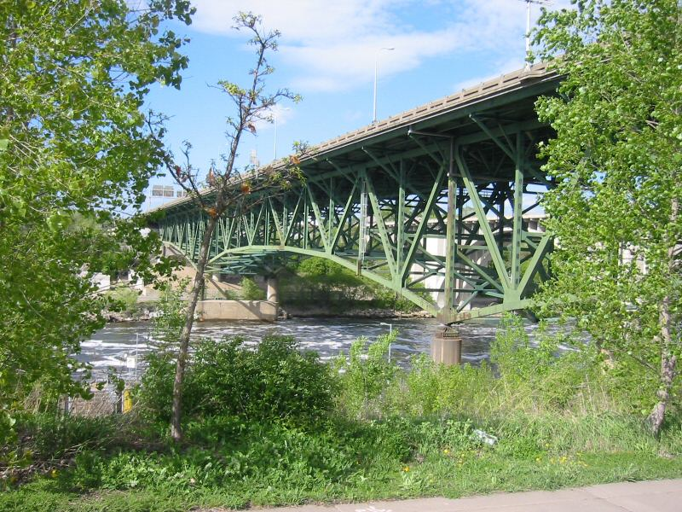
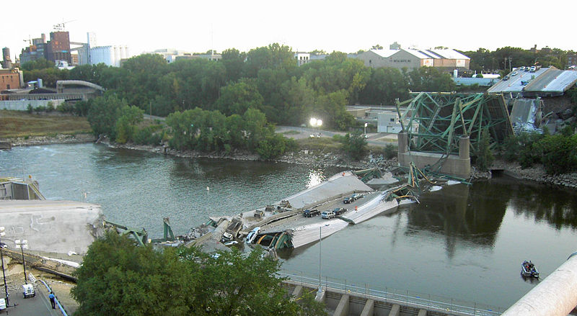

Slide 51
Questions
Why do you think brainstorming is helpful when solving a problem?
How did testing improve your design?
With respect to designing the solution of a problem, what are some important characteristics of a successful team?

Slide 52
Resources
West Virginia Bridge Design & Build Contest. (n.d.). Retrieved March 1, 2022, from https://wvbridgedesignandbuildcontest.com/
Bridge design contest: Presented by engineering encounters. Engineering Encounters. (n.d.). Retrieved March 10, 2022, from https://www.bridgecontest.org/

