Slide 1
CELL VS. CELL
Teacher instructions:
There are a few ways to expand on this activity;
There are instructions for students on the following three slides. Digital, printable, or drawing. This can also be a fun group project during class, using poster board.
Students are to compare the parts of a cell to the parts and apps of a cell phone. They must first look up definitions of the human cell, then compare each component to apps or features/ accessories of a cell phone. You can grade as a project, or not be graded at all and used as an activity. Have fun!! An example is on the last slide.

Slide 2
STUDENT INSTRUCTIONS:
Cell vs. Cell
Have you ever thought about how similar cell phones and apps could be compared to a human cell? Look up the definitions of each cell component. Then use the different apps/ cell phone components to make a comparison to each part of the human cell and it’s function.

Slide 3
STUDENT INSTRUCTIONS-CONT.
Variations:
Digital- Students make a copy of slides. “Add slide” for your vocabulary terms and definitions.
Copy/paste icons into cell phone (you will have to adjust the image sizes). You can find your own by clicking “insert,” “image,” “search the web,” and enter specifics for what you are looking for, click on the image, and at the bottom, choose “insert.” Drag the corners of the box to the size you need.
Use the toolbox bar to insert lines and text boxes to explain which cell part you are referring to, and why it can be compared to the cell component.

Slide 4
STUDENT INSTRUCTION CONT.
Variation 2: Print and cut image and icons. Follow instructions on slide 3 for cell phone icon/ component comparison.
Variation 3: MAKE YOUR OWN! Use paper, markers, etc., to create your own cell phone and draw the components and apps. Draw a line from each one to your explanation of how it relates to part of a cell.

Slide 5
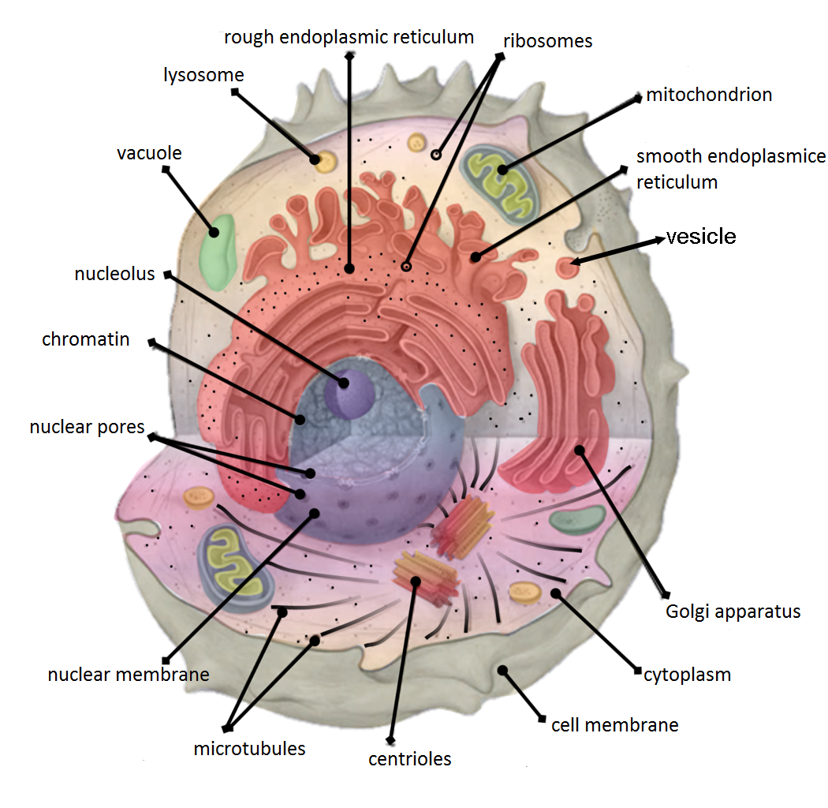
PARTS OF A CELL

Slide 6
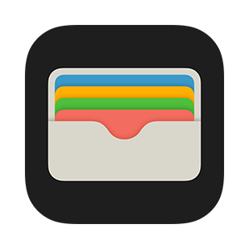
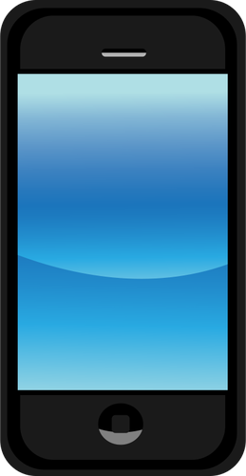

Slide 7
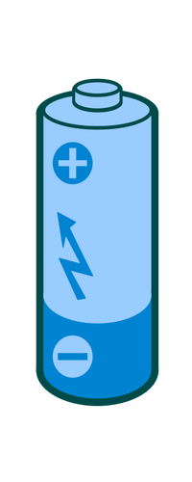
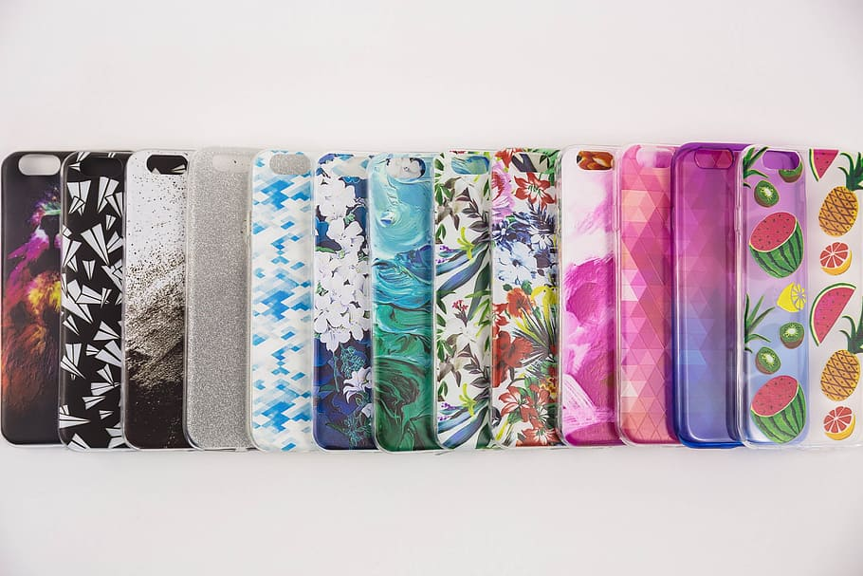
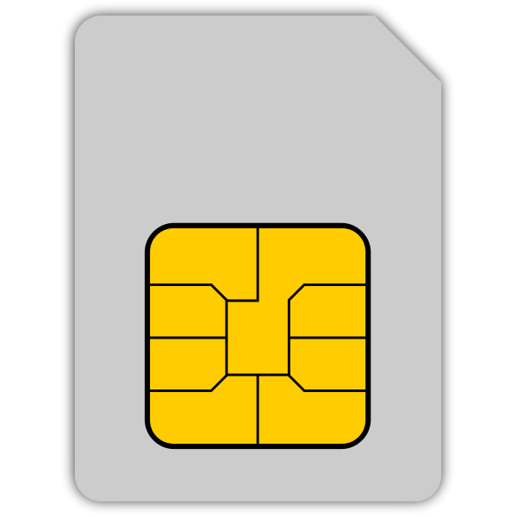
Other cell phone components-
Battery
Case
SIM Card

Slide 8
NEXT SLIDE IS THE KEY
Stop Here !

Slide 9
Case-
Cell Membrane
KEY
Case
Sim Card-
Vacuoles
Storage and protection
Icons -
Golgi Apparatus
SIM Card
App Store-
nucleolus
Apps - Ribosomes
Outside of phone-
Cytoplasm
Control Center-
Nucleus
Entertainment-
Protein
Electrical wires inside- Endoplasmic reticulum
Battery-
Mitochondria

