Slide 1
Coding with Minecraft 3: Coordinates

Slide 2
LESSON A: Introduction to Coordinates

Slide 3
What we’ll learn
The difference between relative coordinates and absolute coordinates in real life and Minecraft
The importance of coordinates
Code a compass rose in Minecraft with coordinates

Slide 4
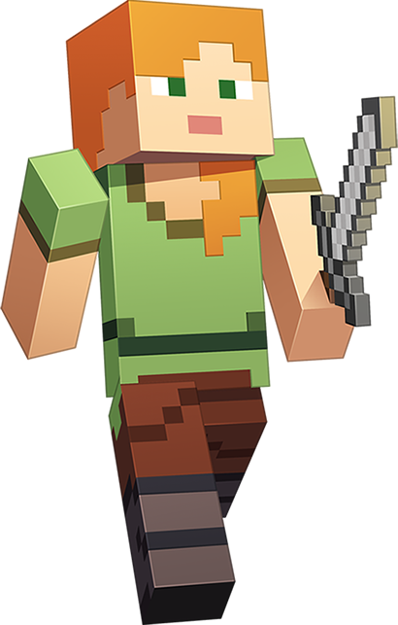
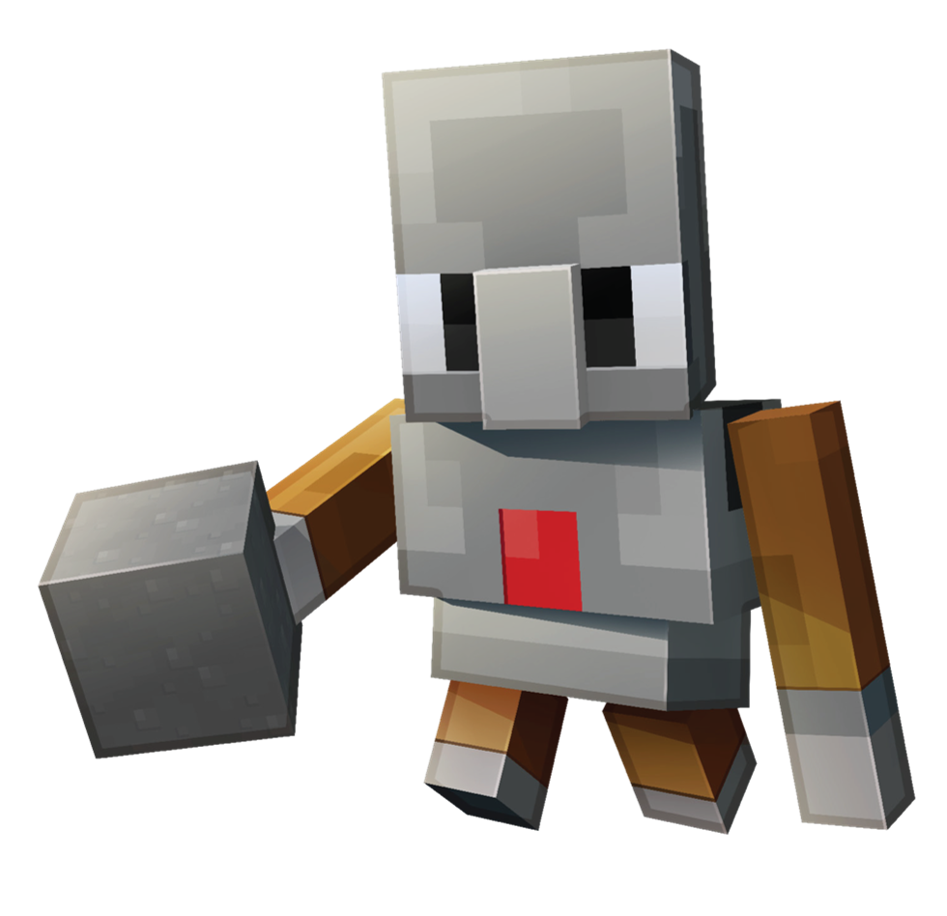
Why are coordinates important?
To know the location of:
Your player
Your agent
Important landmarks, like supplies and resources

Slide 5
coordinates
+Y Up
Tell a program where an action should take place
A 3-dimensional position (X, Y, Z) in Minecraft
-Z North
-X West
+X West
+Z South
-Y Down

Slide 6
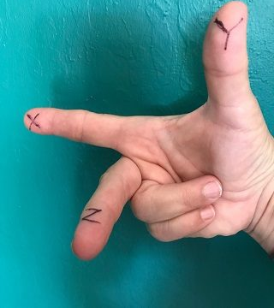
A handy tip
Use this to remember X, Y, Z axes

Slide 7
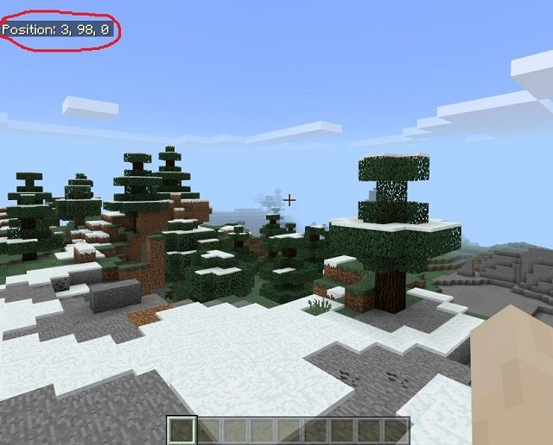
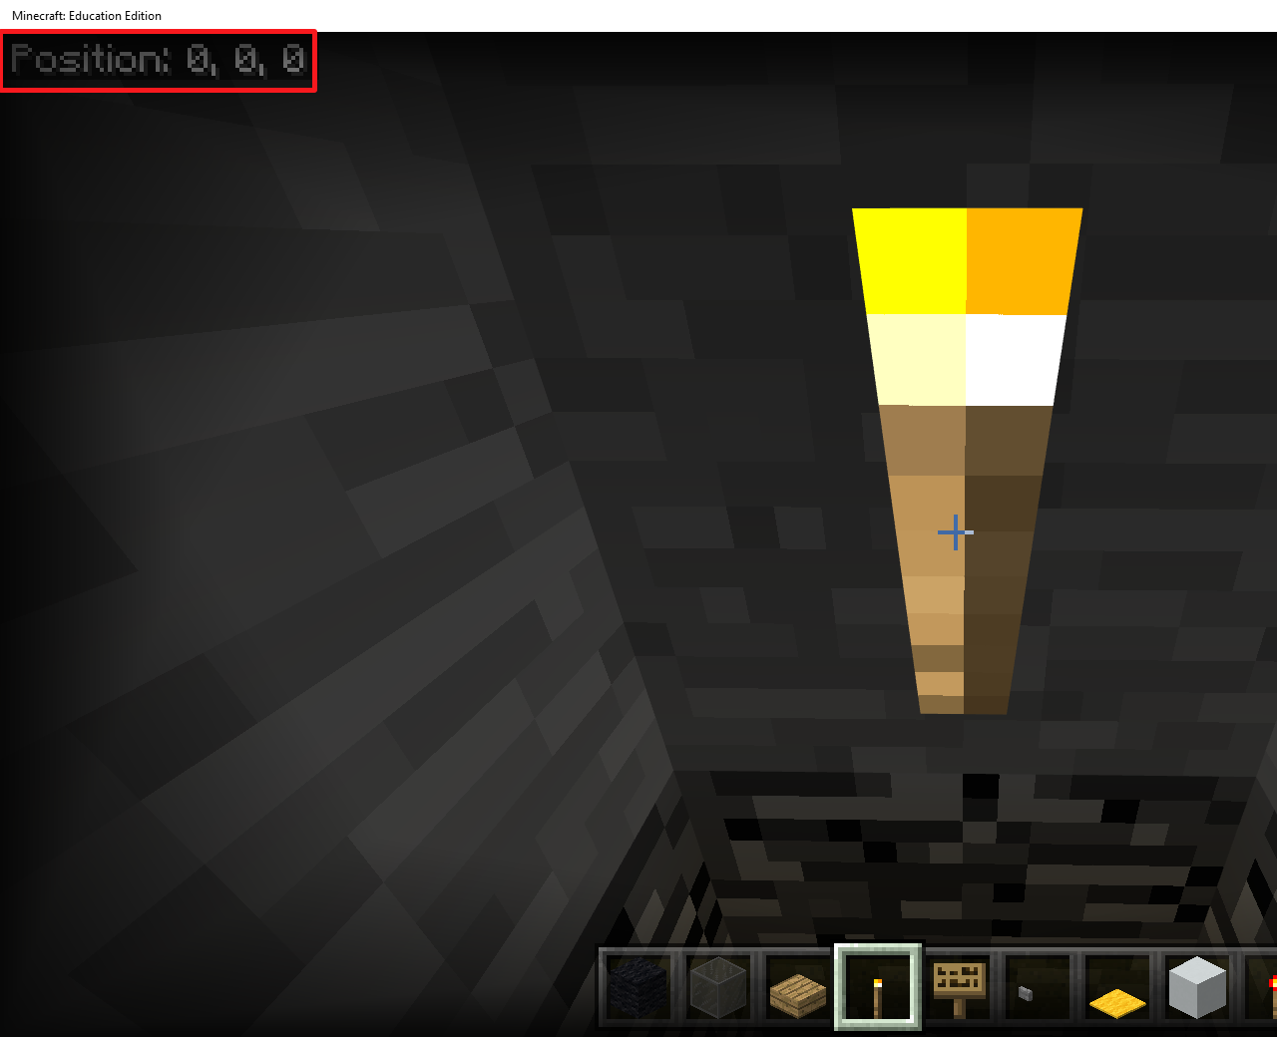
Absolute world position
Based on distance from the world origin
Minecraft world origin: (0, 0, 0)
Visible in the game when you press F1
Player world position: (3, 98, 0)
Move around to see the values change!

Slide 8
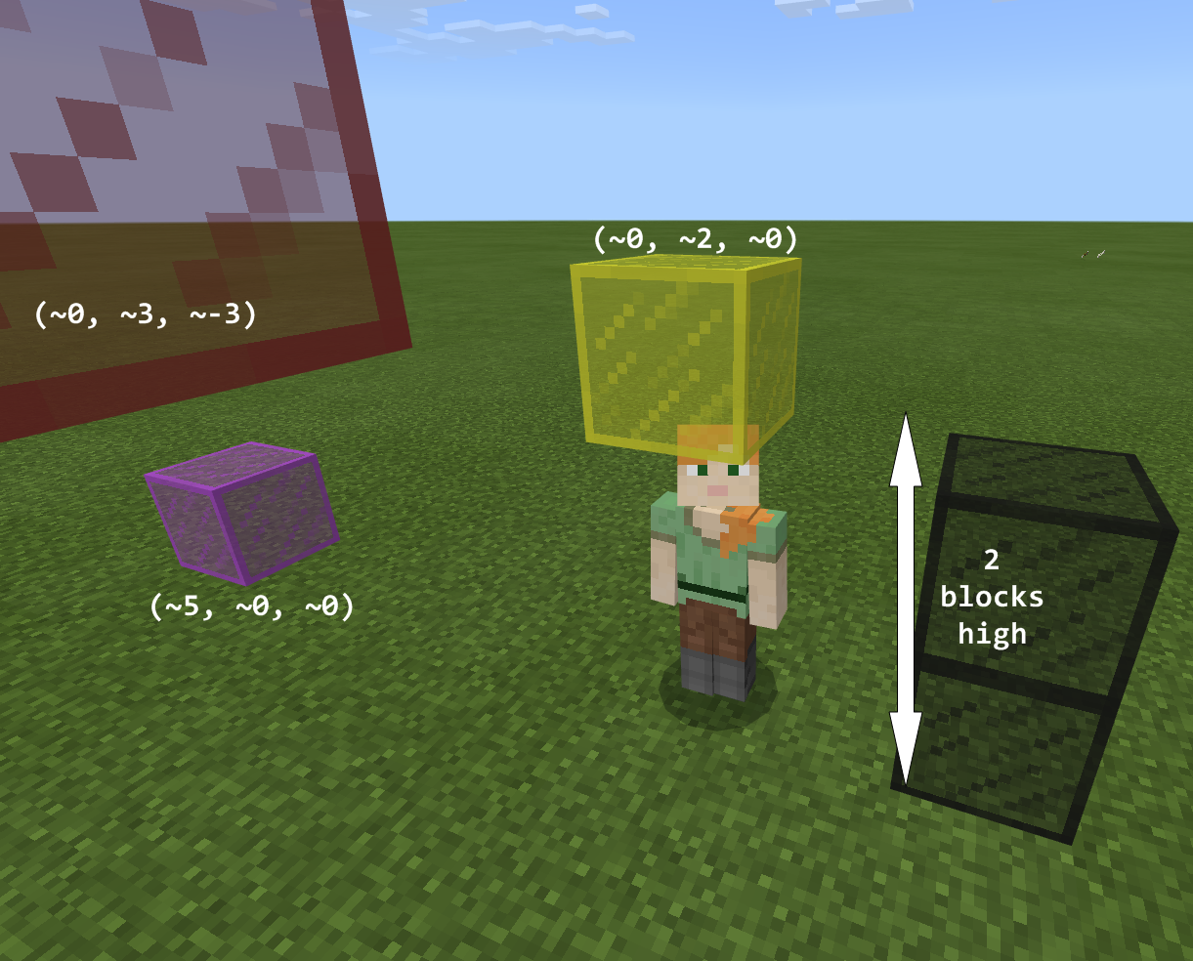
Relative player position
Based on the player’s current position
Player’s current position is always: (~0,~0,~0)
Relative player position: (~X,~Y,~Z)
Not visible in the game

Slide 9
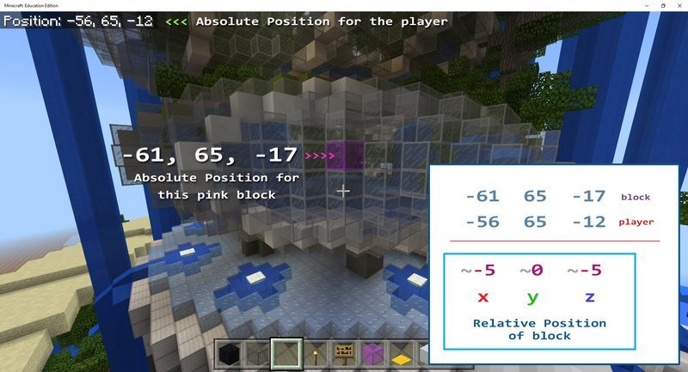
To calculate relative position

Slide 10
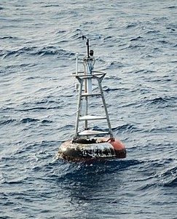
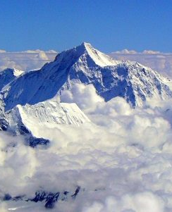
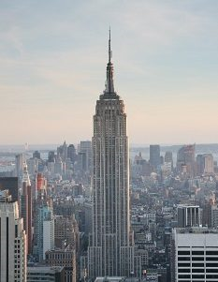
In real life
The earth’s geographical origin point, Null Island is at 0º N 0º E
Mount Everest is at 27º N 86º E
The Empire State Building is at 40º N -73º E
Let’s check it out bing.com/maps

Slide 11
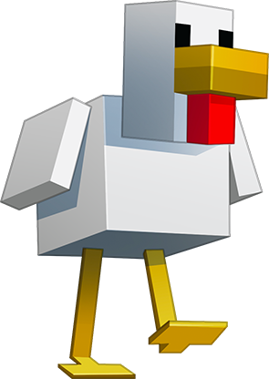
Let’s discuss
What are the values for X, Y, Z for the world origin?
Is the world origin an absolute or relative position?
Is (~0, ~0, ~0) an absolute or relative position?

Slide 12
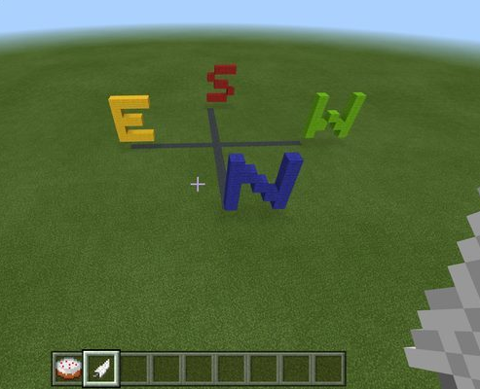
Code with coordinates
Create a compass rose
Use relative player positions
Point to the four cardinal directions
Change the code to make it unique

Slide 13
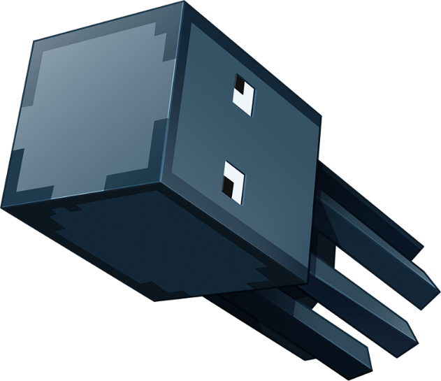
Let’s discuss
What other ideas do you have to use positions when coding?
What’s the difference between absolute world position and relative player position?

Slide 14
LESSON A What we learned today
Why coordinates are important
The difference between absolute and relative positions
Calculated both types of positions from a world map
Coded with an on chat command and relative player positions to create a compass rose

Slide 15
Next time
Turn our classroom into a Minecraft world
More coding with coordinates to copy and paste any part of the Minecraft landscape where you want

Slide 16
LESSON B: Coding with Coordinates

Slide 17
What We’ll learn
Pretend our classroom is a Minecraft world to calculate relative and absolute positions
Code with relative and absolute positions
Copy and paste any part of the Minecraft landscape, like buildings or whatever you want

Slide 18
Review coordinates
+Y Up
What’s absolute world position?
What’s relative player position?
-Z North
-X West
+X West
+Z South
Let’s do an unplugged activity!
-Y Down

Slide 19
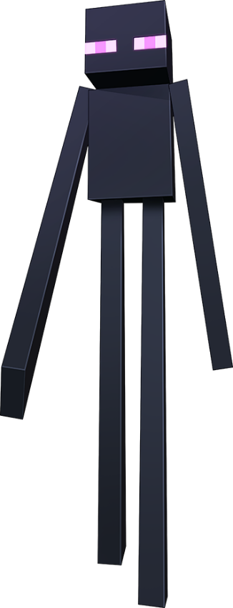
Let’s discuss
Does the absolute position of an object with a permanent place change?
Does the position of an object relative to your position change as you move around the classroom?

Slide 20
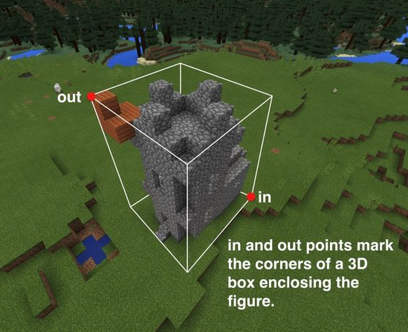
Minecraft moving company
Use on chat commands, coordinates and block operations
Copy and paste entire portions of the Minecraft landscape

Slide 21
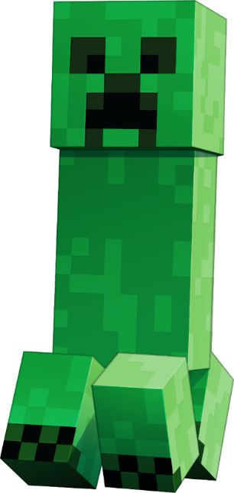
Let’s discuss
In Minecraft, what keyboard shortcut shows your players world position?
How do you easily duplicate blocks in the MakeCode coding workspace?

Slide 22
LESSON B What we learned today
Calculated relative and absolute positions in our “Minecraft” classroom
Coded a tool with relative and absolute positions to copy and paste parts of the Minecraft landscape, like buildings or whatever you want

Slide 23
Next time
Spawn and herd sheep with code
Take a short quiz

Slide 24
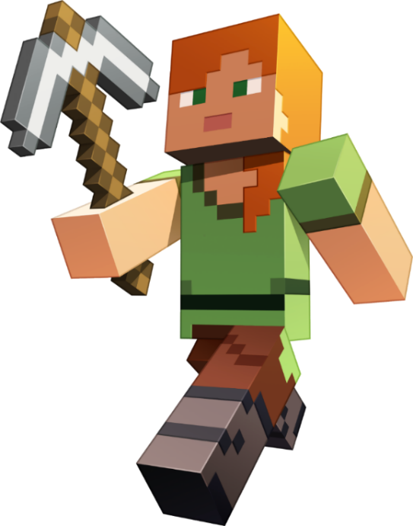
LESSON C: Code with Coordinates and Moving Objects

Slide 25
What we’ll learn
Calculate and code a four-sided pen in Minecraft to herd sheep that we spawn
Check our learning progress with a quiz

Slide 26
Auto-farmer
+Y Up
Spawn sheep
Use an on chat command to build a pen with coordinates
Think of
X as length
Y as height
Z as thickness of the pen wall
-Z North
-X West
+X West
+Z South
-Y Down

Slide 27
LESSON C What we learned today
Used coordinates to calculate and code a pen to herd sheep
Took a quiz

Slide 28
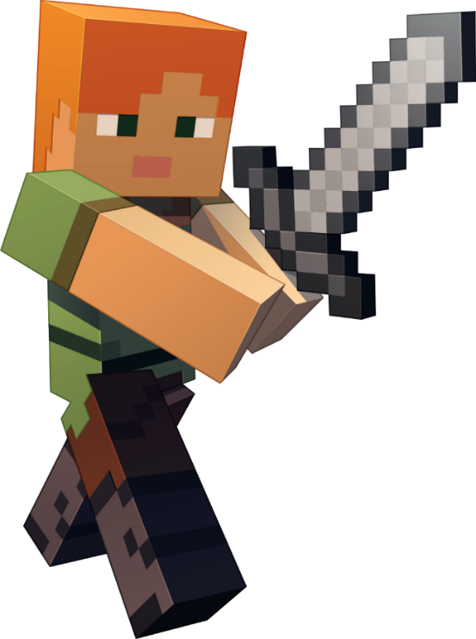
Next time
Your independent project
Think about how you could code with coordinates in a new way to change the Minecraft landscape

Slide 29
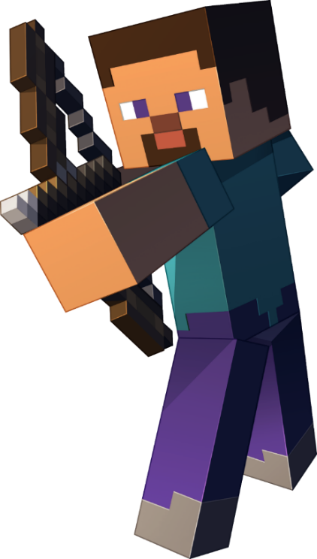
LESSON D : Get Creative with Coordinates

Slide 30
What we’ll learn
Take what you’ve learned about coding to the next level
Create your own MakeCode project that alters the Minecraft landscape in some way

Slide 31
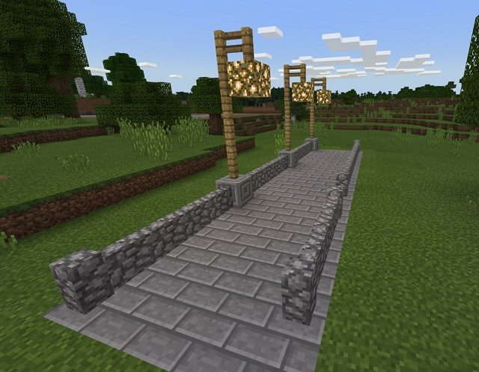
Independent Project
Purpose: Create one or more commands that alter the landscape in some way
Your project should:
Use coordinates in some way
Alter the landscape by using code
Be creative and original

Slide 32
Ideas to consider
In a set area, replace all blocks of a certain type with something new (for example, replace all grass with lava)
Create an “instant swimming pool” filled with water or lava
Create a way to instantly tunnel through a mountain or portions of the nether
Create a way to literally “move mountains”
Make a rainbow
Improve the Minecraft Moving Company activity so that you can enter a height for the upper coordinate rather than having to actually stand there yourself
Experiment with the Mask and Mode menus on the clone block

Slide 33
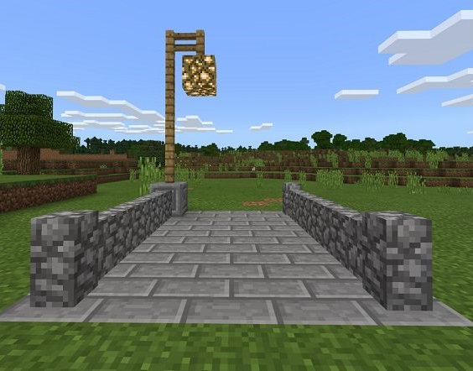
An example
Code to create a section of paved road with streetlights
Duplicate numerous times to create a new street of any length

Slide 34
Minecraft Diary entry
How did you come up with this idea? What problem are you trying to solve and why?
What did you decide to alter in the landscape?
What does your program do?
Describe how your program alters the landscape.
Include at least one screenshot of the result of your program.

Slide 35
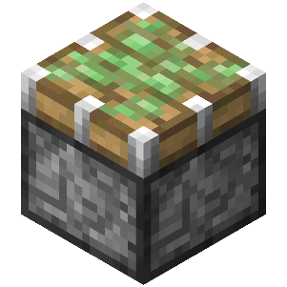
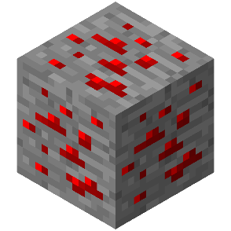
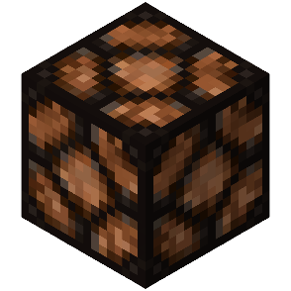
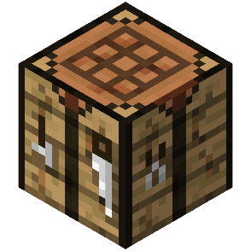
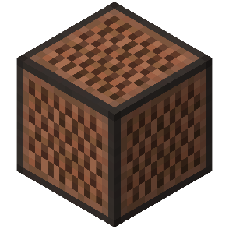
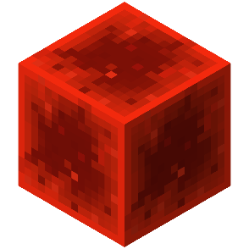
LESSON C What we learned today
To apply our new coding skills with coordinates in original and creative ways
Created your own MakeCode project to alter the Minecraft landscape

Slide 36
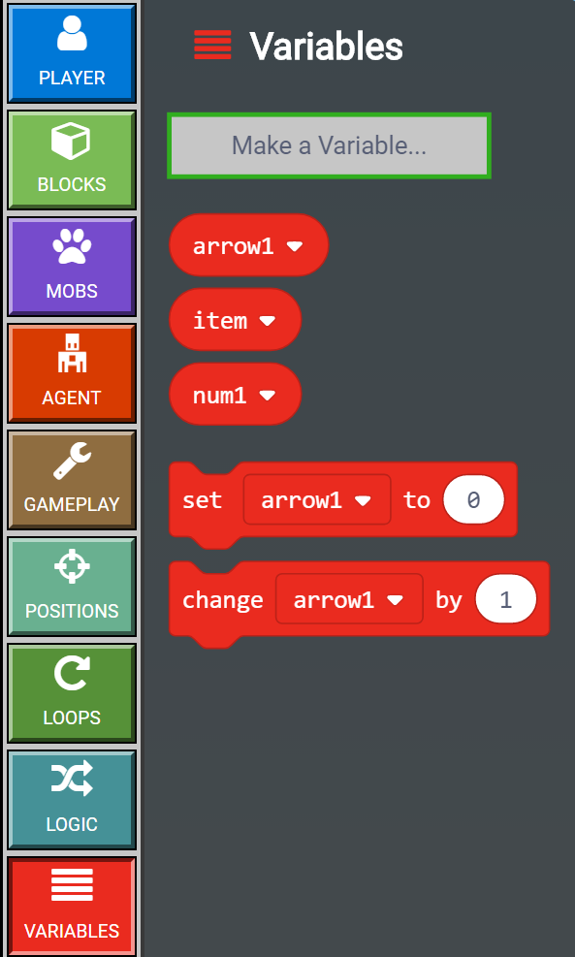
Next time
Learn all about different types of variables
How to code with them

