Slide 1
What is FFA?

Slide 2
Click Below for Video: About Us - National FFA Organization
FFA is the premier youth organization preparing members for leadership and careers in the science, business and technology of agriculture.
FFA is currently comprised of 850,823
student members
Nationwide, there are 8,995 local FFA chapters in all 50 states, Puerto Rico and U.S. Virgin Islands.

Slide 3
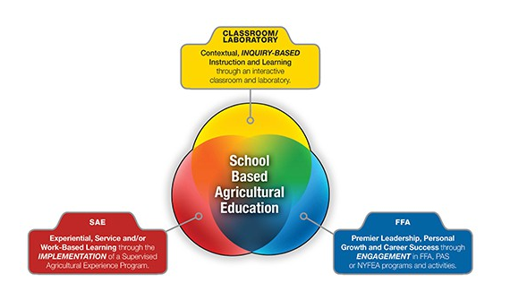
The Three Component model
Through agricultural education, students are provided opportunities for leadership development, personal growth and career success. Agricultural education instruction is delivered through three major components:

Slide 4
Component #1 - Agriculture Education – Classroom & Laboratory
WV Department of Education Agriculture Career Pathways
Explore Courses Here: High School CTE Standards (state.wv.us)
Animal Systems
Agribusiness Systems
Animal Processing
Power, Structural & Technical Systems
Potential Careers:
Greenhouse Operator
Food Services
Mechanics Services
Animal & Plant Production
Potential Careers:
Livestock Farmer
Veterinarian
Veterinary Assistant
Research/Lab Animal Manager
Pet Groomer
Potential Careers:
Butcher
Animal Health Inspector
Processing Plant Manager
Feedlot Processor
Safety Manager
Potential Careers:
Welder
Heavy Equipment Operator
Mechanic/Repair Services
Carpenter
Transportation
Plant Systems
Natural Resources Systems
Potential Careers: Crop Producer
Agronomist
Biologist
Landscape Architect
Potential Careers:
Soil Scientist
Park Ranger
Conservationist
Wildlife Biologist

Slide 5
Component #2 - Agriculture Education – The national ffa organization
FFA is a dynamic youth organization that changes lives and prepares members for premier leadership, personal growth and career success through agricultural education.
FFA develops members’ potential and helps them discover their talent through hands-on experiences, which give members the tools to achieve real-world success.
Members are future chemists, veterinarians, government officials, entrepreneurs, bankers, international business leaders, teachers and premier professionals in many career fields.
FFA is an intracurricular student organization for those interested in agriculture and leadership. It

Slide 6
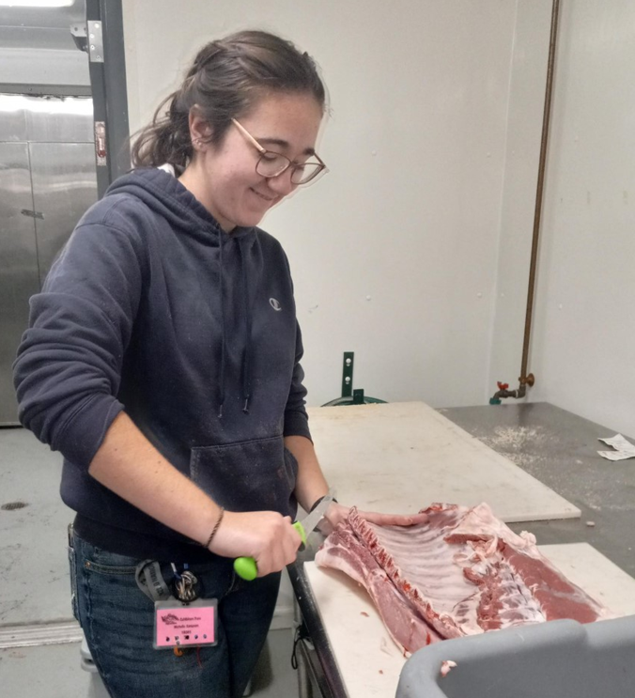
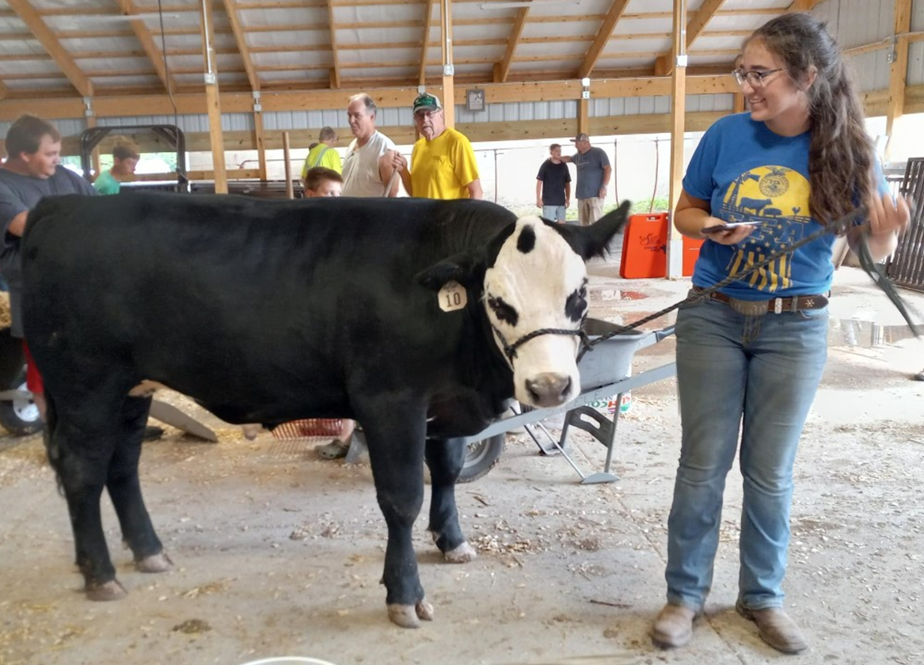
Component #3 - Agriculture Education – The supervised agriculture experience
Explore: SAE for ALL - SAE For All
An SAE is an agriculturally related experience that is conducted outside of class time and is worth ½ credit per academic year.
If a student touches, prepares, sells or communicates about anything related to agriculture, food or natural resources, the experience will count as an SAE.

Slide 7
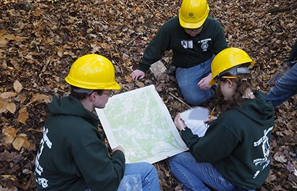
Advantages of the Total Agriculture Program
Students gain the knowledge in the classroom and laboratory environment and apply them to their SAE Programs. FFA Members can earn regional, state and national recognize through awards and scholarships.
Through Career and Leadership Development Events, participating FFA members in grades 7 to 12 are challenged to develop critical thinking skills and effective decision-making skills, foster teamwork and promote communication while recognizing the value of ethical competition and individual achievement. CDE and LDE events occur at the local, state and national levels.
Explore FFA Competitive Events Here: Career and Leadership Development Events - National FFA Organization

Slide 8
Company Overview

