Slide 1
I Can Be An Engineer

Slide 2
Essential Question(s)
What is an Engineer?
What does an Engineer do?
What is the difference between innovation and invention?
Notes:
The goal through the images is to grab from the BIG4. We have a Mechanical, Civil, Chemical, and Electrical image below left to right. No matter the type where you work and what you wear will vary from place to place.

Slide 3
Engineers
Science, Mathematics, Technology, and Engineering are connected.
Engineering is the application of Science and Math
Technology is created by Engineers
Scientists use Technology
Notes:
ACU: Apply, Create, Use.
Engineers identify problems worth solving, apply principles of brainstorming in order to come about plausible solutions to said problem, create prototypes of said potential solutions, and then Use or test those solutions and receive feedback in order to improve upon their designs.

Slide 4
The Big 4
Chemical: applying scientific principles to production that involves chemical change.
Civil: the building and maintenance of structures for both public and private use.
Electrical: study, application, and development of electrical components, systems, and devices.
Mechanical: design and manufacturing of electrical consuming and producing systems. If it moves, they are involved.
Are there any others that you can think of?
Can you see how the ones that you are thinking of might be a combination or an extension of one or more of the Big 4?

Slide 5
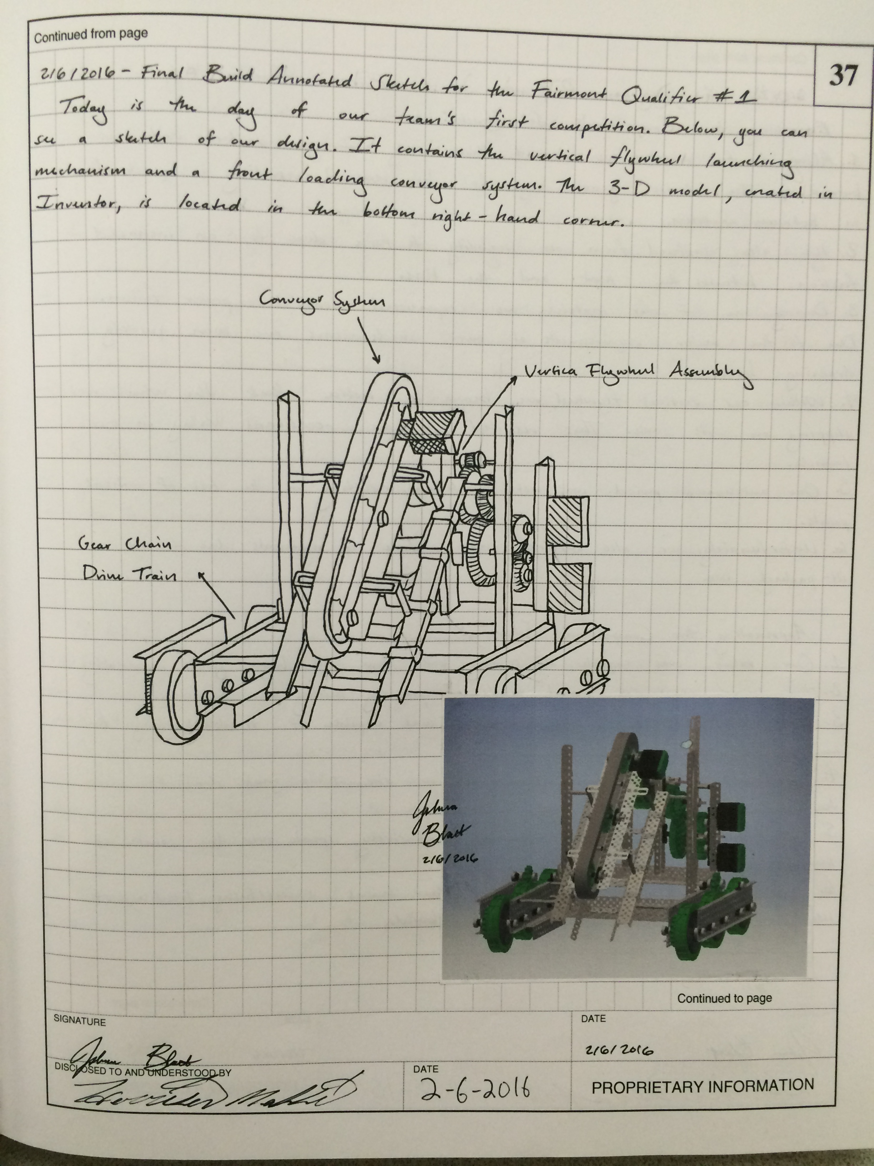
Engineering Notebook
Numbered Pages
An Engineering Notebook is a record of the thoughts and processes used to create solutions and descriptions of those solutions.
A Legal Document. Each page has a notice of Proprietary Nature
May contain:
Sketches
Ideas
Design Concepts
Signed across taped in images
Signed and Dated
Statement of Proprietary Nature
Notes:
Engineering Notebooks are Legal Documents that record both thoughts and processes in a Chronological order signed by both designer and some one to corroborate that design (a witness). Each page is met with some notice of proprietary nature and there are many techniques used within the notebook to assure that the document has not been

Slide 6
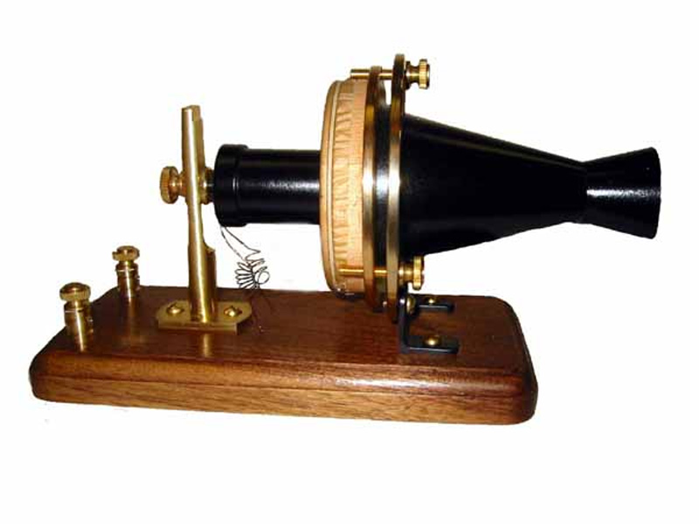
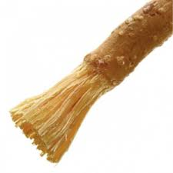
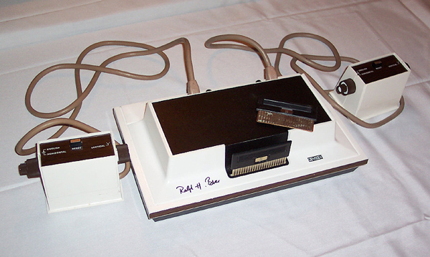
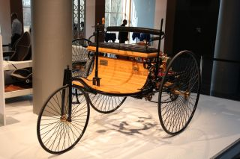
What challenges do you face?
What products or systems do you use that make your life better?
What types of engineer(s) might have helped to create this product of system?
Is this product an invention or innovation?
Notes:
Have students guess what they think these objects below are and why they think that is what they are.. Apply Form v Function discussion.
Then let them have the answer: Left to right:
Telephone
Toothbrush
Game Controller
Car
Have them think about these objects/varieties of these objects that exist today and how they meet a human need. (focus: why does a phone look like it does today? Why would a tooth brush need that shape and a padded handle?

Slide 7
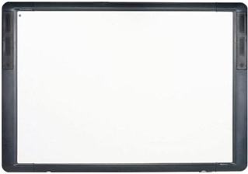
Innovation or Invention?
Smartboard
Promethean Board
Notes:
Most students are aware of the Smartboard and have seen them in a classroom over the course of their educational lives. The Promethean Board is a lit panel that has taken Smartboard principles and innovated to meet certain instructional needs.

Slide 8
Bad Design
Can you think of designs that you haven’t liked?
What was wrong with it?
Why didn’t you like the interaction?
How would you have made it different?

Slide 9
Resources
1876.Centennial.Transmitter.jpg (800×600) (historicindianapolis.com)
Do you know the toothbrush history ? (uniright.net)
https://www.brown.edu/Departments/Joukowsky_Institute/courses/13things/7643.html#:~:text=The%20Magnavox%20Odyssey%2C%20which%20began,motion%20(Douglas%2C%202008).
https://www.livescience.com/37538-who-invented-the-car.html
https://carnegiestemgirls.org/stem-resources/careers/electrical-engineer/
https://www.pinterest.at/pin/793478028084839936/

