Slide 1
Introduction to Manufacturing

Slide 2
Inquiry Lesson: Introduction to Manufacturing
Introduction to the Manufacturing:
Teachers might choose to show any number of historical manufacturing events
Teacher will introduce the Linking Cube Person
Students will form teams of 3-4. They will accurately replicate the Linking Cube Person based off the drawings and assembly videos. They will document a procedures for recreating this Person through a Process Flow Diagram.

Slide 3
WV Adventures
Manufacturing

Slide 4
Vocabulary
Assembly Line
Process Flow

Slide 5
Essential Questions
How would you make a PB& J now?

Slide 6
Inspire
“The surest foundation of a manufacturing concern is quality. After that, and a long way after, comes cost.”
Andrew Carnegie

Slide 7
What is an assembly line?
An assembly line is a manufacturing process which engages people (and sometimes robots) and machines in a production setting. Each worker has a specific task. The process moves from worker to worker until the product is made whole.
Henry Ford is given credit to the creation of this new mass production method. These large production plans used standard parts in order to create an assembly line for cars.

Slide 8
Assembly Line Planning
Product Design
What product are we making?
Manufacturing Process
How will we produce this product?
Schedule Design
What quantity are we trying to make?

Slide 9
Manufacturing Process
Process Flow: diagrams are used to plan out and account for steps in the assembly line.
Define the Process
Determine Constraints
Brainstorm Possible Steps
Organize these steps so they make sense in sequence
Show the Flow
Notes:
You might relate the Process Flow Design to a Conceptual Model.

Slide 10
Process Flow Example
1
Place 2 Slices of Bread on a Clean Plate
2
Use a clean knife to spread peanut butter on side of the bread slice
Steps for Making a PB&J
In this example the process flow describes and maps the steps for assembling a Peanut Butter and Jelly Sandwich
Notice That All Steps Are Numbered.
3
Use clean knife to spread jelly on one side of the 2nd slice
4
Place both slices of bread together evenly so that the peanut butter and jelly are in the middle
5
Use clean knife to slice the sandwich evenly at 45 degrees
Notes:
This one is simple and often utilized in education when you are trying to get students to organize a procedures.
The PB&J assignment is notorious for getting students to think about sequence and also the clarity for which they are providng the user.

Slide 11
Process Flow Example
1
Place 2 Slices of Bread on a Clean Plate
2
Use a clean knife to spread peanut butter on side of the bread slice
Steps for Making a PB&J
In this example the process flow describes and maps the steps for assembling a Peanut Butter and Jelly Sandwich
Notice That All Steps Are Numbered.
Arrows indicate the flow of operation
3
Use clean knife to spread jelly on one side of the 2nd slice
4
Place both slices of bread together evenly so that the peanut butter and jelly are in the middle
5
Use clean knife to slice the sandwich evenly at 45 degrees

Slide 12
Process Flow Example
1
Place 2 Slices of Bread on a Clean Plate
2
Use a clean knife to spread peanut butter on side of the bread slice
Steps for Making a PB&J
In this example the process flow describes and maps the steps for assembling a Peanut Butter and Jelly Sandwich
Notice That All Steps Are Numbered.
Arrows indicate the flow of operation
Steps include what is required to complete: Tools/Materials/etc
3
Use clean knife to spread jelly on one side of the 2nd slice
4
Place both slices of bread together evenly so that the peanut butter and jelly are in the middle
5
Use clean knife to slice the sandwich evenly at 45 degrees

Slide 13
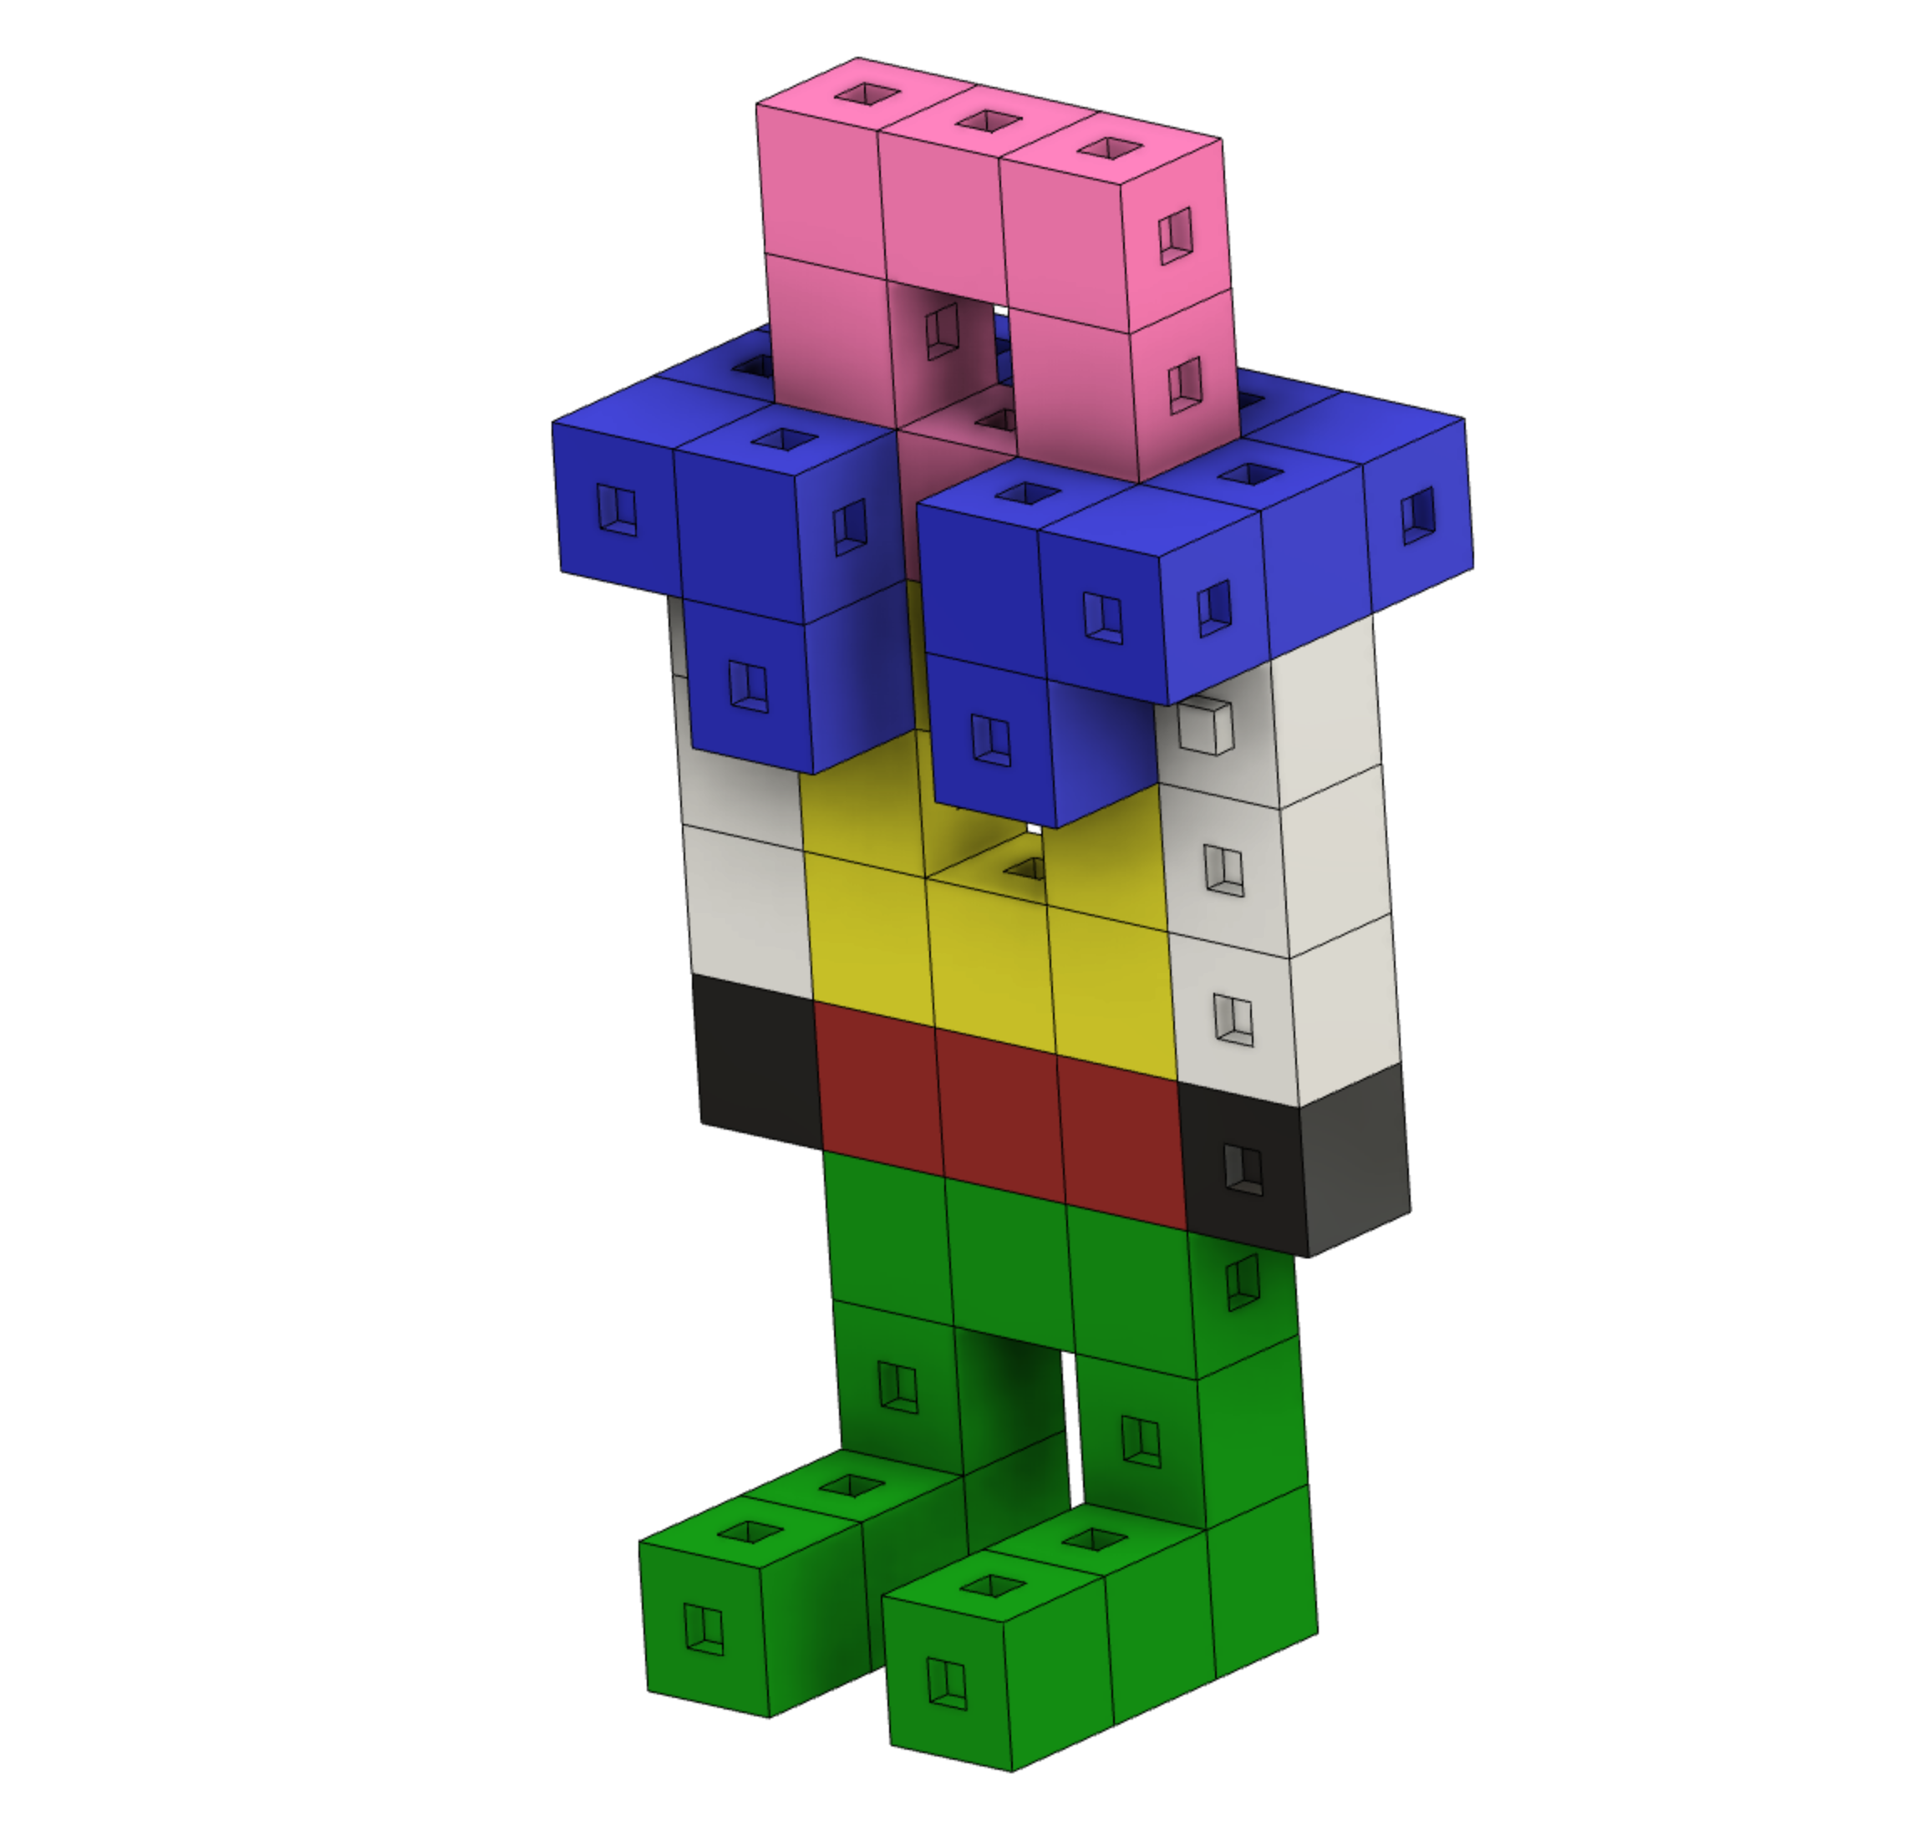
Questions
Can you create this type of Process Flow Design in Building the Linking Cube Person

Slide 14
Resources
History.com Editors. (2012, May 30). The assembly line: Then and now. History.com. Retrieved March 1, 2022, from https://www.history.com/topics/inventions/history-of-the-holidays-the-story-of-labor-day-video
History.com Editors. (2009, November 9). Henry Ford. History.com. Retrieved March 15, 2022, from https://www.history.com/topics/inventions/henry-ford
Learn how everything works! HowStuffWorks. (n.d.). Retrieved March 2, 2022, from http://entertainment.howstuffworks.com/4169-assembly-line-crayola-crayons-video.htm

