Slide 1
Create your Ideal Playground
Playground Examples

Slide 2
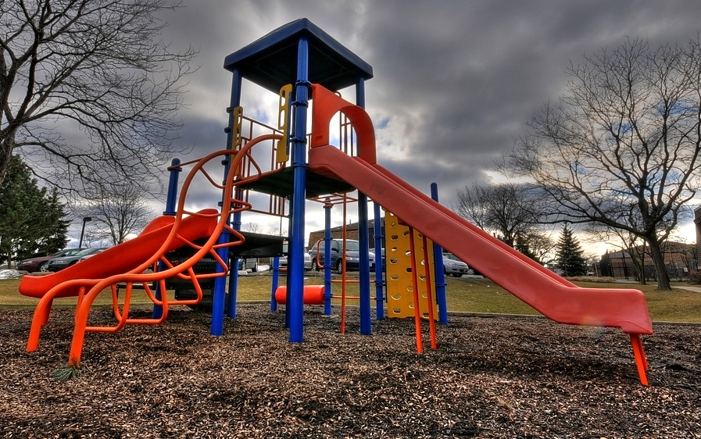
Notes:
NOTE: To change images on this slide, select a picture and delete it. Then click the Insert Picture icon in the placeholder to insert your own image.

Slide 3
Notes:
NOTE: To change images on this slide, select a picture and delete it. Then click the Insert Picture icon in the placeholder to insert your own image.

Slide 4
Notes:
NOTE: To change images on this slide, select a picture and delete it. Then click the Insert Picture icon in the placeholder to insert your own image.

Slide 5
Notes:
NOTE: To change images on this slide, select a picture and delete it. Then click the Insert Picture icon in the placeholder to insert your own image.

