Slide 1
Health Care Facilities
Health Science I

Slide 2
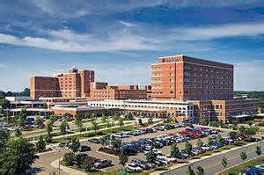
Types of Health Care Facilities- Hospitals
One of the major types of health care facilities
They vary in size and types of services provided.

Slide 3
Types of Hospitals
General Hospitals: treat a wide range of conditions and age groups.
Usually provide diagnostic, medical, surgical, and emergency care.
Specialty Hospitals: provide care for special conditions and age groups.
Burn hospitals, oncology (cancer) hospitals, or pediatric (children’s) hospitals.
Government Hospitals: operated by federal, state, and local government and provide care for government service personnel and their dependents.
University or College Medical Center: provides hospital services for research and education.

Slide 4
Turn and talk…
Your patient is a homeless man brought in by paramedics suffering from hypothermia. After interviewing the gentleman you find he is a veteran suffering with a history of alcoholism and drug abuse.
Where should the patient be sent in order to receive proper care?
Write down your response and be prepared to share two ideas

Slide 5
Long Term Care Facilities
Provide assistance and care for elderly patients, usually called residents.
Nursing Homes: also known as residential care facilities and are designed to care to individuals that can no longer care for themselves.
Extended Care Facilities: provide skilled nursing care and rehabilitative care to patients before they return home.
Assisted Living Facilities: provide services like meals, housekeeping, transportation, ect.. to individuals who can care for themselves.

Slide 6
Medical Offices
Medical Offices provide many different types of medical services to all ages.
Dental Offices provide general dental services to all age groups or specialized care to certain age groups.
Orthodontists – corrective braces for teeth
Cosmetic Surgeons – elective procedures to improve appearance
General Surgeons – Perform different types of surgeries

Slide 7
Clinics
Also called satellite clinics and are health care facilities found within many types of health care organizations.
Surgical clinics
Urgent care clinics
Rehabilitation clinics
Specialty clinics
Outpatient clinics
Health department clinics
Medical center clinics

Slide 8
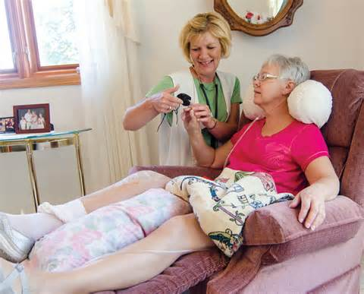
Home Health
Agencies that are designed to provide care in a patient’s home.
These services are frequently used by the elderly or disabled.

Slide 9
Mental Health Facilities
Treat patients with mental health disorders and diseases.
Examples:
Psychiatric clinics or hospitals
Chemical abuse treatment centers (dealing with drug and alcohol abuse)
Physical abuse treatment centers (dealing with child abuse, spousal abuse, or geriatric (elderly) abuse.

