Slide 1
Reverse Engineering

Slide 2
WV Adventures
STEM

Slide 3
Vocabulary
Reverse Engineering
Freehand
Exploded View
Dimension

Slide 4
Essential Questions
What is reverse engineering?
Why do engineers use Multiview drawings?
Why are assemblies important?
Why are dimensions so important?

Slide 5
Inspire
”Enjoy failure and learn from it. You never learn from success.”
James Dyson
Notes:
https://www.jamesdysonfoundation.com/who-we-are.html
James Dyson communicated his ideas through sketches.

Slide 6
What is Reverse Engineering?
Reverse Engineering is the process or measuring and analyzing an existing product in order to better understand it.

Slide 7
How is it Useful?
Reverse engineering can help to create documents on undocumented items.
It can teach us in terms of research.
It can allow us to investigate for example design failure.
It can also help us to improve products.

Slide 8
Tools of the Trade
Micrometers
Calipers
Laser Scanners
Various forms of Imaging
Notes:
In our high schools we use a great deal of Dial Calipers. This is the “Swiss Army Knife” of measurement. In your classrooms your students will recognize rulers/ thermometers/ protractors etc.
You might bring an image of a Dial Caliper up and express to your students that these devices measure down to 0.001”
You might bring one up in an images search.
You find some of these useful
Dial Calipers:
https://www.stefanelli.eng.br/en/simulator-virtual-dial-caliper-thousandth-inch/
Rulers:
https://www.piliapp.com/actual-size/inch-ruler/
Isometric Drawing:
https://www.nctm.org/Classroom-Resources/Illuminations/Interactives/Isometric-Drawing-Tool/

Slide 9
Communicating Ideas
Freehand Sketching: drawing images without drafting tools (i.e. no T squares, triangle, or compasses)
Annotation: notes found on/with sketched objects

Slide 10
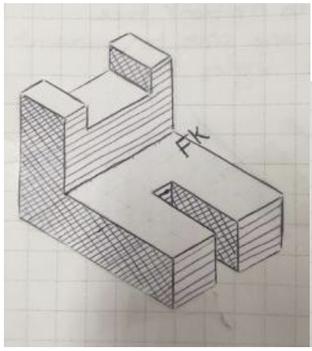
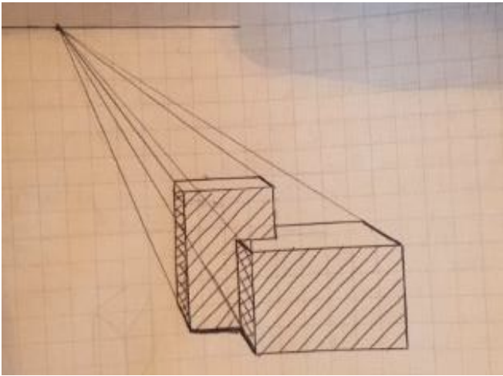
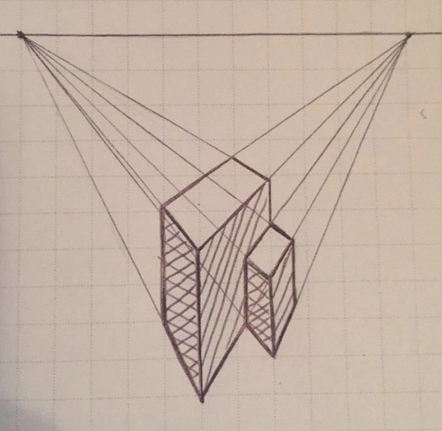
Communicating Ideas
Isometric Sketches: 3D drawing with x and y axes drawn at 120 degrees.
Perspective Sketches: allows viewer to see distance and depth as they would if they were viewing it. (utilizes vanishing point(s))

Slide 11
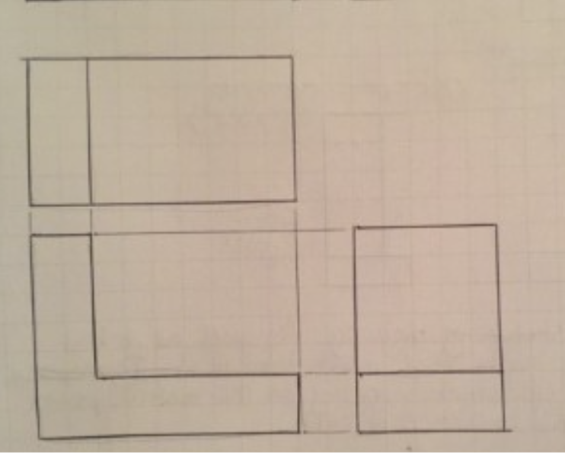
Communicating Ideas
Multiview Drawing: Contains more than 1 view of a drawing generally the Top, Front, and Right Side

Slide 12
Steps
Visual Analysis: Color, Value, Shapes, Space, even Texture are looked at.
Functional Analysis: How does it work? What goes into, through, and comes out as a result?
Structural Analysis: Disassembly of Product (Potentially Destructive) investigating various ”how’s” of those functional analysis. Simple Machines present within are inventoried and explained.

Slide 13
Questions
Why is it important that engineers use accurate measures when drawing?
Why is it important that there be standards of measure like those proposed by American National Standards Institute (ANSI)?

Slide 14
Resources
Actual size of Inch Ruler. (n.d.). Retrieved March 6, 2022, from https://www.piliapp.com/actual-size/inch-ruler/
Nctm.org. (n.d.). Retrieved March 1, 2022, from https://www.nctm.org/Classroom-Resources/Illuminations/Interactives/Isometric-Drawing-Tool/
Prof. Eduardo J. Stefanelli, profissão, E. S. E. por, Stefanelli, E., & profissão, E. por. (2017, January 23). Virtual dial caliper in thousandth of inch - simulator. Prof. Eduardo J. Stefanelli. Retrieved March 1, 2022, from https://www.stefanelli.eng.br/en/simulator-virtual-dial-caliper-thousandth-inch/
Who we are. (n.d.). Retrieved January 10, 2022, from https://www.jamesdysonfoundation.com/who-we-are.html

