Slide 1
Vital Signs
Introduction

Slide 2
Vital Signs are:
Temperature
Pulse
Respiration
Blood pressure

Slide 3
Measuring Body Temperature
4 methods to take a temperature
Ear: Also called “tympanic” readings.
Mouth: Also called “oral” reading.
Armpit: Also called “axillary” reading. They tend to be about one to two degrees lower than temperatures measured orally.
Rectum: Rectal readings are usually one degree higher than oral readings, and are considered the most accurate reading.
Temporal: This is done using the skin of the forehead, and is the least accurate

Slide 4
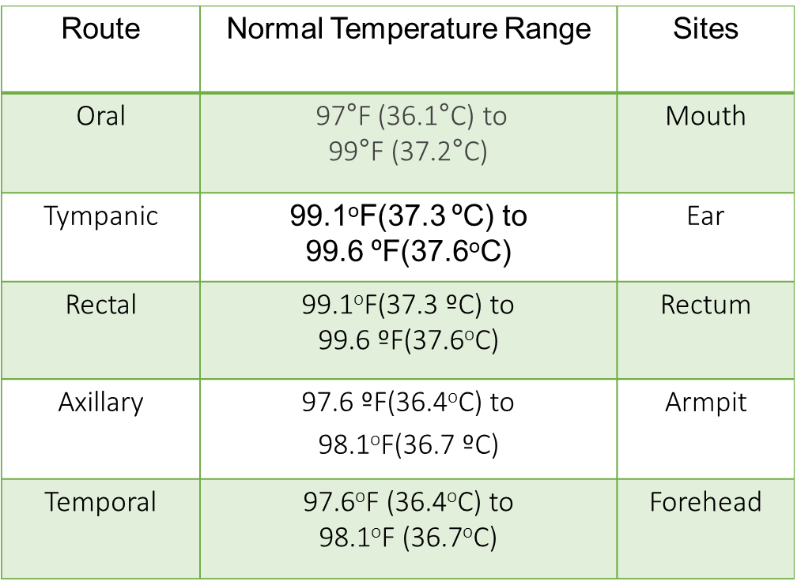
Body Temperature
The amount of heat produced by the body. FEVER is a symptom of an illness, not a disease itself. Fever can happen when a person has an infection, a virus, or a reaction to an immunization.
Symptoms of a fever include: hot dry skin, loss of appetite, irritability, tiredness, and sometimes chills.
Average body temperature is 98.6 degrees Fahrenheit. A temperature of more than 100.4 degrees Fahrenheit is considered a fever.

Slide 5
Procedure for Measuring Temperature
Record to the nearest 0.1º
Oral- wait 15 minutes after eating or drinking
Tympanic- primarily for children
Rectal- usually done in a medical setting
Axillary probe must touch skin
Temporal- must cross temporal artery on the forehead

Slide 6
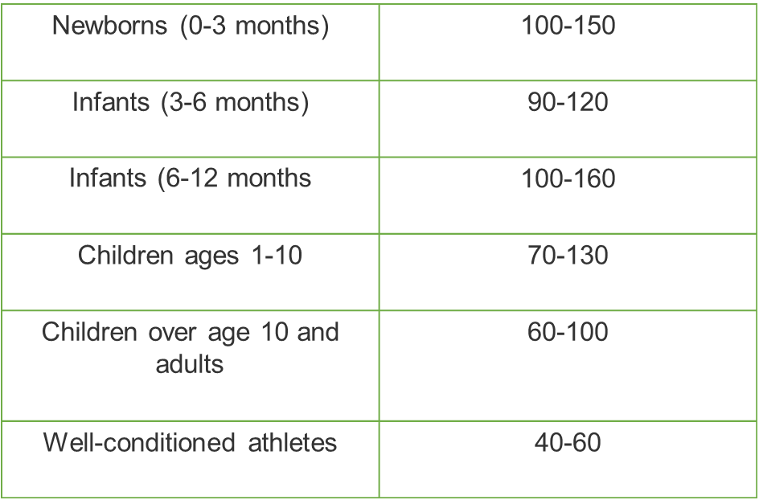
Pulse Rate
Normal Resting Pulse Ranges:
The rate of the heartbeat felt in throbbing blood vessels just under the skin. A pulse rate of 60-100 beats per minute is considered normal for teens and adults at rest.

Slide 7
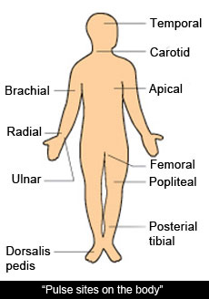
Procedure for Measuring Pulse
Locate pulse (radial-adult, brachial- infant), press lightly with index and third fingers. Count how many beats are felt for a minute using a clock with a second hand.
Above normal: (Tachycardia) greater than 100 beats per minute
Below normal: (Bradycardia) less than 60 bpm

Slide 8
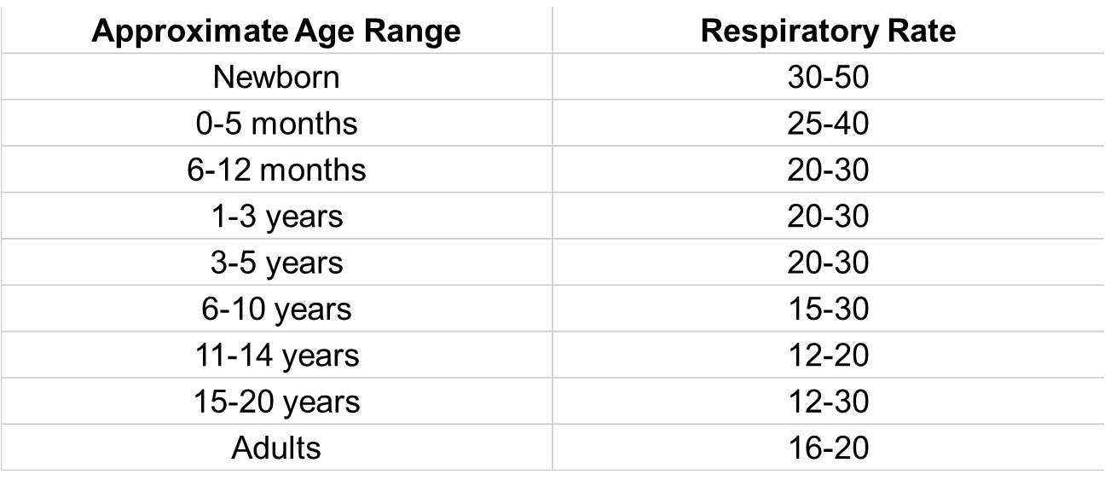
Respiration
Respiration- 1 inhalation and 1 exhalation
Watch and count how many times a person’s chest rises and falls for one minute.
Normal respiratory rate varies for certain age groups

Slide 9
Blood Pressure
The force at which the heart is pumping blood through the body.
It is a technical measurement that needs special equipment and training to get an accurate blood pressure count.
Systolic pressure- ventricles of the heart are contracting, first heart sound when taking blood pressure, top number
Diastolic pressure- ventricles of the heart are relaxing, last heart sound when taking blood pressure, bottom number
Blood pressure = Systolic Pressure
Diastolic Pressure

Slide 10
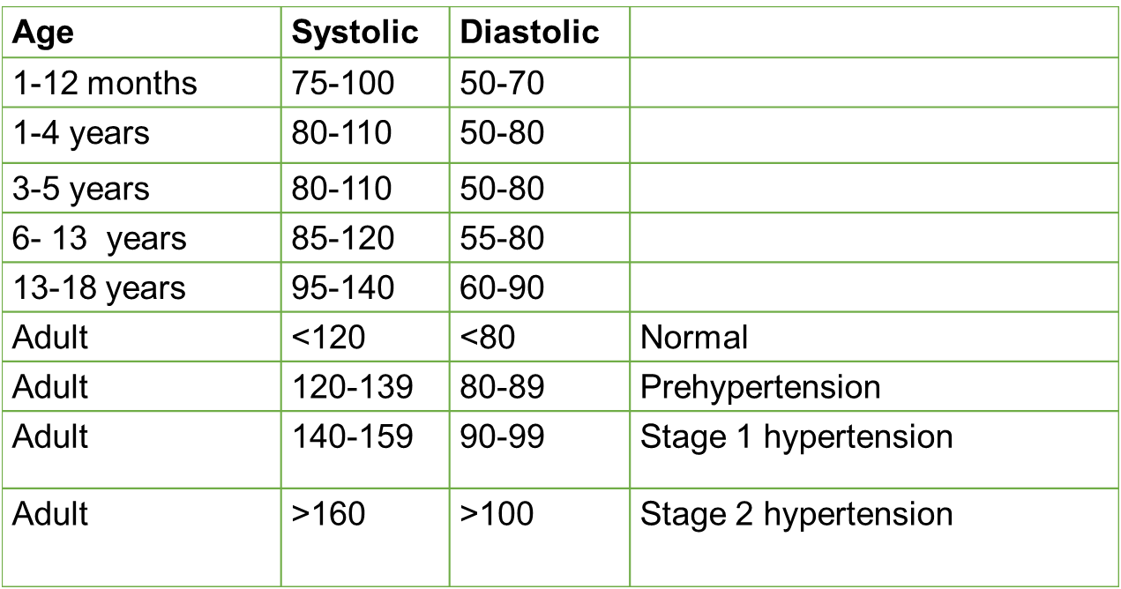
Blood Pressure Ranges
High blood pressure is called Hypertension

